Slide 1

Firms, Markets and other Institutions in a comparative perspective
Ugo Pagano
May-June 2025

Slide 2
Ends-Means Economics.
A long tradition has seen economics as a relation between ends and means. The limited viability of means with respect to the ends generates the problem of scarcity and defines the economic problem.
The neoclassical approach of utility maximization under constraints is seen to be the logical consequence of this approach.
In this first lecture I will try to show that the means-ends problem is not consistent with the neoclassical approach. It requires a more general institutional perspective and that economics is necessarily an evolutionary discipline.

Slide 3
Extended ends and limited capabilities.
The complexity of the standard means-ends problem is undervalued because some crucial arguments of the utility function are excluded from economic analysis.
The capability to solve problems is overvalued because some individual and social resources are implicitly assumed to be free goods.
An institutional approach to the end-means problem should:
- extend the realm of the variables affecting human welfare
- make a realistic assessment of individual and collective capabilities.

Slide 4
Dimensions of Scarcity in Institutional Economics
1) Material scarcity
(as in standard economics)
2) Self-realization scarcity.
3) Social Scarcity
4) Intelligence Scarcity
5) Institutional Scarcity

Slide 5
Dimension 2: Self-realization Scarcity.
Neoclassical theory divides human activities in work (means) and leisure (ends). Utility functions are defined over consumption goods and leisure while the production function on physical inputs and work.
Between productive and consumption activities, a dichotomy arises: consumption activities do not affect production functions while productive activities do not affect the utility functions.
Following the Smithian and the Marxian traditions, one can easily argue that production activities directly affect the utility function. Most human activities are means and ends the same time. Moreover, the distinction between means and ends should be endogenous.

Slide 6
The ends -means separation problem.
When preferences for work are taken into account (and even more if we endogenize the definition of work itself), the problem becomes more complex because ends cannot be separated a a priori from means.
Technological efficiency cannot be stated independently of preferences for different types of human activities.
Self-realization scarcity arises: some human productive activities are more in demand than others because they allow more work satisfaction in terms of creativity and self-realization.

Slide 7
Work and leisure.
Task A
4h
consumption goods
Total time 24 h
Task B
4h
utility
leisure
16 h

Slide 8
Increase of total working time.
Task A
4h
consumption goods
Total
time
24 h
Task B
5 h
utility
leisure
15 h

Slide 9
Change of task allocation.
Task A
2h
consumption goods
Total
time
24 h
Task B
6 h
utility
leisure
16 h

Slide 10
Change of task allocation.
Task A
2h
consumption goods
Total
time
24 h
Task B
6 h
utility

Slide 11
Dimension 3: Social Scarcity
The ends-means problem is complicated by another dimension of scarcity (often considered to be outside the boundaries of economics, possibly belonging to the clumsy realm of sociology).
Goods like power and status affect both utility and production functions. These goods do not set limits to the achievement of our goals because they are available in given positive quantities.
Their positive use is only possible if corresponding negative quantities are consumed by other individuals (who must occupy corresponding opposite positions).
Positional Goods like power and status imply a social scarcity constraint The standard scarcity constraints concerns limited positive amounts of resources. Positional goods are scarce because positive consumption must go together with negative consumption.

Slide 12
Positional goods.
Pure private goods: other individuals consumes a zero amount of what each individual chooses to consume.
Pure public good: each agent must consume the same positive amount that other agents decide to consume
Pure positional good: given the consumption choice of an agent,
the other agent must consume a corresponding negative amount of what the other agent chooses to consume.

Slide 13
 | Robinson | Friday
Public good | + | +
Private good | + | 0
Private good | 0 | +
Positional good | + | -
Positional good | - | +
Public bad | - | -

Slide 14
First order jural positions
Right of i | Duty of j
Exposure of i | Liberty of j
Example 1: boat in danger.
Boats that are in danger enjoy some legal right to be helped by other ships. This right is necessarily correlated with the duty of other boats not to leave when another ship is in danger. This duty does also necessarily entail that other boats do not have the liberty to leave and that a boat that is danger is not exposed to the liberty of the other boats to refuse their help.

Slide 15
Second order jural positions
Power of i | Liability of j
Disability of i | Immunity of j
Example 2: liberty of speech
If, because of the existence of a Bill of Rights the State has no power to change legal entitlements and restrict my liberty of speech (Simmonds, 1986 p. 132), this means that in this respect I have no liability towards the State. In other words, I enjoy an immunity against its power that is correlated to a corresponding disability of the State.

Slide 16
Legal Relations and Social Scarcity
Legal relations are characterised by some form of social scarcity because:
1) no increase in rights is possible without some increase in duties and some decrease in liberties
2) no increase in powers is possible without some increase in
liabilities and some decrease in immunities.
While public goods are typically undersupplied, positional goods are typically oversupplied.
“Legal goods” such as rights, liberties and powers share this problem and some form of legal disequilibrium may typically arise.

Slide 17
Dimension 4: Human Intelligence Scarcity.
Another dimension of scarcity has to do with the limitations of the decision maker. “Maximization activities” are costly and consume scarce resources. One could think that that additional constraints should be added in the standard maximization problem.
The idea that one could deal with maximization costs by simply adding new constraints is wrong. A problem with more constraints is computationally more complex. The individual, who could not solve the rationally unbounded maximization problem, cannot solve a problem where the bounded rationality constraints have been added.
Because of the scarcity of human intelligence maximization behaviour is not consistent with these dimensions of the economic problem.

Slide 18
An infinite regress?
Assume that maximization activity is costly.
Reformulate a new (second order) maximization problem in which an individual decides:
- how many resources to allocate to the maximization activity
- and how many resources to employ in the other activities
Unfortunately, this involves a new maximisation problem with
new (second order) maximization costs.
A reformulation of a (third order) maximization problem would run in the same problem and so on ad infinitum.

Slide 19
First-order bounded maximization.
Production
Resources
Decision-making

Slide 20
Second-order bounded maximization.
Production
Resources
More
decision-making
Decision-making

Slide 21
Dimensions of Bounded Rationality.
Limited Communication Capabilities
Limited Information Capabilities
Limited Calculation Capabilities
(already considered)
4) Limited preference formation Capabilities
5) Limited emotional Capabilities

Slide 22
Dimension 5: Institutional Scarcity
Institutional constraints are due to all the forms of scarcity that we have seen before:
1) Material constraints imply that limited resources can be invested in the building on institutions.
2) Self-realization needs make the institutions of production very complex: they cannot be simply means to future and present consumption.
3) The quest for and the use in production of positional goods imply positional competition and continuous rent-seeking, which undermine the task of institutional building.
4) Because of the limitations of human intelligence, humans can concentrate only on some pieces of the current institutions and take for granted the remaining parts.

Slide 23
Production of institutions by the means of institutions.
5) However a fifth constraint is self-referential:
Institutions are also built by using preceding institutions.
Institutional building is a long and complex process by which different countries develop along paths whose characteristics cannot be judged independently of their past institutions.
The development of institutions is related to all forms of scarcity, including the historical conditions of a country or, in other words, its own present institutional constraints.
Institutional economics must inevitably deal with the historical specificity of the human species and the historical specificity of different societies. Some institutions that work in some place and time may turn out to be bad arrangements in different situations.

Slide 24
Don’t just imagine 100 million junior software engineer interns here (we’ll get those earlier, in the next couple years!). Real automated AI researchers be very smart—and in addition to their raw quantitative advantage, automated AI researchers will have other enormous advantages over human researchers:
• They’ll be able to read every single ML paper ever written, have been able to deeply think about every single previous experiment ever run at the lab, learn in parallel from each of their copies, and rapidly accumulate the equivalent of millennia of experience. They’ll be able to develop far deeper intuitions about ML than any human.
• They’ll be easily able to write millions of lines of complex code, keep the entire codebase in context, and spend humandecades (or more) checking and rechecking every line of code for bugs and optimizations. They’ll be superbly competent at all parts of the job.
• You won’t have to individually train up each automated AI researcher (indeed, training and onboarding 100 million new human hires would be difficult). Instead, you can just teach and onboard one of them—and then make replicas. (And you won’t have to worry about politicking, cultural acclimation, and so on, and they’ll work with peak energy and focus day and night.)
• Vast numbers of automated AI researchers will be able to share context (perhaps even accessing each others’ latent space and so on), enabling much more efficient collaboration and coordination compared to human researchers.

Slide 25
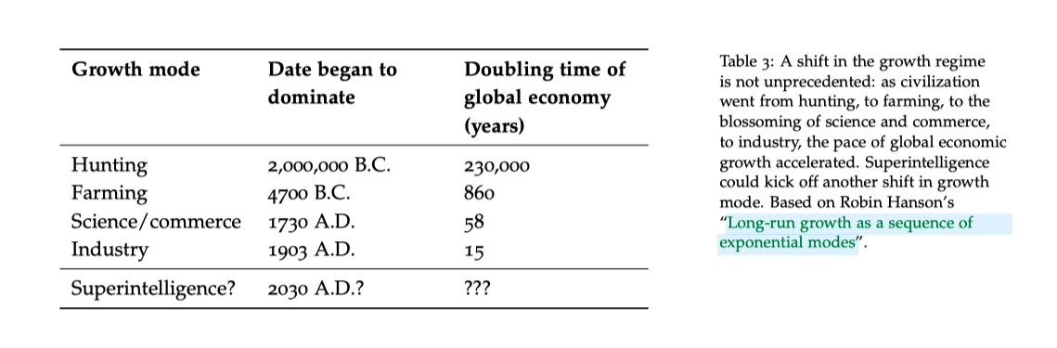
Leopold Aschenbrenner
S I T U AT I O N A L AWA R E N E S S
The Decade Ahead
Not everything in the book should be trusted. The book has been
published last year. A long time if you are interested in this field!
There is nothing about Deepseek but there are interesting data.

Slide 26
Marx’ Dual Vision of Capitalism
    “The a priori system on which the division of labour, within the workshop, is regularly carried out, becomes in the division of labour within the society, an a posteriori, nature-imposed necessity, controlling the lawless caprice of the producers, and perceptible in the barometrical fluctuations of the market-prices”.
    “If one took as a model the division of labour in a modern workshop, in order to apply it to a whole society, the society best organized for the production of wealth would undoubtedly be that which had a single chief employer, distributing tasks to different members of the community according to a previously fixed rule”.

Slide 27
Marx I: primacy of productive forces and single-firm socialism
Productive
Forces
Relations
of Production
Capitalism
Early Stage Socialism

Slide 28
Marx II: biased productive forces and work as end in itself
Relations
of Production
Productive
Forces
Capitalism
Full-Blown Communism

Slide 29
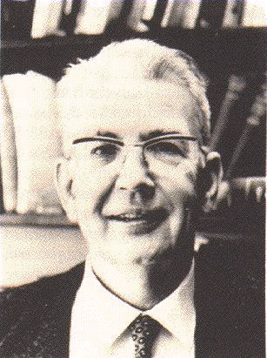
The Young English Socialist.
Some fifty-five years ago, in a seminal article called The Nature of the Firm, a young socialist named Ronald Coase sought to explain the existence of firms, of organizations within which markets were replaced by hierarchy and command.
In the words
of Guido Calabresi:

Slide 30
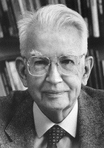
The Old American Libertarian.
Twenty-five years later, in The Problem of Social Cost, Ronald Coase, by then a middle-aged libertarian, indicated how markets could replace hierarchy and command structures to the perceived benefit of those who organized them
In the words
of Guido Calabresi:

Slide 31



Mixing ages: a Schizophrenic
Ronald?

Slide 32

Ronald’s Record
Young Ronald (1937) claims: In a world of zero transaction costs firms would not exist. Firms exist only when market transaction costs are positive.
Old Ronald (1960) claims: In a world of zero transaction costs (and well-defined property rights) all externalities (harmful and beneficial effects) are internalised (taken into account) by market transactions. (Coase theorem)
Old Ronald (1960) also claims:
That the first statement does not contradict the second.
Diagnosis: old age schizophrenia.

Slide 33

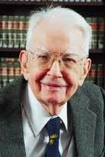
Lissening to Ronald’s reasons........
In his famous 1960 article we must get to Section 6
“The Cost of Market Transaction Taken into Account”
where he points out that:
“The argument has proceeded up to this point on the assumption that there were no cost involved in carrying market transactions.” (1960, p. 114)
"It is clear that an alternative form of economic organization which could achieve the same result at less cost that would be incurred by using the market would enable the value of production to be raised. As I explained many years ago the firm represents such an alternative to organising market transactions" (1960, p. 115).
"But the firm is not the only possible answer to this problem…. "an alternative solution is direct governmental regulation" (Coase 1960 p. 116).

Slide 34
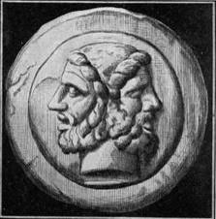
Ronald’s un-divided self.
Coase argues that the “Coase theorem” (but there is no theorem according to Coase!) is perfectly consistent with the 1937 article and they make up one unique theory. He is correct.
According to the “Coase theorem”, in a world of zero transaction costs, markets can internalize all externalities. State intervention and Pigouvian taxes (and firms) are all unnecessary in that framework.
Unsurprisingly, if one institution (the market) is assumed to be costless, only two things can happen:
If the other institutions are costly, they disappear.
If the other institutions are also costless, they may co-exist but their mix cannot be a relevant economic issue.

Slide 35

The challenge to microeconomics of the Re-constructed Ronald.
In this way, Coase challenges the standard building of microeconomics
where the existence and the size of the firms are explained
by U-shaped cost curves (with an initial phase of increasing returns).
The positive and negative effects (increasing and decreasing returns)
which the production of some units has on other homogeneous units,
are only a particular type of externality.
In a world of zero transaction costs, this externality is internalized by markets.
Once this compensation is made, to break even,
it is not necessary to produce a certain number of units within a firm.
In a world of zero transaction costs, whatever the technology, firms do not exist...

Slide 36

The changing optimal mix of costly institutions: a Coasian example
The optimal mix among institutions is recalculated each time that technological data changes.
Coase provides an example from ICT technology: the introduction of telephone lines decreased the costs of using both market and firm internal organizations.
However, the institutional mix would stay unchanged only if the costs of using markets and firms were decreasing in the same proportion. Otherwise it would be efficiently re-adjusted in all market (?) economies.

Slide 37
Institutions as costly substitutes
New Institutional Economics has correctly emphasized that institutions are costly substitutes, and that growth requires their optimal mix.
Explaining and searching for the efficient institutional mix is one of the main purposes of new institutional economics.
However, New Institutional Economics suffers from two important limitations:
no institutional complementarities
implicit reliance on meta-institutions.

Slide 38

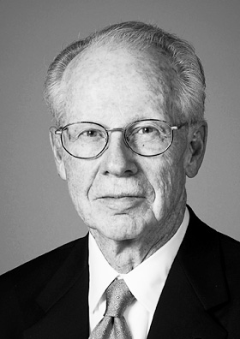
Markets!!!
“I assume, for expositional convenience, that in the beginning there was the market” (Williamson 1975:20)
“Markets and firms are alternative instruments for competing a related set of transactions…where a set of transactions ought to be executed across markets or within a firm depends on the relatively efficiency of each mode” (Williamson 1975:8)

Slide 39

Meta-markets?
NIE has overcome the narrow limits of Economics built on the premises of costly resources and free institutions.
However, its job is unfinished and contradictory:
In the NIE framework, the market acts under two contradictory roles:
A costly institution to be selected
The costless (meta-)institution by which all the institutions (including markets) are selected.

Slide 40
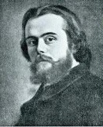


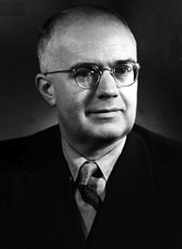
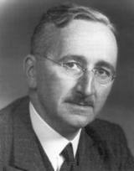
Disequilibriun
Transaction Costs
?
Forms of
Co-ordination
Forms of authority
 | Command | Competition
Ex-ante | (A) Marx | (B) Rational expectations
Ex-post | (C) Lange | (D) Hayek

Slide 41
Within a firm, its members:
(a) can act under the authority of a single plan derived
from a single model,
(b) can learn how to formulate the plan according to consistent
learning rules the authority of which is accepted by the members of the firm,
(c) can save the costs which they would incur if each member
of the firm had to formulate a complete plan based on her model,
(d) can avoid costly inconsistencies by coordinating ex-ante
the actions before they are implemented
(e) can eliminate unforeseen ex-post inconsistencies in the plan by constantly monitoring the emergence of ex-post imbalances.

Slide 42
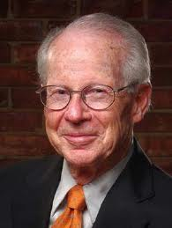
The Specificity Problem (Williamson)
Specificity, Illiquidity, and Irreversibility
Analogy with monitoring: rights should go to the
most specific factors.
Difference with monitoring: asset specificity cannot be defined by referring to a single relationship
Specificity, Competition and the Fundamental
Transformation.
Ex-ante competition → → → Ex-post monopoly
Two explanations of monopoly
The monopoly branch
The efficiency branch

Slide 43
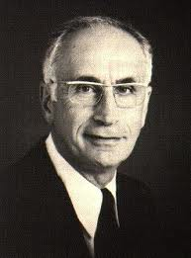
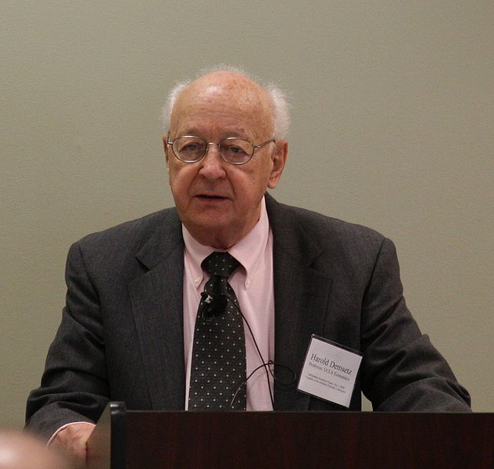
The monitoring problem
(Alchian, Demsetz)
Team work
Employer with hiring
and firing rights
Why capitalist ownership of the means of Production?
Hard to monitor
capital
Capitalist ownership
The same argument can be applied to hard to monitor labour.
Both arguments can be inverted.

Slide 44
Two directions of causation.
Specificity and Monitoring Characteristics of Assets
Property Rights and
Organizational Form
The most specific and difficult to monitor agents can save the greatest amount of agency costs when they control the organization.
:
:
The agents controlling the organization will tend to become the most specific and difficult to monitor

Slide 45
(1) In the property right domain a property right system P^{C} is marginally better than another property right system P^{L} if the corresponding technology T^{c} instead of the technology T^{L} prevails in the technology domain.
(2) In the technology domain a technology T^{L} is marginally better than a technology T^{c} if a property right system P^{L} instead of property right system P^{C} prevails in the property right domain.
Where
T^{c} : a technology where capital is intensively used as a specific and hard to monitor resource
T^{L} : technology where labour is intensively used as a specific and hard to monitor resource
P^{C} : a governance system where the owners of capital have strong rights and safeguards
P^{L} : a governance system where workers have strong rights and
safeguards.
We can have multiple equilibria (P^{C}, T^{c}) and (P^{L}, T^{L} )
P^{C} and T^{c} and P^{L} and T^{L} are, in this case, institutional complements.

Slide 46
Inverting the Argument.
In a word of positive transaction costs the owners of resources enjoying rights and safeguards tend to become more specific and hard to monitor than those without rights and safeguards. This claim can be stated as:
(2) In the technology domain a technology T^{L} is marginally better than a technology T^{c} if a property right system P^{L} instead of property right system P^{C} prevails in the property right domain.
This is an argument that has been typical emphasized by radical economists against the efficiency predictions of NIE. However, it is consistent when NIE when one assumes positive transaction costs.

Slide 47
Pagano Rowthorn 1994
(2) Inverted argument:
Under capitalist ownership (P^{C}) firms maximise:
R^{c} = Q (k,K,l,L) - [rk + RK +wl + (H+W)L] (1) ----->(T^{c})
Under labour ownership (P^{L}) firms maximise:
R^{L} = Q (k,K,l,L) - [rk + (Z+R)K + wl +WL] (2) ----- >(T^{L})
(1) Original NIE argument:
Capitalist property rights P^{C} can prevail if R^{c} ≥ R^{L} or,
ZK - HL ≥ 0 (3) <----- (T^{c})
workers' property rights P^{L} can prevail if R^{L} ≥ R^{c}, or:
HL - ZK ≥ 0 (4) <----- (T^{L})
We can have multiple self-enforcing equilibria
(P^{C}, T^{c}) and (P^{L}, T^{L} ) that are institutional complements.

Slide 48
Conditions for organizational equilibria
Let:
(k^{c},,K^{c}, l^{c}, L^{c}) = argmax R^{c} (k, K, l, L) (5)
(k^{L}, K^{L}, l^{L}, L^{L})= argmax R^{L} (k, K ,l, L) (6)
Then a firm will be in a capitalist organisational equilibrium (COE) if:
ZK^{c} - HL^{c} ≥ 0 (7)
and in a labour organisational equilibrium (LOE) if:
HL^{L} - ZK^{L} ≥ 0 (8)
Or:

Slide 49
Multiplicity of organizational equilibria
K^{c}/L^{c} ≥ H/Z (7')
K^{L}/L^{L} ≤ H/Z (8')
Because: (H+W)/R ≥ W/(Z+R) we have:
K^{c}/L^{c} ≥ K^{L}/L^{L} (9)
We have therefore 3 cases:
1) K^{c}/L^{c} ≥ H/Z ≥ K^{L}/L^{L} (10)
(multiple organisational equilibria).
2) K^{c}/L^{c} ≥ K^{L}/L^{L} > H/Z (11)
(only a COE exists).
3) H/Z > K^{c}/L^{c} ≥ K^{L}/L^{L} (12)
(only a LOE exists).

Slide 50
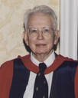
Coase’s
Journey
Costly decentralized market transactions.
The firm as centralization of market transaction

Slide 51
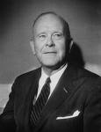
Fuller’s
Journey
Costly centralized public orderings.
The firm as decentralization of public orderings

Slide 52
A joint Coase-Fuller
Journey?
Costly decentralized market transactions.
Costly centralized public orderings.
The firm
as as centralization of market transaction
and
as decentralization of public orderings

Slide 53
Calabresi’s Fundamental Transformation:
Because of the high number of possible accidents, negotiations occur after individuals have “disinvested” in specific accidents.
Ex-Ante Competition
Ex-Post Bilateral Monopoly
Ex-Post Transactions under Courts Supervision.

Slide 54
Williamsons’s Fundamental Transformation:
Because of the high number of possible events, negotiations occur after individuals have invested in specific assets.
Ex-Ante Competition
Ex-Post Bilateral Monopoly
Ex-Post Transactions under Firms’ Governance.

Slide 55
Ex-ante contractual Incompleteness
Calabresi and Williamson
Ex-post Verification Capabilities.
Calabresi
Williamson
Public orderings.
Independent
Agents.
Fuller-Coase
Emergence
of
the Firm.
Private Orderings.
Employed
Agents

Slide 56
Grossman, Hart and Moore Model
a) Specificity is both absolute and a marginal.
b) Contractual incompleteness is justified by the facts
that specific investments in human capital are
observable but not verifiable.
c) Agents are characterised by unbounded rationality
and decide their investments in the 1th period on the
basis of the anticipated bargaining of the 2nd period.
d) They exchange machines in the first period to
maximise the total surplus (Swiss Cheese Assumption)

Slide 57
Hart’s non-fundamental transformation:
Lacking courts’ verification, ex-post bargaining is not constrained by competitive markets.
Ex-Ante Competition
Ex-Post Bilateral Monopoly
Ex-ante competitive exchanges of property rights .

Slide 58
M1 (Input) M2
_______ <------ _______
a1 a2
Ex-ante relationship-specific investments are made at date 0 and the widget is supplied at date 1.
There is only uncertainty about the type of widget M1 requires and this uncertainty is resolved at date 1.
Assume that:
-the parties are risk-neutral and have large (unlimited) amounts of initial wealth and the interest rate to be zero;
it is too costly for the parties to specify particular uses of assets a1 and a2 in a date 0 contract.
Non-integration: M1 owns a1 and M2 owns a2.
Type 1 integration: M1 owns a1 and a2
Type 2 integration: M2 owns a1 and a2
i non-negative number expressing level and cost of M1's relationship-specific investment.

Slide 59
If trade occurs:
M1's revenue is denoted by R(i);
his ex post payoff is R(i) - p where p is the agreed widget price
his ex-ante payoff is R(i) - p - i
If trade does not occur:
M1 buys a "non-specific" widget from an outside supplier at price p that may lead to lower-quality output
M1's revenue is indicated by r(i;A)
his ex-post payoff by r(i;A) - p
Remark: lower-case r indicates the absence of M2's human capital and the argument A refers to the set of assets M1has access to in the event that trade does not occur.
Under non-integration A = {a1}
under type 1 integration A = {a1, a2}.
under type 2 integration A ={Φ}

Slide 60
e denotes M2's relationship-specific investment at date O
If trade occurs
M2's production costs are denoted by C(e)
her ex-post payoff is p-C(e)
her ex-ante payoff is p - C(e) -e
If trade does not occur
M2 will sell her widget on the competitive spot market for p
but will have to make some adjustments to turn it into a general-purpose widget. In this case
M2's production costs are denoted by c(e; B)
her ex-post payoff is p-c(e;B)
Remark: lower-case c indicates the absence of M1's human capital and the argument B refers to the set of assets M2 has access to in the event that trade does not occur.
Under non-integration B = {a2}
under type 1 integration B ={Φ}
under type 2 integration B = {a1, a2}.

Slide 61
If trade occurs
the total ex-post surplus is:
R(i)-p+p-C(e) = R(i) - C(e)
If trade does not occur:
the total ex-post surplus is:
r(i;A) - p + p - c(e;B) = r(i;A) - c(e;B)

Slide 62
Assumption 1: because of the specific investments there are always ex-post gains from trade:
(2.1) R(i) - C(e) > r(i;A) - c(e;B) ≥ O
for all i and e and for all A,B
where A ∩ B = Φ
and A U B= {a1, a2}
Remark : (2.1) captures the idea that the investments i and e are relationship-specific: they pay off more if trade occurs than if it does not.

Slide 63
Assumption 2: relationship-specificity also applies in a marginal sense:
the marginal return from each investment is greater the more assets in the relationship, human and otherwise, to which the person making the investment has access.
(2.2) R' (i) > r' (i; a1, a2) ≥ r' (i; a1) ≥ r'(i; Φ)
for all 0 < i < ∞
(2.3) |C'(e)| > |c'(e; a1, a2)| ≥ |c' (e; a2)| ≥ c' (e; Φ)
for all 0 < e < ∞.
where: r'(i;A) = ∂r(i;A)/∂(i) and c'(e) = ∂c(e;B)/∂e
R' > 0, R" < 0 r' ≥ 0 r" ≤ 0
C' < 0 C" > O c' ≤ 0 c" ≥ 0

Slide 64
Assumption 3:
(Swiss Cheese)
R,r,C,c (the results) and i, e (the investments) are observable to both parties, but are not verifiable to outsiders. Thus, neither the results of the investments in human capital nor the levels investments themselves can be part of an enforceable contract.
The Physical Assets a1, a2 can be exchanged at zero transaction costs.

Slide 65
Ex-post division of surplus.
Consider what happens at date 1 given particular investment decisions i and e.
Take also the asset ownership structure as fixed for the moment.
We can suppress i, e and the set of assets A and B that M1 and M2 control.
Denote M1's revenue and M2 costs by:
R and C if trade occurs
r and c if trade does not occur.
Assumption 1---> there are ex post gains from trade given by:
[(R-C) - (r-c)].
Assumption 3 ---> they cannot be achieved under the initial contract.
Since the parties have symmetric information, it is reasonable to expect them to realise the gains through negotiation.

Slide 66
Assumption 4 Bargaining is such that the ex-post gains from trade [(R-C) - (r-c)] are divided 50/50 as in the Nash bargaining solution. Then M1 and M2 ex-post payoffs equal:
(2.4) Π1 = R-p = r - p + 1/2 [(R-C) - (r-c)] =
= - p + 1/2R + 1/2r - 1/2C + 1/2 c
(2.5) Π2 = p - C = p - c + 1/2[(R-C) - (r-c)] =
p - 1/2C - 1/2 c + 1/2R + 1/2r
and the widget price is given by:
(2.6) p = p + 1/2 (R-r) - 1/2 (c - C)

Slide 67
The first-best choice of investments
(We assume no wealth effects)
In a first-best world the parties would maximise the date 0 (net) present value of their trading relationship.
(2.7) R(i) - i - C(e) - e
Denote the unique solution to the first-best problem by (i*, e*)
The first-order conditions for maximising 2.7 are:
(2.8) R' (i*) = 1
(2.9) | C' (e*) | =1

Slide 68
The second-best choice of investments.
Now consider the second best incomplete contracting world, where the parties choose their investments non-cooperatively at date O.
Suppose that the ownership structure is such that:
M1 owns the set of assets A
M2 owns the set of assets B
(2.10) Π1 - i = - p + 1/2R(i) + 1/2r(i;A) - 1/2C(e) + 1/2 c(e;B) - i
(2.11) Π2 - e = p - 1/2C(e) - 1/2 c(e;B) + 1/2R + 1/2r(i;A) - e
Differentiating (2.10) with respect to i and (2.11) with respect to e yields the following necessary and sufficient conditions for a Nash equilibrium:
(2.12) 1/2 R'(i) + 1/2 r'(i; A) = 1
(2.13) 1/2 |C'(e)| + 1/2 |c'(e;B) | = 1

Slide 69
(2.12) and (2.13) can be written as follows for the three leading ownership structures:
Non-integration.
(2.14) 1/2R'(io) + 1/2 r'(io, a1) = 1
(2.15) 1/2 |C'(eo)| + 1/2 |c'(eo; a2)| = 1
Type 1-integration.
(2.16) 1/2R'(i1) + 1/2 r'(i1; a1,a2) = 1
(2.17) 1/2 |C'(e1)| + 1/2 |c'(e1; Φ )| = 1
Type 2-integration.
(2.18) 1/2R'(i2) + 1/2 r'(i2; Φ ) = 1
(2.19) 1/2 |C'(e2)| + 1/2 |c'(e2;a1,a2)| = 1

Slide 70
Proposition 1. Under any ownership structure there is underinvestment in relationship-specific investments. That is, the investment choices in (2.12) and (2.13) satisfy i < i*, e < e*.
Proof. Suppose i,e satisfy (2.12) and (2.13). Then, by (2.2) and (2.3)
R'(i) > 1/2 R'(i) + 1/2 r'(i;A) = 1
| C'(e)| > 1/2 |C' (e)| + 1/2 | c'(e;B)| = 1
The result follows since R" < 0, C" > 0.
Intuition: M1's payoff increases by less than R'(i); the remaining gains go to M2. M1 does not take M2 payoffs into account and hence invests too little.

Slide 71
1) All ownership structures imply under-investment.
2) Relative to non-integration, type 1 integration raises M1's investment, but lowers M2's.
3) Relative to non-integration, type 2 integration raises M2's investment but lowers M1's.
(2.20) i* > i1 ≥ io ≥ i2
(2.21) e* > e2 ≥ eo ≥ e1
Efficient ex-post bargaining implies that the total surplus from the relationship is given by:
S = R(i) - i - C(e) - e
where i and e satisfy the necessary and sufficient Nash bargaining conditions (2.12) and (2.13).

Slide 72
The ex-ante choice of the ownership structure.
Simply compare the total surplus from the various arrangements:
So = R(io) - io - C(eo) - eo
S1 = R(i1) - i1 - C(e1) - e1 (2.23)
S2 = R(i2) - i2 - C(e2) - e2
The theory predicts that the ownership structure that yields the highest value of S will be chosen in equilibrium.
Example: If at the starting point of their relationship M1 owns a1 and M2 owns a2, and S1 > Max(So S2),
then M1 will buy a2 from M2 at some price that will make both better off.
Remark: Any change in ownership structure that increases r'(i.)) (resp. increases |c'(e; .)|) without decreasing |c'(e; .)| (resp. decreasing r'(i; )) or, more generally that increases i or e without decreasing the other moves the parties closer to the first best.

Slide 73
Definition 3. Assets a1 and a2 are independent if
r'(i; a1,a2) = r'(i; a1) and c'(e;a1,a2) = c'(e;a1).
Intuition: Independent assets should be owned separately because with respect to no-integration concentrating ownership of independent assets does not increase the investment of the owner while it reduces the incentive to invest of the non-owner.
Definition 4. Assets a1 and a2 are strictly complementary if either r'(i;a1) = r'(i; Φ ) or c'(i;a2) = c'(e; Φ ).
Intuition: Complementary assets should be owned together because with respect to non-integration concentrating the ownership of complementary assets increases marginal return from investment of the owner without decreasing the incentive to invest of the non-owner.

Slide 74
Limitations of the GHM model.
No genuine Williamson-Calabresi fundamental transformation
One way relation between technology and property rights.
Identification between ownership and control.
No genuine theory of the firm as private governance.
Swiss Cheese Assumption.

Slide 75
IPR as Global Rights
With the institutions of WTO and Trips, the possibility of choosing the rights of a particular model of capitalism has become limited.
Intellectual Rights are global rights and limit the available choices.
This raises the following questions:
What are the effects of intellectual property rights on human capital investments?
Is there a “second best” allocation of intellectual property rights?
What is the dominant force? The efficient drive to second best or path dependency.
Could we do better with a reward system operating in the public sphere of the economy?
What are the effects of Trips on the open vs. closed science boundaries?

Slide 76
Why is the NPR approach better interpreted as a theory of intellectual ownership?
When technological knowledge is involved to a significant extent the degree of contractual incompleteness is likely to be high.
The notion of asset specificity has a clear-cut content when the specific investments at stake concern assets that, because of IP protection, cannot be legally replicated without the owner’s consent. They become unique resources.
  (By contrast, even when the physical asset is presently unique, the specificity of human capital may only last a relatively short time if the asset can be reproduced).
The incentive effect of private property are likely to be greater for IPRs
Notes:
As I recalled a couple of slides ago, the New Property Rights theory provides an analytical framework relevant in circumstances characterized by contractual incompleteness.
The easier it is to specify in a contract the details of the relationship, the lower the importance of the allocation of residual rights of control.
Now, in the NPR approach the source of contractual incompleteness resides in the impossibility of third-party verification of the contractual provisions. This is a circumstance particularly likely to occur when contracts involve investments specific to intellectual assets.

Slide 77
Transaction costs and inversion the Skills-IPR direction of causation.
If transaction costs prevent property rights from being attributed to the “efficient owner”, whoever is the current owner will invest in human capital specific to the assets
The logic of the NPR approach can therefore be inverted
A double relation of causation should be considered. If property rights are chosen on the basis of given technologies and abilities, also the opposite is true: abilities and technologies are chosen on the basis of existing property rights. (Concept of Organizational Equilibrium and of Institutional Complementarities).
Firms Capabilities
Intellectual Property

Slide 78
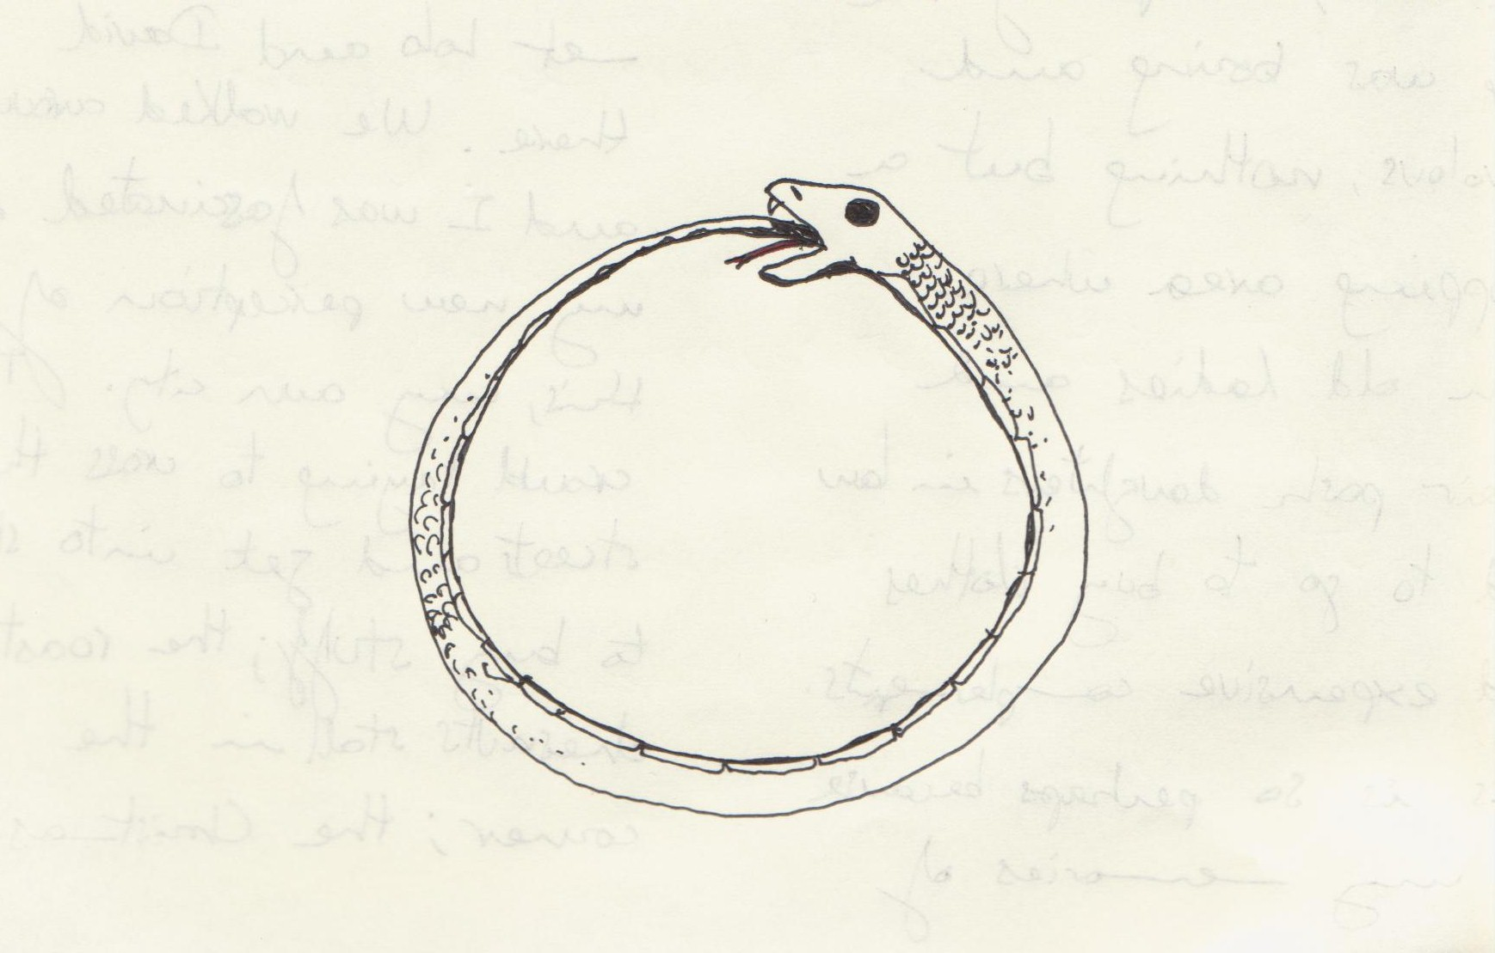

Vicious and virtuos circles
The monopolistic ownership of intellectual property encourages investment in the skills necessary to improve the knowledge that one owns. The skills that are developed make it even more convenient to acquire and produce more private knowledge.
Other individuals may be trapped in vicious circles of under-investment in human capital where the lack of intellectual property discourages the acquisition of skills and the lack of skills discourages the acquisition of intellectual property.

Slide 79
A simple model on the institutional complementarity between IPRs and technology
Consider two different (sets of) agents G and B and consider two different domains of choice:
  the property rights domain (P)
  the technology domain (T)
P^{G} and P^{B} denote, respectively, the cases in which the assets A are attributed to the individuals G and the case in which they are given to the individuals B at the beginning of the period
T^{G} and T^{B} denote two different technologies characterized by the fact that the intensity of the specific investment of agents G with respect to agents B is relatively higher in T^{G} than in T^{B}
Denote by x the extra-agency cost that G must pay to induce B to invest in capabilities when G owns A
Denote by y the extra-agency cost that B must pay to induce G to invest in capabilities when B owns A

Slide 80
Given the property rights system P^{G}, the firm will maximise::
(1) R_{G} = Q(I_{G}, I_{B}) – [I_{G}c_{G}+ (x + c_{B}) I_{B}] ----->T^{G}
Given the property rights system P^{B} , the firm will maximise::
(2) R_{B} = Q(I_{G}, I_{B}) – [(y +c_{G}) I_{G}+ c_{B} I_{B}] -----> T^{B}
Given an (optimal) technology T defined by (I_{Gy}, I_{B}) , property rights over assets A will be attributed:
to agents G when the benefit U(P^{G}) of the property rights structure P^{G} exceeds the benefit U(P^{B}) of the property rights structure P^{B}, that is when R_{G} ≥ R_{B}, or:
(3) yI_{G} ≥ x I_{B} -----> P^{G}
to agents B if the benefit U(P^{B}) of the property rights structure P^{B} is greater that the benefit deriving of the property rights structure P^{G} , i.e. when R_{B} ≥ RG, or:
(4) x I_{B} ≥ y I_{G} -----> P^{B}

Slide 81
Since:
the ratio x / y is positive and I_{G}^{G} / I_{B}^{G} ≥ I_{G}^{B} / I_{B}^{B}
x / y can either fall in the interval defined by I_{G}^{G} / I_{B}^{G} and I_{G}^{B} / I_{B}^{B}
0r outside it.
We have therefore that:
a) Multiple property rights-technology equilibria (P^{G}, T^{G}) and (P^{B}, T^{B}) exist when the following condition is satisfied:
I_{G}^{G} / I_{B}^{G} ≥ x / y ≥ I_{G}^{B} / I_{B}^{B}
i.e. when both condition (5) and (6) are satisfied.
b) A unique equilibrium (P^{G}, T^{G}) exists when: I_{G}^{G} / I_{B}^{G} ≥ x / y
i.e. when condition (5) is satisfied but condition (6) is not satisfied.
c) A unique equilibrium (P^{B}, T^{B}) exists when: I_{G}^{B} / I_{B}^{B} ≤ x / y
i.e. when condition (6) is satisfied but condition (5) is not satisfied.

Slide 82
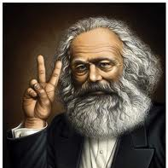
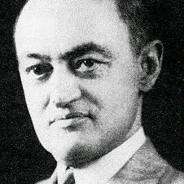
In both Marx and Schumpeter knowledge was not part of capital
In Marx workers are deprived of their intellectual potencies while knowledge is embodied in machines and in the capabilities of management (a stream of Marxism powerfully developed by Harry Braverman Labor and Monopoly Capital).
In Schumpeter innovations give a new asymmetric distribution of knowledge, yielding a competitive advantage to the innovators. and destroying old capital. However, the advantage is only temporary. After a while, imitation takes place, extra-profits disappear, and the innovation becomes common knowledge.

Slide 83


National intellectual monopolies
National States should balance:
the possibly beneficial incentives of patents on investments
with:
high prices (especially when cost of waiting for the product is very high)
blockage of innovative investments requirimg that knowledge
the danger of patent trolls ( blocking competitive innovations)
Like Trade Secrets, Intellectual Property Rights could not effectively be enforced at local level. Unlike land or machines, which stay in one place, knowledge is a non-rival good, which can be used everywhere in the world.
"Erga omnes" property rights on knowledge had to be defined and enforced at global level and not simply at national level.
Their establishment had major consequences:

Slide 84

First effect: inequality
The distribution of the use of knowledge can be more egalitarian than that of land of machines. Everyone can use the same piece of knowledge!
However, while the privatization of a machine does not restrict the liberty of others to use an identical machine, the so-called privatization of knowledge forbids the use of an identical piece of knowledge, causing increasing inequality. (An alternative explanation of r>g, Piketty 2014)
- Hierarchy and inequality in global value chains (Durand and Milberg 2020).
-- Low wages and firms' inequality even in the core countries (Song et al.2019).
--- Developing vs. established monopolies and research exploitation (Rikap 2021)
---- Kicking away the ladder for developing countries (Chang 2002)

Slide 85

Second effect: financialization
With the transformation of intellectual monopolies into ordinary assets, the capital of the firms included new fictitious commodities yielding future rents subject to financial claims.
On the other side of the balance sheet, the financialization of the economy has as its counterpart the multiplication of these monopoly assets.
By contrast, public knowledge cannot be included in any public or private balance sheet; it is a global common of all humanity.
When knowledge is privatized, in spite of an enormous increase of financial wealth, real-world wealth can sharply decrease.
.

Slide 86

Third effect: stagnation
Intellectual monopolies have been greatly reinforced by their transformation into full-blown global property rights. A reinforcement of monopolies has two types of effects:
A) immediate (or even anticipatory) effects:
expectations of future monopoly rents increase innovative investments.
B) medium and long terms effects:
blocking effects, anti-common tragedies, patent trolls and secrecy inhibiting research decrease innovative investments
Deterministic explanations such as that of Haskel and Westlake (2018), who see the growth of intangibles as a purely technological phenomenon (unrelated to a property right shock), fail to explain the boom of the 1990s which has preceded the subsequent stagnation.

Slide 87
Knowledge-Markets Complementarities
Open Science – Open Markets Complementarities:
When much Knowledge is produced as open science, markets can be open to numerous competitors.
When there are numerous competitors, each piece of knowledge produced as a public good yields greater benefits.
Closed Science – Closed Market Complementarities:
When much knowledge is produced as closed science as an exclusive intellectual monopoly, markets are are also closed to competition.
When market are closed, the production of knowledge can be worthwhile only for the few organizations that have sufficient market power.

Slide 88
Knowledge-Markets institutional complementarities
Increases the relative adavantage of
Open
Science
Open
Markets
Increases the relative adavantage of
Closed
Science
Closed
Markets
We have two possible
institutional complements
O-S ,
O-M
C-S ,
C-M

Slide 89
Re-enter AI
In principle, AI could favor open science and open markets. Semi-public multinational infrastructures are possible. They may start using sensitive data and using them for an initial development of algorithmic efficiency.
At the same time, AI can be a way in which public row data are used to generate private knowledge. Improved proprietary algorithms may increase knowledge monopolization and market closures.

