Slide 1

Firms, Markets and other Institutions in a comparative perspective
Ugo Pagano
May-June 2024

Slide 2
Ends-Means Economics.
A long tradition has seen economics as a relation between ends and means. The limited viability of means with respect to the ends generates the problem of scarcity and defines the economic problem.
The neoclassical approach of utility maximization under constraints is seen to be the logical consequence of this approach.
In this first lecture I will try to show that the means-ends problem is not consistent with the neoclassical approach. It requires a more general institutional perspective.

Slide 3
Extended ends and limited capabilities.
The complexity of the standard means-ends problem is undervalued because some crucial arguments of the utility function are excluded from economic analysis.
The capability to solve problems is overvalued because some individual and social resources are implicitly assumed to be free goods.
An institutional approach to the end-means problem should:
- extend the realm of the variables affecting human welfare
- make a realistic assessment of individual and collective capabilities.

Slide 4
Dimensions of Scarcity in Institutional Economics
1) Material scarcity
(as in standard economics)
2) Self-realization scarcity.
3) Social Scarcity
4) Intelligence Scarcity
5) Institutional Scarcity

Slide 5
Dimension 2: Self-realization Scarcity.
Neoclassical theory divides human activities in work (means) and leisure (ends). Utility functions are defined over consumption goods and leisure while the production function on physical inputs and work.
Between productive and consumption activities, a dichotomy arises: consumption activities do not affect production functions while productive activities do not affect the utility functions.
Following the Smithian and the Marxian traditions, one can easily argue that production activities directly affect the utility function. Most human activities are means and ends the same time. Moreover, the distinction between means and ends should be endogenous.

Slide 6
The ends -means separation problem.
When preferences for work are taken into account (and even more if we endogenize the definition of work itself), the problem becomes more complex because ends cannot be separated a a priori from means.
Technological efficiency cannot be stated independently of preferences for different types of human activities.
Self-realization scarcity arises: some human productive activities are more in demand than others because they allow more work satisfaction in terms of creativity and self-realization.

Slide 7
Work and leisure.
Task A
4h
A
consumption goods
Total time 24 h
Task B
4h
utility
leisure
16 h

Slide 8
Increase of total working time.
Task A
4h
consumption goods
Total
time
24 h
Task B
5 h
utility
leisure
15 h

Slide 9
Change of task allocation.
Task A
2h
A
consumption goods
Total
time
24 h
Task B
6 h
utility
leisure
16 h

Slide 10
Dimension 3: Social Scarcity
The ends-means problem is complicated by another dimension of scarcity (often considered to be outside the boundaries of economics, possibly belonging to the clumsy realm of sociology).
Goods like power and status affect both utility and production functions. These goods do not set limits to the achievement of our goals because they are available in given positive quantities.
Their positive use is only possible if corresponding negative quantities are consumed by other individuals (who must occupy corresponding opposite positions).
Positional Goods like power and status imply a social scarcity constraint The standard scarcity constraints concerns limited positive amounts of resources. Positional goods are scarce because positive consumption must go together with negative consumption.

Slide 11
Positional goods.
Pure private goods: other individuals consumes a zero amount of what each individual chooses to consume.
Pure public good: each agent must consume the same positive amount that other agents decide to consume
Pure positional good: given the consumption choice of an agent,
the other agent must consume a corresponding negative amount of what the other agent chooses to consume.

Slide 12
 | Robinson | Friday
Public good | + | +
Private good | + | 0
Private good | 0 | +
Positional good | + | -
Positional good | - | +
Public bad | - | -

Slide 13
First order jural positions
Right of i | Duty of j
Exposure of i | Liberty of j
Example 1: boat in danger.
Boats that are in danger enjoy some legal right to be helped by other ships. This right is necessarily correlated with the duty of other boats not to leave when another ship is in danger. This duty does also necessarily entail that other boats do not have the liberty to leave and that a boat that is danger is not exposed to the liberty of the other boats to refuse their help.

Slide 14
Second order jural positions
Power of i | Liability of j
Disability of i | Immunity of j
Example 2: liberty of speech
If, because of the existence of a Bill of Rights the State has no power to change legal entitlements and restrict my liberty of speech (Simmonds, 1986 p. 132), this means that in this respect I have no liability towards the State. In other words, I enjoy an immunity against its power that is correlated to a corresponding disability of the State.

Slide 15
Legal Relations and Social Scarcity
Legal relations are characterised by some form of social scarcity because:
1) no increase in rights is possible without some increase in duties and some decrease in liberties
2) no increase in powers is possible without some increase in
liabilities and some decrease in immunities.
While public goods are typically undersupplied, positional goods are typically oversupplied.
“Legal goods” such as rights, liberties and powers share this problem and some form of legal disequilibrium may typically arise.

Slide 16
Dimension 4: Human Intelligence Scarcity.
Another dimension of scarcity has to do with the limitations of the decision maker. “Maximization activities” are costly and consume scarce resources. One could think that that additional constraints should be added in the standard maximization problem.
The idea that one could deal with maximization costs by simply adding new constraints is wrong. A problem with more constraints is computationally more complex. The individual, who could not solve the rationally unbounded maximization problem, cannot solve a problem where the bounded rationality constraints have been added.
Because of the scarcity of human intelligence maximization behaviour is not consistent with these dimensions of the economic problem.

Slide 17
An infinite regress?
Assume that maximization activity is costly.
Reformulate a new (second order) maximization problem in which an individual decides:
- how many resources to allocate to the maximization activity
- and how many resources to employ in the other activities
Unfortunately, this involves a new maximisation problem with
new (second order) maximization costs.
A reformulation of a (third order) maximization problem would run in the same problem and so on ad infinitum.

Slide 18
First-order bounded maximization.
Production
Resources
Decision-making

Slide 19
Second-order bounded maximization.
Production
Resources
More
decision-making
Decision-making

Slide 20
Dimensions of Bounded Rationality.
Limited Communication Capabilities
Limited Information Capabilities
Limited Calculation Capabilities
(already considered)
4) Limited preference formation Capabilities
5) Limited emotional Capabilities

Slide 21
Dimension 5: Institutional Scarcity
Because of the assumption of complete markets,
Neoclassical economics rules out the huge gap existing between:
the goals of coordinating individual decisions
and the institutions that provide the means for this purpose.
If at least one institution (the market) is available at zero costs, we have a world where collective capabilities are not limited. In this world the problem of institutional scarcity does not arise.
However, setting up, improving and running institutions is a long historical process which requires the solution of numerous collective action problems. For instance, the blossoming of markets require common rules and cultural standards as well as institutions defining and enforcing property rights.

Slide 22
The roots of institutional constraints
Institutional constraints are due to all the forms of scarcity that we have seen before:
1) Material constraints imply that limited resources can be invested in the building on institutions.
2) Self-realization needs make the institutions of production very complex: they cannot be simply means to future and present consumption.
3) The quest for and the use in production of positional goods imply positional competition and continuous rent-seeking, which undermine the task of institutional building.
4) Because of the limitations of human intelligence, humans can concentrate only on some pieces of the current institutions and take for granted the remaining parts.

Slide 23
Production of institutions by the means of institutions.
5) However a fifth constraint is self-referential:
Institutions are also built by using preceding institutions.
Institutional building is a long and complex process by which different countries develop along paths whose characteristics cannot be judged independently of their past institutions.
The development of institutions is related to all forms of scarcity, including the historical conditions of a country or, in other words, its own present institutional constraints.
Institutional economics must inevitably deal with the historical specificity of the human species and the historical specificity of different societies. Some institutions that work in some place and time may turn out to be bad arrangements in different situations.

Slide 24
Two architectures of economic theory
Consumers Firms
Markets
Individuals
Markets Firms

Slide 25
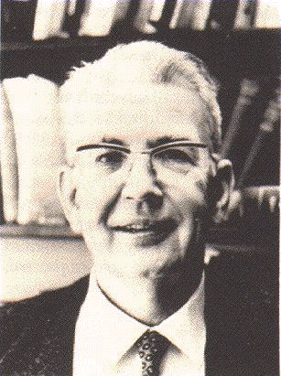
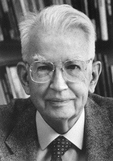
Ronald vs. Ronald
The Young(er) The Old

Slide 26
The Young English Socialist.
Some fifty-five years ago, in a seminal article called The Nature of the Firm, a young socialist named Ronald Coase sought to explain the existence of firms, of organizations within which markets were replaced by hierarchy and command.
In the words
of Guido Calabresi:

Slide 27
The Old American Libertarian.
Twenty-five years later, in The Problem of Social Cost, Ronald Coase, by then a middle-aged libertarian, indicated how markets could replace hierarchy and command structures to the perceived benefit of those who organized them
In the words
of Guido Calabresi:

Slide 28

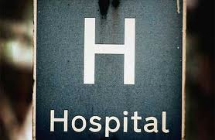

Mixing ages: a Schizophrenic
Ronald?

Slide 29

Ronald’s Record
Young Ronald (1937) claims: In a world of zero transaction costs firms would not exist. Firms exist only when market transaction costs are positive.
Old Ronald (1960) claims: In a world of zero transaction costs (and well-defined property rights) all externalities (harmful and beneficial effects) are internalised (taken into account) by market transactions. (Coase theorem)
Old Ronald (1960) also claims:
That the first statement does not contradict the second.
Diagnosis: old age schizophrenia.

Slide 30

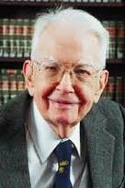
Lissening to Ronald’s reasons........
In his famous 1960 article we must get to Section 6
“The Cost of Market Transaction Taken into Account”
where he points out that:
“The argument has proceeded up to this point on the assumption that there were no cost involved in carrying market transactions.” (1960, p. 114)
"It is clear that an alternative form of economic organization which could achieve the same result at less cost that would be incurred by using the market would enable the value of production to be raised. As I explained many years ago the firm represents such an alternative to organising market transactions" (1960, p. 115).
"But the firm is not the only possible answer to this problem…. "an alternative solution is direct governmental regulation" (Coase 1960 p. 116).

Slide 31
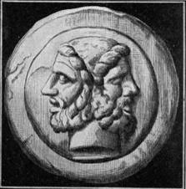
Ronald’s un-divided self.
Coase argues that the “Coase theorem” (but there is no theorem according to Coase!) is perfectly consistent with the 1937 article and they make up one unique theory. He is correct.
According to the “Coase theorem”, in a world of zero transaction costs, markets can internalize all externalities. State intervention and Pigouvian taxes (and firms) are all unnecessary in that framework.
Unsurprisingly, if one institution (the market) is assumed to be costless, only two things can happen:
If the other institutions are costly, they disappear.
If the other institutions are also costless, they may co-exist but their mix cannot be a relevant economic issue.

Slide 32

The challenge to microeconomics of the Re-constructed Ronald.
In this way, Coase challenges the standard building of microeconomics
where the existence and the size of the firms are explained
by U-shaped cost curves (with an initial phase of increasing returns).
The positive and negative effects (increasing and decreasing returns)
which the production of some units has on other homogeneous units,
are only a particular type of externality.
In a world of zero transaction costs, this externality is internalized by markets.
Once this compensation is made, to break even,
it is not necessary to produce a certain number of units within a firm.
In a world of zero transaction costs, whatever the technology, firms do not exist...

Slide 33
Institutions as costly substitutes
New Institutional Economics has correctly emphasized that institutions are costly substitutes, and that growth requires their optimal mix.
Explaining and searching for the efficient institutional mix is one of the main purposes of new institutional economics.
However, New Institutional Economics suffers from two important limitations:
no institutional complementarities
implicit reliance on meta-institutions.

Slide 34

The changing optimal mix of costly institutions: a Coasian example
The optimal mix among institutions is recalculated each time that technological data changes.
Coase provides an example from ICT technology: the introduction of telephone lines decreased the costs of using both market and firm internal organizations.
However, the institutional mix would stay unchanged only if the costs of using markets and firms were decreasing in the same proportion. Otherwise it would be efficiently re-adjusted in all market (?) economies.

Slide 35

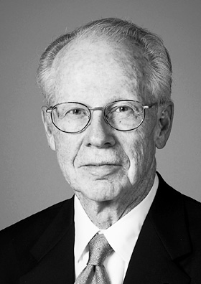
Markets!!!
“I assume, for expositional convenience, that in the beginning there was the market” (Williamson 1975:20)
“Markets and firms are alternative instruments for competing a related set of transactions…where a set of transactions ought to be executed across markets or within a firm depends on the relatively efficiency of each mode” (Williamson 1975:8)

Slide 36

Meta-markets?
NIE has overcome the narrow limits of Economics built on the premises of costly resources and free institutions.
However, its job is unfinished and contradictory:
In the NIE framework, the market acts under two contradictory roles:
A costly institution to be selected
The costless (meta-)institution by which all the institutions (including markets) are selected.

Slide 37
Costly institutions and development
If some meta-institutions could calculate the optimal institutional mix for each new technology, all economies would follow the same efficient development path.
But there are no costless meta-institutions!!! In each location, institutional change is constrained by the costly institutions within which the change should take place.
The nature of these constraints becomes clear when we introduce the concept of institutional complementarity.

Slide 38

Institutional Complementarities
The fact that costly institutions cannot be substituted in a costless meta-institutional environment becomes even more evident when we accept the existence of institutional complementarities ( formalized by Aoki).
If institution are costly one should not only ask whether one institution may be a substitute for another, but also how the existence of one institution may influence the cost of running another institution.
Institutional complementarities limit the possibilities of institutional substitution and may make their substitution particularly costly.

Slide 39
Institutional substitution and institutional frameworks
Free meta-institutions, located in a Nirvana without institutional complementarites, do not exist.
Institutional substitution occurs in a certain moment of history and in specific locations.
The institutional substitution possibilities are limited by various factors, including the pre-existing institutions and their webs of complementarities.
Understanding institutional substitution requires a careful study of each evolving institutional framework.

Slide 40
The Coasian example re-examined
Telephone lines induce an efficient institutional substitution between markets and firms. Coase believes that firms’ size increases.
If meta-markets, internalizing all institutional complementarities, existed, the same new institutional mix would prevail in all economies . By contrast, since substitution is a real situation characterized by numerous institutional complementarities, the results will be different.
If the complementary institutions are not feasible, firms size may not increase or may increase much less.
Stakeholders conflicts involve different governance solutions (and different firm sizes) and they co-evolve with different corporate assets.

Slide 41
Limitations of the Coasian approach
1) Efficiency bias: firms exist because markets are imperfect
but the firms-markets mixture is supposed to be efficient
in a market economy.
2) Because of efficient meta-markets, we have transaction costs without transition costs
3) No disequilibrium transaction costs.
(Relative advantages of Marx and Hayek)

Slide 42
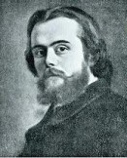

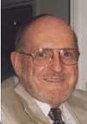
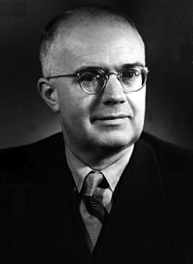
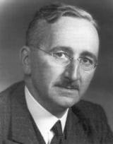
Disequilibriun
Transaction Costs
?
Forms of
Co-ordination
Forms of authority
 | Command | Competition
Ex-ante | (A) Marx | (B) Rational expectations
Ex-post | (C) Lange | (D) Hayek

Slide 43
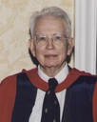
Coase’s
Journey
Costly decentralized market transactions.
The firm as centralization of market transaction

Slide 44
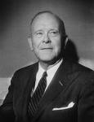
Fuller’s
Journey
Costly centralized public orderings.
The firm as decentralization of public orderings

Slide 45
A joint Coase-Fuller
Journey?
Costly decentralized market transactions.
Costly centralized public orderings.
The firm
as as centralization of market transaction
and
as decentralization of public orderings

Slide 46
Within a firm, its members:
(a) can act under the authority of a single plan derived
from a single model,
(b) can learn how to formulate the plan according to consistent
learning rules the authority of which is accepted by the members of the firm,
(c) can save the costs which they would incur if each member
of the firm had to formulate a complete plan based on her model,
(d) can avoid costly inconsistencies by coordinating ex-ante
the actions before they are implemented
(e) can eliminate unforeseen ex-post inconsistencies in the plan by constantly monitoring the emergence of ex-post imbalances.

Slide 47
The firm as a private ordering
Firm central authority replaces markets (and state authorities) to enforce and coordinate the agents' relations.
Central governance has the disadvantage that the agents will influence the central authority to enhance their privileges. Firms need to develop adequate forms of Private Ordering.
Fuller: the firm as a decentralization of the public ordering
Coase: the firm as a centralization of market transactions
Coase
Fuller

Slide 48
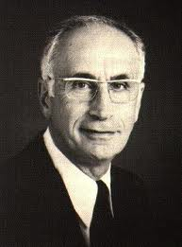
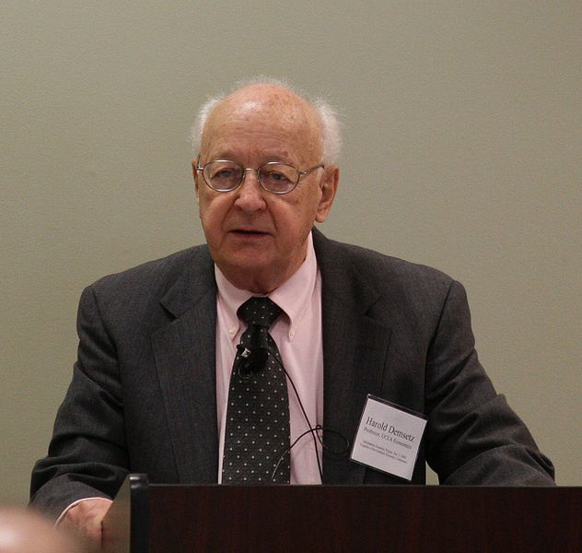
The monitoring problem
(Alchian, Demsetz)
Team work
Employer with hiring
and firing rights
Why capitalist ownership of the means of Production?
Hard to monitor
capital
Capitalist ownership
The same argument can be applied to hard to monitor labour.
Both arguments can be inverted.

Slide 49
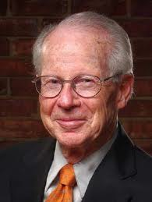
The Specificity Problem (Williamson)
Specificity, Illiquidity, and Irreversibility
Analogy with monitoring: rights should go to the
most specific factors.
Difference with monitoring: asset specificity cannot be defined by referring to a single relationship
Specificity, Competition and the Fundamental
Transformation.
Ex-ante competition → → → Ex-post monopoly
Two explanations of monopoly
The monopoly branch
The efficiency branch

Slide 50
Transaction cost efficiency under alternative behavioural assumptions
Bounded Rationality | Opportunism | Asset Specificity | Contracting Process:
0 | + | + | Planning
+ | 0 | + | Promise
+ | + | 0 | Ex-post competition
+ | + | + | Governance

Slide 51
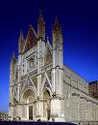

The Cathedral framework.
Contractual incompleteness does not imply that everything should be decided in future negotiations, unfettered by third-party judiciary.
In the Cathedral, when ex-ante exchanges have been impossible, courts can still supervise ex-post negotiations. In Calabresi’s framework, when high transactions make it impossible to have ex-ante property exchanges, it is still possible to apply liability rules and courts’ supervision of ex-post transactions.

Slide 52
3 (+1) Columns for the Cathedral.
Property rules (low transaction costs).
Liability rules (intermediate transaction costs)
Negligence rules and criminal law (high transaction costs or inalienable assets).
Another Column:
Private orderings and corporate governance.
Both Calabresi and Williamson involve a fundamental transformation that makes monopoly and competition two different stages of the same relations.

Slide 53
Calabresi’s Fundamental Transformation:
Because of the high number of possible accidents, negotiations occur after individuals have “disinvested” in specific accidents.
Ex-Ante Competition
Ex-Post Bilateral Monopoly
Ex-Post Transactions under Courts Supervision.

Slide 54
Williamsons’s Fundamental Transformation:
Because of the high number of possible events, negotiations occur after individuals have invested in specific assets.
Ex-Ante Competition
Ex-Post Bilateral Monopoly
Ex-Post Transactions under Firms’ Governance.

Slide 55
The Fundamental Differences.
Unlike accidental disinvestments, specific investments are more likely to involve a voluntary choice of the counterpart and of the third party endowed with judicial power.
In cases like car accidents, the ex-post relation lasts only for the time of readdressing the specific damage. There are no gains from continued cooperation and no incentive of private third parties to make second-order specific investments in the verification of the specific (dis)investments.
The private agents making verification investments can set up governance structures and become residual claimants for the extra-return on (first order) specific investments which are due to they “second-order investments” in the building of appropriate private orderings.

Slide 56
Ex-ante contractual Incompleteness
Calabresi and Williamson
Ex-post Verification Capabilities.
Calabresi
Williamson
Public orderings.
Independent
Agents.
Fuller-Coase
Emergence
of
the Firm.
Private Orderings.
Employed
Agents

Slide 57
Grossman, Hart and Moore Model
a) Specificity is both absolute and a marginal.
b) Contractual incompleteness is justified by the facts
that specific investments in human capital are
observable but not verifiable.
c) Agents are characterised by unbounded rationality
and decide their investments in the 1th period on the
basis of the anticipated bargaining of the 2nd period.
d) They exchange machines in the first period to
maximise the total surplus (Swiss Cheese Assumption)

Slide 58


From butter milk to Swiss cheese
In a famous passage, quoted by Coase in his 1937 article on Nature of the Firm (p. 35), Denis Robertson (1928) observed how in the market economy firms can be seen as
"islands of conscious power in this ocean of unconscious cooperation like lumps of butter coagulating in a pail of buttermilk".
In the New Property Rights approach the memory of the butter and the buttermilk has faded away . Its place has been taken by some sort of Swiss cheese where holes of incomplete contracts are open in a desert of perfectly working and costless markets.
Still, the model is useful because it allows us to see how many things change when we just carve few holes of contractual incompleteness in the neo-classical approach.

Slide 59
Hart’s non-fundamental transformation:
Lacking courts’ verification, ex-post bargaining is not constrained by competitive markets.
Ex-Ante Competition
Ex-Post Bilateral Monopoly
Ex-ante competitive exchanges of property rights .

Slide 60
M1 (Input) M2
_______ <------ _______
a1 a2
Ex-ante relationship-specific investments are made at date 0 and the widget is supplied at date 1.
There is only uncertainty about the type of widget M1 requires and this uncertainty is resolved at date 1.
Assume that:
-the parties are risk-neutral and have large (unlimited) amounts of initial wealth and the interest rate to be zero;
it is too costly for the parties to specify particular uses of assets a1 and a2 in a date 0 contract.
Non-integration: M1 owns a1 and M2 owns a2.
Type 1 integration: M1 owns a1 and a2
Type 2 integration: M2 owns a1 and a2
i non-negative number expressing level and cost of M1's relationship-specific investment.

Slide 61
If trade occurs:
M1's revenue is denoted by R(i);
his ex post payoff is R(i) - p where p is the agreed widget price
his ex-ante payoff is R(i) - p - i
If trade does not occur:
M1 buys a "non-specific" widget from an outside supplier at price p that may lead to lower-quality output
M1's revenue is indicated by r(i;A)
his ex-post payoff by r(i;A) - p
Remark: lower-case r indicates the absence of M2's human capital and the argument A refers to the set of assets M1has access to in the event that trade does not occur.
Under non-integration A = {a1}
under type 1 integration A = {a1, a2}.
under type 2 integration A ={Φ}

Slide 62
e denotes M2's relationship-specific investment at date O
If trade occurs
M2's production costs are denoted by C(e)
her ex-post payoff is p-C(e)
her ex-ante payoff is p - C(e) -e
If trade does not occur
M2 will sell her widget on the competitive spot market for p
but will have to make some adjustments to turn it into a general-purpose widget. In this case
M2's production costs are denoted by c(e; B)
her ex-post payoff is p-c(e;B)
Remark: lower-case c indicates the absence of M1's human capital and the argument B refers to the set of assets M2 has access to in the event that trade does not occur.
Under non-integration B = {a2}
under type 1 integration B ={Φ}
under type 2 integration B = {a1, a2}.

Slide 63
If trade occurs
the total ex-post surplus is:
R(i)-p+p-C(e) = R(i) - C(e)
If trade does not occur:
the total ex-post surplus is:
r(i;A) - p + p - c(e;B) = r(i;A) - c(e;B)

Slide 64
Assumption 1: because of the specific investments there are always ex-post gains from trade:
(2.1) R(i) - C(e) > r(i;A) - c(e;B) ≥ O
for all i and e and for all A,B
where A ∩ B = Φ
and A U B= {a1, a2}
Remark : (2.1) captures the idea that the investments i and e are relationship-specific: they pay off more if trade occurs than if it does not.

Slide 65
Assumption 2: relationship-specificity also applies in a marginal sense:
the marginal return from each investment is greater the more assets in the relationship, human and otherwise, to which the person making the investment has access.
(2.2) R' (i) > r' (i; a1, a2) ≥ r' (i; a1) ≥ r'(i; Φ)
for all 0 < i < ∞
(2.3) |C'(e)| > |c'(e; a1, a2)| ≥ |c' (e; a2)| ≥ c' (e; Φ)
for all 0 < e < ∞.
where: r'(i;A) = ∂r(i;A)/∂(i) and c'(e) = ∂c(e;B)/∂e
R' > 0, R" < 0 r' ≥ 0 r" ≤ 0
C' < 0 C" > O c' ≤ 0 c" ≥ 0

Slide 66
Assumption 3:
(Swiss Cheese)
R,r,C,c (the results) and i, e (the investments) are observable to both parties, but are not verifiable to outsiders. Thus, neither the results of the investments in human capital nor the levels investments themselves can be part of an enforceable contract.
The Physical Assets a1, a2 can be exchanged at zero transaction costs.

Slide 67
Ex-post division of surplus.
Consider what happens at date 1 given particular investment decisions i and e.
Take also the asset ownership structure as fixed for the moment.
We can suppress i, e and the set of assets A and B that M1 and M2 control.
Denote M1's revenue and M2 costs by:
R and C if trade occurs
r and c if trade does not occur.
Assumption 1---> there are ex post gains from trade given by:
[(R-C) - (r-c)].
Assumption 3 ---> they cannot be achieved under the initial contract.
Since the parties have symmetric information, it is reasonable to expect them to realise the gains through negotiation.

Slide 68
Assumption 4 Bargaining is such that the ex-post gains from trade [(R-C) - (r-c)] are divided 50/50 as in the Nash bargaining solution. Then M1 and M2 ex-post payoffs equal:
(2.4) Π1 = R-p = r - p + 1/2 [(R-C) - (r-c)] =
= - p + 1/2R + 1/2r - 1/2C + 1/2 c
(2.5) Π2 = p - C = p - c + 1/2[(R-C) - (r-c)] =
p - 1/2C - 1/2 c + 1/2R + 1/2r
and the widget price is given by:
(2.6) p = p + 1/2 (R-r) - 1/2 (c - C)

Slide 69
The first-best choice of investments
(We assume no wealth effects)
In a first-best world the parties would maximise the date 0 (net) present value of their trading relationship.
(2.7) R(i) - i - C(e) - e
Denote the unique solution to the first-best problem by (i*, e*)
The first-order conditions for maximising 2.7 are:
(2.8) R' (i*) = 1
(2.9) | C' (e*) | =1

Slide 70
The second-best choice of investments.
Now consider the second best incomplete contracting world, where the parties choose their investments non-cooperatively at date O.
Suppose that the ownership structure is such that:
M1 owns the set of assets A
M2 owns the set of assets B
(2.10) Π1 - i = - p + 1/2R(i) + 1/2r(i;A) - 1/2C(e) + 1/2 c(e;B) - i
(2.11) Π2 - e = p - 1/2C(e) - 1/2 c(e;B) + 1/2R + 1/2r(i;A) - e
Differentiating (2.10) with respect to i and (2.11) with respect to e yields the following necessary and sufficient conditions for a Nash equilibrium:
(2.12) 1/2 R'(i) + 1/2 r'(i; A) = 1
(2.13) 1/2 |C'(e)| + 1/2 |c'(e;B) | = 1

Slide 71
(2.12) and (2.13) can be written as follows for the three leading ownership structures:
Non-integration.
(2.14) 1/2R'(io) + 1/2 r'(io, a1) = 1
(2.15) 1/2 |C'(eo)| + 1/2 |c'(eo; a2)| = 1
Type 1-integration.
(2.16) 1/2R'(i1) + 1/2 r'(i1; a1,a2) = 1
(2.17) 1/2 |C'(e1)| + 1/2 |c'(e1; Φ )| = 1
Type 2-integration.
(2.18) 1/2R'(i2) + 1/2 r'(i2; Φ ) = 1
(2.19) 1/2 |C'(e2)| + 1/2 |c'(e2;a1,a2)| = 1

Slide 72
Proposition 1. Under any ownership structure there is underinvestment in relationship-specific investments. That is, the investment choices in (2.12) and (2.13) satisfy i < i*, e < e*.
Proof. Suppose i,e satisfy (2.12) and (2.13). Then, by (2.2) and (2.3)
R'(i) > 1/2 R'(i) + 1/2 r'(i;A) = 1
| C'(e)| > 1/2 |C' (e)| + 1/2 | c'(e;B)| = 1
The result follows since R" < 0, C" > 0.
Intuition: M1's payoff increases by less than R'(i); the remaining gains go to M2. M1 does not take M2 payoffs into account and hence invests too little.

Slide 73
1) All ownership structures imply under-investment.
2) Relative to non-integration, type 1 integration raises M1's investment, but lowers M2's.
3) Relative to non-integration, type 2 integration raises M2's investment but lowers M1's.
(2.20) i* > i1 ≥ io ≥ i2
(2.21) e* > e2 ≥ eo ≥ e1
Efficient ex-post bargaining implies that the total surplus from the relationship is given by:
S = R(i) - i - C(e) - e
where i and e satisfy the necessary and sufficient Nash bargaining conditions (2.12) and (2.13).

Slide 74
The ex-ante choice of the ownership structure.
Simply compare the total surplus from the various arrangements:
So = R(io) - io - C(eo) - eo
S1 = R(i1) - i1 - C(e1) - e1 (2.23)
S2 = R(i2) - i2 - C(e2) - e2
The theory predicts that the ownership structure that yields the highest value of S will be chosen in equilibrium.
Example: If at the starting point of their relationship M1 owns a1 and M2 owns a2, and S1 > Max(So S2),
then M1 will buy a2 from M2 at some price that will make both better off.
Remark: Any change in ownership structure that increases r'(i.)) (resp. increases |c'(e; .)|) without decreasing |c'(e; .)| (resp. decreasing r'(i; )) or, more generally that increases i or e without decreasing the other moves the parties closer to the first best.

Slide 75
Definition 3. Assets a1 and a2 are independent if
r'(i; a1,a2) = r'(i; a1) and c'(e;a1,a2) = c'(e;a1).
Intuition: Independent assets should be owned separately because with respect to no-integration concentrating ownership of independent assets does not increase the investment of the owner while it reduces the incentive to invest of the non-owner.
Definition 4. Assets a1 and a2 are strictly complementary if either r'(i;a1) = r'(i; Φ ) or c'(i;a2) = c'(e; Φ ).
Intuition: Complementary assets should be owned together because with respect to non-integration concentrating the ownership of complementary assets increases marginal return from investment of the owner without decreasing the incentive to invest of the non-owner.

Slide 76
Proposition 2(C) If assets a1 and a2 are independent, then non integration is optimal.
Proof. Because of the definition of independence the solution to:
(2.14) 1/2R'(io) + 1/2 r'(io, a1) = 1
(2.16) 1/2R'(i1) + 1/2 r'(i1; a1,a2) = 1
is the same; that is i1 = io. Since e1 ≤ eo non-integration dominates type 1 integration. Also, the solutions to:
(2.15) 1/2 |C'(eo)| + 1/2 |c'(eo; a2)| = 1
(2.19) 1/2 |C'(e2)| + 1/2 |c'(e2;a1,a2)| = 1
are the same; that is eo = e2. Since i2 ≤ io non-integration dominates also type 2 integration.

Slide 77
Proposition 2 (D) If assets a1 and a2 are strictly complementary, then some form of integration is optimal.
Proof: Suppose first that:
r'(i;a1) = r'(i; Φ)
Then the solutions to
(2.14) 1/2R'(io) + 1/2 r'(io, a1) = 1
and
(2.18) 1/2R'(i2) + 1/2 r'(i2; Φ) = 1
are the same; that is io = i2. Since eo ≤ e2 type 2 integration dominates non-integration. The same argument shows that, if c'(e;a2) = c'(e, Φ) type 1 integration dominates non-integration.

Slide 78
Limitations of the GHM model.
No genuine Williamson-Calabresi fundamental transformation
One way relation between technology and property rights.
Identification between ownership and control.
No genuine theory of the firm as private governance.
Swiss Cheese Assumption.

Slide 79

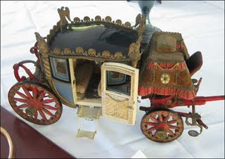
GM-Fisher Body: an hold-up story?
Much literature sees the reason for the existence and growth of firms in common ownership of machines and plants which avoids hold-up problems.
A typical example, given in this literature, is the GM-Fisher Body vertical integration when Fisher-Body was holding-up GM which wanted to expand production facilities
Fisher increased its short-term proﬁt by failing to make the investments required by GM in a plant located near GM production facilities in Flint, Michigan.

Slide 80
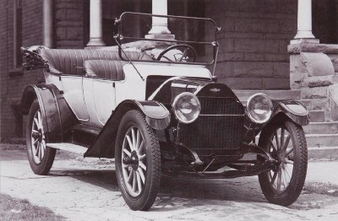



Top management with a judicial function.
GM growth required the adjudication of the responsibilities among individuals cooperating in production.
Example: Kettering vs. the production production and the failure of the copper-cooled (air-cooled) engine.
The role of Alfred Sloan:
- Separation between top management and management of division
- No horse trading in the central offices.
- Top management with a “judicial function” adjudicating rewards and liabilities.

Slide 81


A different interpretation.
The transition from open body to closed body.
Road-holding: fit between car body and engine.
Unlike airplanes and boats, the body and engine of the car became co-specific.
Unified liability towards customers and internal adjudications of liabilities.
Sloan’s “internalization” of the judicial function.

Slide 82
Institutional Substitution and Institutional Complementarity
Scarcity does not only involve substitution but also complementarity
problems.
This is true for both standard economic resources and for institutions.
Two different questions arise:
a) Which institutions can replace other institutions?
b) Which institutions can favour some institutions instead
of other institutions?
The questions a) and b) are related:
When following Coase we say that, under some circumstances,
there is tendency to replace markets with firms we should not forget
that this tendency may be favoured by the fact that
the public ordering has very incomplete rules and poor enforcement.
Markets and the public ordering are complementary institutions.
(Fuller L. L. 1969, Pagano IRLE 2000)

Slide 83
The Notion of Institutional Complementarity (Aoki, 2001)
Economic agents face different domains of games in selecting their choice in a given institutional framework; choices in one domain act as exogenous parameters in other domains and vice-versa
EXAMPLE:
two domains of choices X and Y; {X1, X2} and {Y1, Y2}, with agents i choosing in X and agents j choosing in Y, according to their utilities (respectively, u for i and v for j).
a) for agent i
b) for agent j
There can be one Nash equilibrium, but also two pure Nash equilibria (institutional arrangements) for the system as (X1,Y1) and (X2,Y2).
When such multiple equilibria exist, we say that
(i) X1 and Y1 are institutional complements;
(ii) X2 and Y2 are institutional complements.

Slide 84
Families’-Employers’ institutional complementarities
Increases the relative adavantage of
Discriminating
Employer
Inegalitarian Family
Increases the relative adavantage of
Non- discriminating
Employer
Egalitarian
Family
We have two possible
institutional complements
D-E ,
I-F
N-E ,
E-F

Slide 85
Complementarities and Evolution.
Complex organisms and survival of the fittest.
Epistatic Relations, Stasis and Punctuated Equilibria.
Allopatric Speciation and the Continuity of Evolution.

Slide 86
Two directions of causation.
Specificity and Monitoring Characteristics of Assets
Property Rights and
Organizational Form
The most specific and difficult to monitor agents can save the greatest amount of agency costs when they control the organization.
:
:
The agents controlling the organization will tend to become the most specific and difficult to monitor

Slide 87
New Institutional theory has emphasized that owners of specific and
hard-to-monitor resources tend to acquire rights and safeguards more than the owners of general purpose and easy-to monitor resource. This claim can be stated as:
(1) In the property right domain, a property right system P^{C} is marginally better than another property right system P^{L} if the corresponding technology T^{c} instead of the technology T^{L} prevails in the technology domain.
Where
T^{c} : a technology where capital is intensively used as a specific and hard to monitor resource
T^{L} : technology where labour is intensively used as a specific and hard to monitor resource
P^{C} : a governance system where the owners of capital have strong rights and safeguards
P^{L} : a governance system where workers have strong rights and
Safeguards.

Slide 88
Inverting the Argument.
In a word of positive transaction costs the owners of resources enjoying rights and safeguards tend to become more specific and hard to monitor than those without rights and safeguards. This claim can be stated as:
(2) In the technology domain a technology T^{L} is marginally better than a technology T^{c} if a property right system P^{L} instead of property right system P^{C} prevails in the property right domain.
This is an argument that has been typical emphasized by radical economists against the efficiency predictions of NIE. However, it is consistent when NIE when one assumes positive transaction costs.

Slide 89
(1) In the property right domain a property right system P^{C} is marginally better than another property right system P^{L} if the corresponding technology T^{c} instead of the technology T^{L} prevails in the technology domain.
(2) In the technology domain a technology T^{L} is marginally better than a technology T^{c} if a property right system P^{L} instead of property right system P^{C} prevails in the property right domain.
Where
T^{c} : a technology where capital is intensively used as a specific and hard to monitor resource
T^{L} : technology where labour is intensively used as a specific and hard to monitor resource
P^{C} : a governance system where the owners of capital have strong rights and safeguards
P^{L} : a governance system where workers have strong rights and
safeguards.
We can have multiple equilibria (P^{C}, T^{c}) and (P^{L}, T^{L} )
P^{C} and T^{c} and P^{L} and T^{L} are, in this case, institutional complements.

Slide 90
Pagano Rowthorn 1994
(2) Inverted argument:
Under capitalist ownership (P^{C}) firms maximise:
R^{c} = Q (k,K,l,L) - [rk + RK +wl + (H+W)L] (1) ----->(T^{c})
Under labour ownership (P^{L}) firms maximise:
R^{L} = Q (k,K,l,L) - [rk + (Z+R)K + wl +WL] (2) ----- >(T^{L})
(1) Original NIE argument:
Capitalist property rights P^{C} can prevail if R^{c} ≥ R^{L} or,
ZK - HL ≥ 0 (3) <----- (T^{c})
workers' property rights P^{L} can prevail if R^{L} ≥ R^{c}, or:
HL - ZK ≥ 0 (4) <----- (T^{L})
We can have multiple self-enforcing equilibria
(P^{C}, T^{c}) and (P^{L}, T^{L} ) that are institutional complements.

Slide 91
Conditions for organizational equilibria
Let:
(k^{c},,K^{c}, l^{c}, L^{c}) = argmax R^{c} (k, K, l, L) (5)
(k^{L}, K^{L}, l^{L}, L^{L})= argmax R^{L} (k, K ,l, L) (6)
Then a firm will be in a capitalist organisational equilibrium (COE) if:
ZK^{c} - HL^{c} ≥ 0 (7)
and in a labour organisational equilibrium (LOE) if:
HL^{L} - ZK^{L} ≥ 0 (8)
Or:

Slide 92
Multiplicity of organizational equilibria
K^{c}/L^{c} ≥ H/Z (7')
K^{L}/L^{L} ≤ H/Z (8')
Because: (H+W)/R ≥ W/(Z+R) we have:
K^{c}/L^{c} ≥ K^{L}/L^{L} (9)
We have therefore 3 cases:
1) K^{c}/L^{c} ≥ H/Z ≥ K^{L}/L^{L} (10)
(multiple organisational equilibria).
2) K^{c}/L^{c} ≥ K^{L}/L^{L} > H/Z (11)
(only a COE exists).
3) H/Z > K^{c}/L^{c} ≥ K^{L}/L^{L} (12)
(only a LOE exists).

Slide 93
Organizational equilibria and complementarities
a) because of (1) and (2) when a property right system P^{C} (instead of the property right system P^{L}) prevails, a technology T^{c} (characterised by a higher ratio K/L than a technology T^{L}) does marginally better than T^{L}.
b) (3) and (4) imply that, when a technology T^{c} instead of a technology T^{L} prevails P^{C}, does marginally better than P^{L}.
Thus, the supermodularity conditions are satisfied in the model and we can have multiple organizational equilibria where P^{C} is an institutional complement of T^{c} and P^{L} is an institutional complement of T^{L}

Slide 94
Role of the elasticity of substitution in the model.
Role of the elasticity of substitution as an anti-virus.
Multiplicity of equilibria and elasticity of substitution
Efficiency and elasticity of substitution
Institutional stability and elasticity of substitution.
Institutional scarcity involves that the cost of alternative arrangements
involves reactions of various magnitude of economic organizations.

Slide 95
(Meta-)Complementarities
Stakeholders conflicts can give raise to concentrated ownership and organized workers (US) or to dispersed ownership and disorganized workers (EU).
A model of “conflictual complementarities” shows how these two possible property rights arrangements can emerge as equilibria of the game played by the different stakeholders.
Different corporate assets are developed under the two arrangements. Each arrangements saves on those resources that because of they specificity and monitoring attributes are particularly costly under each system of corporate rights.
A model of “synergic complementarities” between corporate rights and assets is used to show the cases in which multiple organizational arrangements are possible.
The two complementarities are therefore linked together by meta-complementarities, characterizing each system of corporate governance.
For a formal model of meta-complemetarities you may give a look to my article with Fabio Landini Stakeholders’ conflicts and corporate assets: an institutional meta-complementarities approach in Socio-Economic Review, Volume 18, Issue 1, January 2020, Pages 53–80,

Slide 96
The Notion of Institutional Complementarity (Aoki, 2001)
Economic agents face different domains of games in selecting their choice in a given institutional framework; choices in one domain act as exogenous parameters in other domains and vice-versa
EXAMPLE:
two domains of choices X and Y; {X1, X2} and {Y1, Y2}, with agents i choosing in X and agents j choosing in Y, according to their utilities (respectively, u for i and v for j).
a) for agent i
b) for agent j
There can be one Nash equilibrium, but also two pure Nash equilibria (institutional arrangements) for the system as (X1,Y1) and (X2,Y2).
When such multiple equilibria exist, we say that
(i) X1 and Y1 are institutional complements;
(ii) X2 and Y2 are institutional complements.

Slide 97
Two complementarities:
Stake-Holders Conflicts
Conflictual Complementarities
Varieties of Capitalism
Synergic complementarities
Fitting Corporate Assets

Slide 98
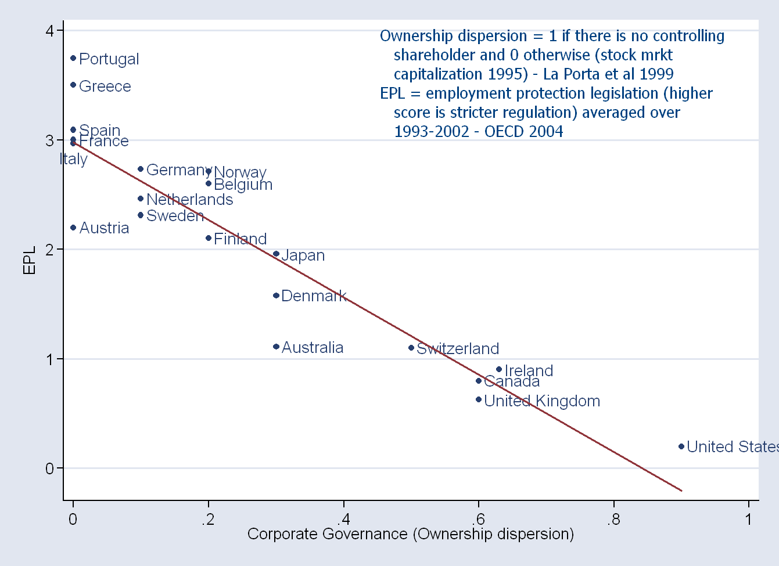

Slide 99


Dispersed varieties of capitalism
Capitalist diversify their interests by holding shares in different firms.
Workers do not concentrate their interests by the means of political action. Unions and Social-Democracy are weak.
Managerial hierarchies and firms’ size are not limited by the owners’ interests to control the firm.
Managers have strong incentives to invest in firms’ specific and difficult to monitor skills. Dispersed owners and disorganized workers do not have the same incentives.

Slide 100

Concentrated varieties of capitalism
Capitalist concentrate their interests by having single families owning relevant percentages of shares in each firm.
Workers cannot concentrate their interests by concentrating property. They react by the means of costly political action forming centralized unions
Managerial hierarchies and firms’ size are limited by the owners’ concentrated ownership and strong unions.
Managers have little incentive to invest in difficult to monitor and firm-specific skills. These corporate assets are more likely to be developed by other stakeholders as owners and workers who have strong rights on the organization.

Slide 101
Conflictual Complementarities: different stake-hoders interactions
Managers
Dispersed
ownership
Disorganized
workers’ interests
Concentrated ownership
M
Organized
workers’ interests

Slide 102
Synergic complementarities: stakeholders rights and firms’ technical assets
Specificity and Monitoring Characteristics of Assets
Property Rights and
Organizational Form
The most specific and difficult to monitor agents can save the greatest amount of agency costs when they control the organization.
:
:
The agents controlling the organization will tend to become the most specific and difficult to monitor

Slide 103
The evolution of the American variety of capitalism
Stakeholders
Conflicts
At the time of the second industrial revolution, thanks to two major revolutionary conflicts (independence war and secession war), the US had already fought successfully against the old European aristocracy and the slave-owning American farmers of the South.
The development of large firms happened in the framework of a strong democracy. Large block holdings, present in more than one firm, were seen with suspicion by early antitrust authorities, (Sherman and Clayton acts). Pyramids were dismantled by F.D. Roosevelt by the means of appropriate fiscal policies.
This “exceptional” early dispersion of capitalist interests made it less important to concentrate workers’ interests in strong unions and in social democratic parties. A dispersed equilibrium emerged.

Slide 104
The evolution of the American variety of capitalism
Corporate Assets
The American dispersed equilibrium has encouraged investment in human skills of professional managers, the diversification of ownership, and the concentration of large amounts of capital in corporations.
By contrast, it has provided only very mild incentives for the human capital of owners and workers. The absence of family control (Berle and Means) and the extension of managerial hierarchies have allowed the growth of large firms.
In turn the characteristics of the technical and productive assets have reinforced the institutional stability of the American model.

Slide 105
Evolutionary roots of the European varieties
Stakeholders conflicts
The European countries (with possible exception of Switzerland) followed a different path: at the time of the second industrial revolution, their societies were hierarchical and still permeated by aristocratic privileges.
No democratic authority could limit the concentration of the power of the capitalist dynasties occurring with the second industrial revolution.
A social-democratic reaction concentrated also workers’ interest and a concentrated equilibrium emerged in all these countries.

Slide 106
Evolutionary roots of the European varieties
Corporate Assets
This distribution of rights entailed a stronger incentive for owners (and their heirs) to invest in the human capital necessary to run firms while, at the same time, employment protection creates conditions favourable to firm-specific investments also for some workers.
By contrast, investments in the human capital of professional managers is discouraged. Family control and limited managerial hierarchies have also limited the size of the firms.
Also the technology, favoured by the European forms of corporate governance, reinforces in turn the distribution of rights characterizing these systems: ‘concentrated’ owners and workers have a vested interest in finding the political safeguards that protect their investments in physical and human capital associated with this technology.

Slide 107


The British Metamorphosis
(I): from concentrated equilibrium to disequilibrium.
At the time of the second industrial revolution, aristocratic influence, early unionization and a deep sense of class division made Britain a typical case of concentrated equilibrium.
However, transmission and division of inheritance, coupled with the international role of the city produced a dispersion of property.
In seventies the UK was characterized by a situation of "institutional disequilibrium" where the traditionally well-organized British unions were not matched by a countervailing centralization of firms' ownership.

Slide 108


The British Metamorphosis
(II): from disequilibrium to dispersed equilibrium.
This institutional disequilibrium coincided with a crisis of the British economy . For some time, "continental solutions" (such as pyramids and cross-share holding on one side and some "responsible" centralization of union's activity on the other) seemed to have a chance to prevail (Franks, Mayer, Rossi 2005).
These "continental solutions" were, however, opposed by the city. Eventually the Thatcher government made a sharp move towards a dispersed type of institutional equilibrium, characterised by strong limitations of unions' activities and by a (much advertised) shareholder popular capitalism.
These arrangements have not been substantially reversed by the subsequent Labour Party governments.

Slide 109



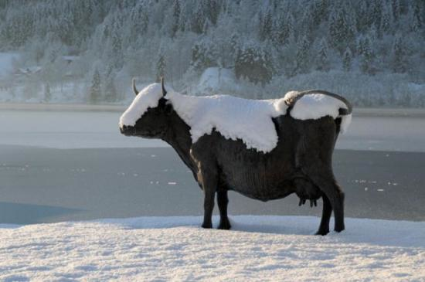
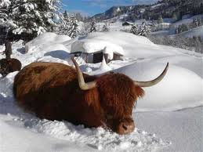
Switzerland: an Alpine America?
There are remarkable similarities between U. S. and Switzerland. Both countries came to an early tolerance of religious and ethnic diversity. The "cement of society" relied more on shared values and ways of life than on ethnic or religious homogeneity.
Also Switzerland achieved an early definitive exit from aristocratic privileges (in 1847). Swiss feudal ties were traditionally weak. The peasants were difficult to dominate because they were often far away on the Alpine pastures and because they were well trained in military activities (serving, often, as the most valuable mercenaries all around Europe).
Like the U. S., at the time of the second industrial revolution, Switzerland had a robust democracy and satisfied the conditions to realize a “dispersed equilibrium”.

Slide 110
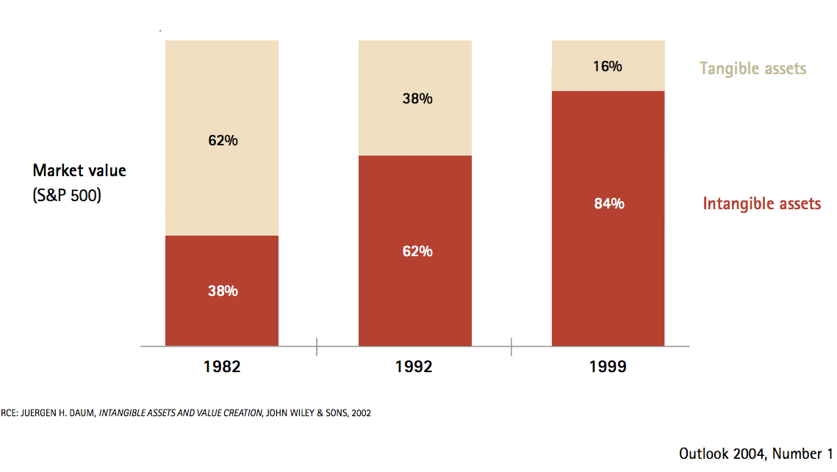
1982-1999:
La great mutation of corporate capitalism

Slide 111
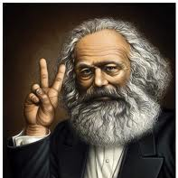
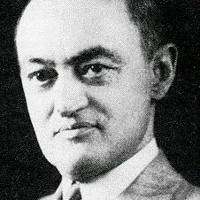
In both Marx and Schumpeter knowledge was not part of capital
In Marx workers are deprived of their intellectual potencies while knowledge is embodied in machines and in the capabilities of management (a stream of Marxism powerfully developed by Harry Braverman Labor and Monopoly Capital).
In Schumpeter innovations give a new asymmetric distribution of knowledge, yielding a competitive advantage to the innovators. and destroying old capital. However, the advantage is only temporary. After a while, imitation takes place, extra-profits disappear, and the innovation becomes common knowledge.

Slide 112

Catherine Fisk, and the history of the knowledge struggle
“In enforcing contracts first, only if they were express, and later by recognizing such contracts as implied-to maintain secrecy of the employer's methods, courts created a new species of "intellectual" property at the expense of older notions of artisanal independence. This was undoubtedly a case of "creative destruction" of one form of economic privilege to create another-the corporate intellectual property.” (Fisk, p. 445 2001).
1) 1800-1860 Skilled workers had no fiduciary responsibility.
2) 1860- 1890 Development of Trade Secrets as an Obligation of Employment and the Use of Contracts to control knowledge.
3) 1890 -1920 Breach of Trade Secret as a misappropriation of property automatically forbidden by the employment contract.

Slide 113

Katharina Pistor and the code of Capital
Three attributes transform ordinary assets into capital assets: priority, universality, and durability.
Priority gives the holder of capital a superior right over others. It operates like an ace in a game of cards.
Universality ensures that the priority right will be upheld against anybody; it extends priority in space.
Durability insulates capital from a range of creditor claims; it extends priority in time.
Attributing private property rights on land, machines and other tangible assets could be done and enforced at local level.

Slide 114


National intellectual monopolies
National States should balance:
the possibly beneficial incentives of patents on investments
with:
high prices (especially when cost of waiting for the product is very high)
blockage of innovative investments requirimg that knowledge
the danger of patent trolls ( blocking competitive innovations)
Like Trade Secrets, Intellectual Property Rights could not effectively be enforced at local level. Unlike land or machines, which stay in one place, knowledge is a non-rival good, which can be used everywhere in the world.
"Erga omnes" property rights on knowledge had to be defined and enforced at global level and not simply at national level.

Slide 115

Trade secrets
Even if trade secrets can be seen as a primitive form intellectual property they cannot be included among capital assets because they lack the attributes of priority, durability and universality which characterizes IPR.
1) The holder of a trade secret has no priority towards other holders of trade secrets.
2 )The right to enforce trade secrets is not universal. It holds only against individuals who got the knowledge from the person who developed the technology.
3) Trade secrets are not durable. They can expire at any moment in time when the technology is available in the public space.
Trade secrets could not effectively be enforced at local level. Even at the time of the industrial revolution different national states were actively engaged in the poaching of skilled workers carrying trade-secrets.

Slide 116
Globalization transformed intellectual monopoly into capital
This situation changed radically in the second half of the 90s.
With the end of the Cold War the lobbying on multinationals (Sell 2003) made it possible the transformation of national monopolies into intellectual property rights.
The institutions of globalization (WTO and TRIPS) transformed national monopolies into intellectual property rights, whose global enforcement was claimed to be a necessary condition for international trade.
With 1994 TRIPS agreement monopoly privileges became erga omnes property rights, more difficult to modify than ordinary rights.
While national authorities could expropriate a house to make a road, they could do the same with a patent, even when it hindered ends such as public health or it blocked important innovations.
This was a paradox. Expropriated houses are usually destroyed. Expropriating knowledge is tantamount to sharing it.

Slide 117
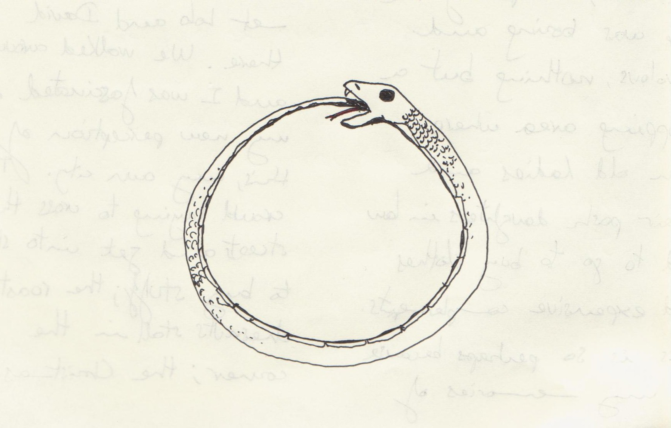

Vicious and virtuos circles
The monopolistic ownership of intellectual property encourages investment in the skills necessary to improve the knowledge that one owns. The skills that are developed make it even more convenient to acquire and produce more private knowledge.
Other individuals may be trapped in vicious circles of under-investment in human capital where the lack of intellectual property discourages the acquisition of skills and the lack of skills discourages the acquisition of intellectual property.

Slide 118

First effect: inequality
The distribution of the use of knowledge can be more egalitarian than that of land of machines. Everyone can use the same piece of knowledge!
However, while the privatization of a machine does not restrict the liberty of others to use an identical machine, the so-called privatization of knowledge forbids the use of an identical piece of knowledge, causing increasing inequality. (An alternative explanation of r>g, Piketty 2014)
- Hierarchy and inequality in global value chains (Durand and Milberg 2020).
-- Low wages and firms' inequality even in the core countries (Song et al.2019).
--- Developing vs. established monopolies and research exploitation (Rikap 2021)
---- Kicking away the ladder for developing countries (Chang 2002)

Slide 119

Second effect: financialization
With the transformation of intellectual monopolies into ordinary assets, the capital of the firms included new fictitious commodities yielding future rents subject to financial claims.
On the other side of the balance sheet, the financialization of the economy has as its counterpart the multiplication of these monopoly assets.
By contrast, public knowledge cannot be included in any public or private balance sheet; it is a global common of all humanity.
When knowledge is privatized, in spite of an enormous increase of financial wealth, real-world wealth can sharply decrease.
.

Slide 120

Third effect: stagnation
Intellectual monopolies have been greatly reinforced by their transformation into full-blown global property rights. A reinforcement of monopolies has two types of effects:
A) immediate (or even anticipatory) effects:
expectations of future monopoly rents increase innovative investments.
B) medium and long terms effects:
blocking effects, anti-common tragedies, patent trolls and secrecy inhibiting research decrease innovative investments
Deterministic explanations such as that of Haskel and Westlake (2018), who see the growth of intangibles as a purely technological phenomenon (unrelated to a property right shock), fail to explain the boom of the 1990s which has preceded the subsequent stagnation.

Slide 121
Global Patents and Investments.

Slide 122

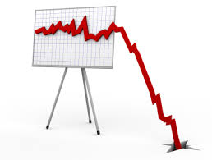
Dynamics of Intellectual
Monopoly Capitalism
The overall restriction of investment opportunities generates a dynamic process shown in the preceding figure (joint work with Filippo Belloc).
In the figure of the preceding slide, we can observe a total world increase of investments for about five years after the TRIPs but, after this initial phase, a continuous decline starting in 1999 and culminating with the recent global financial crisis.
The interactions between productive forces and production relations is likely to have produced two different dynamics of Intellectual Monopoly Capitalism, the first characterizing the roaring nineties and the second the much less glamorous first decade of the new millennium. And the 2008 financial crisis was more due to a famine of good investment opportunities than to a saving glut……

Slide 123
Pandemics and intellectual monopolies
The covid epidemics has shown the dramatic consequences of the transformation of intellectual monopolies into globally enforced intellectual property rights.
The WTO did not allow a patent waiver for the pandemics. The sharing of results and experiments was made impossible by patent holders. Early innovations, made by non-western countries, such as the Sputnik vaccine, were not authorized using the argument that they did not meet western industrial standards.
Research was mainly directed to gain high monopoly rents (mRNA patents).
Perhaps, the most dramatic failure was in the field of sub-unit vaccines (a part of the virus plus an adjutant drug). The alliance of Sanofi and GSK, trying to us proprietary adjutant drugs, failed whereas Cuba relying on freely available adjutants succeeded. The search of monopoly profits inhibited innovations!
Covid vaccines vs. flue network (Kapczynski 2017)

Slide 124
Knowledge-Markets Complementarities
Open Science – Open Markets Complementarities:
When much Knowledge is produced as open science, markets can be open to numerous competitors.
When there are numerous competitors, each piece of knowledge produced as a public good yields greater benefits.
Closed Science – Closed Market Complementarities:
When much knowledge is produced as closed science as an exclusive intellectual monopoly, markets are are also closed to competition.
When market are closed, the production of knowledge can be worthwhile only for the few organizations that have sufficient market power.

Slide 125
Open Science: free-riding on a global common
National states have traditionally tried to balance:
the advantages of open access knowledge (properly discussed and verified in a public space and universally available on competitive markets)
with the incentive advantage of granting intellectual monopolies.
By making intellectual monopolies rights to be granted and enforced at international level, national states lost this function, which has not been replaced by a global authority.
Each national state can gain by acquiring global monopolies for the national industry and by free-riding on its contribution to open-science.
Generalized unfair competition is a consequence of the present institutional architecture of the global economy.

Slide 126
Knowledge-Markets institutional complementarities
Increases the relative adavantage of
Open
Science
Open
Markets
Increases the relative adavantage of
Closed
Science
Closed
Markets
We have two possible
institutional complements
O-S ,
O-M
C-S ,
C-M

Slide 127
The shadow of the war
Public funding of open-science research is cut throughout the globe.
By contrast, military research expands and yields increasingly sophisticated means of human misery and destruction. Unfortunately, the celebrated "entrepreneurial state" is increasingly specialized in these activities. While open-science is a global common, increasingly exposed to free-riding, military research is a positional good and can easily degenerate into an arms' race.
The synergy between military and privatized research is becoming the main engine of innovation. Firms working in the clumsy boundaries between military and commercial research can enjoy the advantages of massive public research fundings, secure demand for part of their products and extra-secrecy before and after patenting their products. The innovations of most sectors (chips, telecommunications, automatic driving, space technology, parts of biomedical products etc.) have both military and commercial fallouts.
An increasingly dominant shadow of the war permeates large sectors of modern intellectual monopoly capitalism.

Slide 128
Military secrets and patents' disclosure
In exchange for the disclosure of an invention patents grant a monopoly on its application. From this point of view a "secret patent" should make no sense (also because new applicants could apply for the same patent).
However, in 1951 the U. S enacted the "Invention Secrecy Act" designed to prevent disclosure of new inventions and technologies that, in the opinion of selected federal agencies, presented a possible threat to the national security of the United States. The patent is refused, but the patent office keeps the record of the patent, that could be granted in the future.
On 21 Sept. 1960 NATO countries signed in Paris an agreement for "the mutual safeguarding of secrecy of inventions relating to defense and for which applications have been made". The agreement made it possible the extension of the US invention secrecy to all NATO countries.
On 19 Oct. 1970 NATO members signed a "NATO agreement on the Communication of Technical Information for defense purposes, among NATO Governments and Organizations, by providing means for the protection of proprietary technical information against unauthorized use or disclosure by or on behalf of a recipient NATO Government or Organization." Roughly speaking, these created the conditions for the circulation of "semi-secret" patents among NATO countries.

Slide 129

Hierarchical Globalization
Prior to the enactment of Bayh-Dole Act (1980), public (including military) and research were poorly connected. The U.S. government had accumulated 28,000 patents, but fewer than 5% of those patents were commercially licensed. There was a commitment to non-exclusive licensing and to open markets.
The Bayh-Dole act authorized federal agencies to grant exclusive licenses to inventions owned by the federal government.
Moreover, the legislation decentralized control of federally funded inventions. The responsibility and authority to commercialize inventions was given to the institutions or the companies receiving a grant.
Military secrecy created a protected circulation of technology among NATO countries. Inventions could be made partially secret. Bay- Doyle allowed military research to generate exclusive patents.
In this framework WTO created a hierarchical globalization where US and NATO countries could grant and withdraw intellectual monopoly rights.

Slide 130
De-globalization?
The pandemics and the wars are putting under an increased tension the architecture of globalization devised in the 1990ths. The pandemics has revealed the fragility of long supply chains and the limits of global intellectual monopolies. The wars are increasing the importance of military research.
The hierarchical globalization, built on private closed science, secretive military research and big monopolies is challenged by the fact that other countries, mainly China, are trying to create a similar competing system.
In this situation a de-globalization is occurring. The break-up of the world economy into blocs is possible. Dangerous conflicts will be increasingly be added to the shortcomings of intellectual monopolies.

Slide 131

What can be done?
1) Change from the language of property to that of monopoly
2) Consider that intangibles can generate monopolies even independently of IPR
3) Challenge market hierarchies and value chains
4) Fund more open-access knowledge and create more open-access markets
5) Propose WTO rules against free-riding on the human knowledge common
6) Create an International Court for the expropriation of basic privatized knowledge
7) Have global human missions based on global knowledge commons

Slide 132


At the end of the journey
    We started from a world were many dimensions of scarcity were missing.
    We moved to a world of costly and interdependent institutions......
This allowed us to see that economic systems differ through time and at the same moment of time, even if they are covered under the common umbrella of market economies.
Understanding these complex realities makes economics much more messy but also more interesting!

