Slide 1
Models of Capitalism
Ugo Pagano
Università di Siena
2021-2022

Slide 2
Outline
1) Capitalism and Scarcity
2) The Evolution of Property
3) Technology and Institutions
4) Institutional Complementarities and Varieties of Capitalism
5) Divisions of Labor
6) Power and Wealth
7) Intellectual Monopoly Capitalism

Slide 3
1
Capitalism and Scarcity

Slide 4
Ends-Means Economics.
A long tradition has seen economics as a relation between ends and means. The limited viability of means with respect to the ends generates the problem of scarcity and defines the economic problem.
The neoclassical approach of utility maximization under constraints is seen to be the logical consequence of this approach.
In this first lecture I will try to show that the means-ends problem is not consistent with the neoclassical approach. It requires a more general institutional perspective. One that introduces the historical specificity of economic systems and in particular of different models of capitalism.

Slide 5
Extended ends and limited capabilities.
The complexity of the standard means-ends problem is undervalued because some crucial arguments of the utility function are excluded from economic analysis.
The capability to solve problems is overvalued because some individual and social resources are implicitly assumed to be free goods.
An institutional approach to the end-means problem should:
- extend the realm of the variables affecting human welfare
- make a realistic assessment of individual and collective capabilities.

Slide 6
Dimensions of Scarcity in Institutional Economics
1) Material scarcity
(as in standard economics)
2) Self-realization scarcity.
3) Social Scarcity
4) Intelligence Scarcity
5) Institutional Scarcity

Slide 7
Dimension 2: Self-realization Scarcity.
Neoclassical theory divides human activities in work (means) and leisure (ends). Utility functions are defined over consumption goods and leisure while the production function on physical inputs and work.
Between productive and consumption activities, a dichotomy arises: consumption activities do not affect production functions while productive activities do not affect the utility functions.
Following the Smithian and the Marxian traditions, one can easily argue that production activities directly affect the utility function. Most human activities are means and ends the same time. Moreover, the distinction between means and ends should be endogenous.

Slide 8
The ends -means separation problem.
When preferences for work are taken into account (and even more if we endogenize the definition of work itself), the problem becomes more complex because ends cannot be separated a a priori from means.
Technological efficiency cannot be stated independently of preferences for different types of human activities.
Self-realization scarcity arises: some human productive activities are more in demand than others because they allow more work satisfaction in terms of creativity and self-realization.

Slide 9
Work and leisure.
Task A
4h
A
consumption goods
Total time 24 h
Task B
4h
utility
leisure
16 h

Slide 10
Increase of total working time.
Task A
4h
A
consumption goods
Total
time
24 h
Task B
5 h
utility
leisure
15 h

Slide 11
Change of task allocation.
Task A
2h
A
consumption goods
Total
time
24 h
Task B
6 h
utility
leisure
16 h

Slide 12
Dimension 3: Social Scarcity
The ends-means problem is complicated by another dimension of scarcity (often considered to be outside the boundaries of economics, possibly belonging to the clumsy realm of sociology).
Goods like power and status affect both utility and production functions. These goods do not set limits to the achievement of our goals because they are available in given positive quantities.
Their positive use is only possible if corresponding negative quantities are consumed by other individuals (who must occupy corresponding opposite positions).
Positional Goods like power and status imply a social scarcity constraint The standard scarcity constraints concerns limited positive amounts of resources. Positional goods are scarce because positive consumption must go together with negative consumption.

Slide 13
Positional goods.
Pure private goods: other individuals consumes a zero amount of what each individual chooses to consume.
Pure public good: each agent must consume the same positive amount that other agents decide to consume
Pure positional good: given the consumption choice of an agent, the other agent* must consume a corresponding negative amount.
* We are now assuming an economy with only two individuals – an assumption that we will change later

Slide 14
 | Robinson | Friday
Public good | + | +
Private good | + | 0
Private good | 0 | +
Positional good | + | -
Positional good | - | +
Public bad | - | -

Slide 15
The positional nature of legal relations
Hohfeld W. N. (1919) Fundamental Legal Conceptions
Commons J. R.(1924) Legal Foundations of Capitalism
give an explanation of legal relations that clarifies their positional nature.
Legal relations are ex-post identities but ex-ante they may be characterized by conflict (or disequilibrium) and by an “Hobbesian” wasteful competition where:
the extension of somebody’s right would require the limitation of somebody else liberties and
the extension of somebody’s power would require the limitation of somebody’s else immunities.

Slide 16
First order jural positions
Right of i | Duty of j
Exposure of i | Liberty of j
Example 1: boat in danger.
Boats that are in danger enjoy some legal right to be helped by other ships. This right is necessarily correlated with the duty of other boats not to leave when another ship is in danger. This duty does also necessarily entail that other boats do not have the liberty to leave and that a boat that is danger is not exposed to the liberty of the other boats to refuse their help.

Slide 17
Second order jural positions
Power of i | Liability of j
Disability of i | Immunity of j
Example 2: liberty of speech
If, because of the existence of a Bill of Rights the State has no power to change legal entitlements and restrict my liberty of speech (Simmonds, 1986 p. 132), this means that in this respect I have no liability towards the State. In other words, I enjoy an immunity against its power that is correlated to a corresponding disability of the State.

Slide 18
Legal Relations and Social Scarcity
Legal relations are characterised by some form of social scarcity because:
1) no increase in rights is possible without some increase in duties and some decrease in liberties
2) no increase in powers is possible without some increase in liabilities and some decrease in immunities.
While public goods are typically undersupplied, positional goods are typically oversupplied.
“Legal goods” such as rights, liberties and powers share this problem and some form of legal disequilibrium may typically arise.

Slide 19
Asymmetric effects of (positional) competition.
The Smithian and neo-classical tradition have emphasized the virtues of competition under the requirement of “well-defined” private property rights - that is under a complicated set of legal equilibria. In the Smithian tradition the main problem is material scarcity.
The Hobbesian tradition has focused on the wasteful positional competition which arises when individuals try to enlarge their rights at the expenses of others. In the Hobbesian tradition the main problem is social scarcity.
When the equilibrating institutions are lacking, economic competition can easily degenerate into wasteful positional competition. Competition can have opposite effects in different frameworks.

Slide 20
Dimension 4: Human Intelligence Scarcity.
Another dimension of scarcity has to do with the limitations of the decision maker. “Maximization activities” are costly and consume scarce resources. One could think that that additional constraints should be added in the standard maximization problem.
The idea that one could deal with maximization costs by simply adding new constraints is wrong. A problem with more constraints is computationally more complex. The individual, who could not solve the rationally unbounded maximization problem, cannot solve a problem where the bounded rationality constraints have been added.
Because of the scarcity of human intelligence maximization behaviour is not consistent with these dimensions of the economic problem.

Slide 21
An infinite regress?
Assume that maximization activity is costly.
Reformulate a new (second order) maximization problem in which an individual decides:
- how many resources to allocate to the maximization activity
- and how many resources to employ in the other activities
Unfortunately, this involves a new maximisation problem with
new (second order) maximization costs.
A reformulation of a (third order) maximization problem would run in the same problem and so on ad infinitum.

Slide 22
First-order bounded maximization.
Production
Resources
Decision-making

Slide 23
Second-order bounded maximization.
Production
Resources
More
decision-making
Decision-making

Slide 24
And so on ad infinitum.
Production
Resources
More
decision-making
Decision-making

Slide 25
God and human constraints
Unbounded outside observers (God) could tell us which one is the best solution for us without being bounded by our own constraints. But we are not God and we must face the problem of cognitive scarcity.
If we ignore the different maximization costs faced by the different individuals we are assuming a strange economy where individuals face costly resources and “free” rationality.
Under this assumption the maximization hypothesis is saved
but the general neo-classical paradigm of scarcity is abandoned

Slide 26
Dimensions of Bounded Rationality.
Limited Communication Capabilities
Limited Information Capabilities
Limited Calculation Capabilities
(already considered)
Limited preference formation Capabilities
Limited emotional Capabilities

Slide 27
New Property right approach and limited Communication Capabilities
The "New Property Rights" approach considers this case.
However, this approach considers one particular type of communication cost (that arising with third party enforcers) and assumes that the cost of transmitting this information is infinitely large.
Given this assumption, we have a trivial solution to the "economising on bounded rationality problem": zero resources will be dedicated to communicate with the third party enforcers and the agents can exclusively concentrate on the problem of allocating the resources among the other uses.
Hayek and central planning. Are really prices (the only) zero-costs price transmitters?

Slide 28
A meta-channel?
Economising on bounded communication skills would require a "meta-channel" where the agents could choose the most economical channels taking into account the "learning by using" effects and the "network externalities" that are involved in the choice.
However, this begs the very question that it is supposed to answer: how a (meta-)channel is ever chosen . A convincing story should neither exclude the possibility that agents try (some times, rationally) to look for better channels nor that they can be locked in "a priori" inefficient channels.

Slide 29
Bounded information processing skills
Economising on this type of bounded rationality is notoriously difficult.
If processing information is costly, then the agents will process additional information only when its expected marginal benefit outweighs its marginal cost. But the expected marginal benefit will depend on the a-priori beliefs of the agents. These can be wrong because there is no way to be certain about the value of additional information before processing it. (See Stigler (1961).
Individuals can be trapped in wrong beliefs that are not changed. The acquisition of additional knowledge, which would show them to be wrong, is (wrongly) assumed to be too costly.

Slide 30
Bounded preference formation skills.
If bounded rationality does also involve that the "production" of preference is costly, we should not be surprised by the fact that the agents try to economise also on this type of activity.
However, this consideration does not only imply that the room for optimising behaviour is limited even further. It does also involve an inversion of the traditional links existing between preferences and choices.
When this type of bounded rationality is acknowledged, past choices have a great influence in determining the types of preferences that are going to be developed. In this sense choices influence preferences and they are not simply their outcome.

Slide 31
Meta-preferences?
Since individuals faced some choices, they developed the preferences in particular areas. They keep on making this type of choices because they develop preferences only within this particular range.
Economising on preference formation can only rarely be done on the basis of some "meta-preferences" that can rationally justify the preferences that have been developed. Like preferences, these "meta-preferences" are costly to develop and are subject to the observations that we have just made.

Slide 32
Limited emotional Capabilities
We are aware that being a rational chooser can be often stressing. For this reason, while we try to develop the emotional ability to behave in this way, we try also to economise on it.
Those who do not economise on rationality and never relax may later pay for the overuse of these scarce capabilities and may, sometimes, have later serious nervous breakdowns.
In the economists' language, this is tantamount to saying that these individuals have distributed inefficiently over time their own emotional ability to behave rationally. We have the usual vicious circle: at a higher level we take for granted unbounded emotional skills.

Slide 33
Dimension 5: Institutional Scarcity
Because of the assumption of complete markets,
Neoclassical economics rules out the huge gap existing between:
the goals of coordinating individual decisions
and the institutions that provide the means for this purpose.
If at least one institution (the market) is available at zero costs, we have a world where collective capabilities are not limited. In this world the problem of institutional scarcity does not arise.
However, setting up, improving and running institutions involve a long historical process which requires the solution of numerous collective action problems. For instance, the blossoming of markets require common rules and cultural standards as well as institutions defining and enforcing property rights.

Slide 34
The roots of institutional constraints
Institutional constraints are due to all the forms of scarcity that we have seen before:
1) Material constraints imply that limited resources can be invested in the building on institutions.
2) Self-realization needs make the institutions of production very complex: they cannot be simply means to future and present consumption.
3) The quest for and the use in production of positional goods imply positional competition and continuous rent-seeking, which undermine the task of institutional building.
4) Because of the limitations of human intelligence, humans can concentrate only on some pieces of the current institutions and take for granted the remaining parts.

Slide 35
Production of institutions by the means of institutions.
5) However a fifth constraint is self-referential:
Institutions are also built by using preceding institutions.
Institutional building is a long and complex process by which different countries develop along paths whose characteristics cannot be judged independently of their past institutions.
The development of institutions is related to all forms of scarcity, including the historical conditions of a country or, in other words, its own present institutional constraints.
Institutional economics must inevitably deal with the historical specificity of the human species and the historical specificity of different societies. Some institutions that work in some place and time may turn out to be bad arrangements in different situations.
This historical specificity problem holds for different models of capitalism and for economic systems different from capitalism.

Slide 36
The neo-classical double neutrality assumption.
“In a competitive equilibrium it does not matter who hires whom” Samuelson (1957).
First neo-classical neutrality assumption:
Productive forces do not influence the typology of ownership arrangements.
Second neo-classical neutrality assumption:
Ownership arrangements do not influence the nature of the productive forces.

Slide 37
2
The Evolution of Property

Slide 38
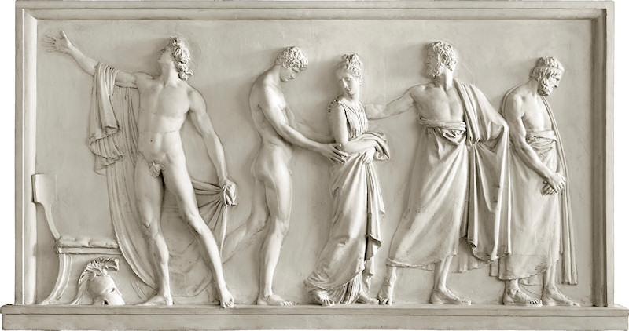
Achilles gave his slave girl to Agamemnon, neither in good grace nor in fear of him but because he did not want to split the unity of the Greeks..........At first the incident could be interpreted as an indication of a violation of property rights. But seeing it in another way this incident can also be seen as an exception to the rule….....
Individuals had property rights to the spoils of war.

Slide 39
Property Rights vs. Possession
Private property does not arise from an evolutionary mechanism where individuals fight for the possession rival resources.
It arises from different evolutionary mechanisms that make it convenient to recognize others’ liberty and rights, as well as some forms of (initially rudimentary) collective agreements. It has properties analogous to those of other liberties and rights such as the liberty of opinion.
Property rights can also restrict human liberty in a way that possession could never do. Possession of knowledge does not exclude others’ possession of it. Private property rights can restrict this liberty.

Slide 40
Three Possible Evolutionary Stories
Tangible Things
Empathy and reciprocity
Property rights
Struggle for possession
Community enforcement and property rights
Intangible Things
Property rights
Limited possession
Un-consteded possession

Slide 41
The Hawks and dove game.
 | Hawk | Dove
Hawk | V -C 2 | V
Dove | 0 | V 2
V is the fitness increase that is obtained by winning a resource.
C is the cost of a fight.
(When a Hawk meets a Hawk is has 50% prob of winning
the resource and 50% prob of being injured.)

Slide 42

The All Hawks
Equilibrium
An evolutionary stable strategy (EES) cannot be invaded by a small number of players with a different strategy (otherwise it cannot last for long). It is immediately evident that a pure strategy of uncontested possession (all doves) is impossible because the pay-off E(D,D) which doves obtain when they meet each other is less than the pay-off E(H,D)that a hawk obtains when meeting a dove, or:
E(D,D)< E(H,D)
Thus, a pure dove strategy cannot be an EES. When introduced into a world of all doves, a few hawks (or even better one hawk) have a great time!
By contrast, hawk behavior is the only possible strategy when the risk of injury is more than offset by the benefits of the resource. When 1/2 (V-C) > 0 or when V > C, no group of invading doves can do better than the hawks.

Slide 43

Some room for doves
There is only one over-emphasized case in which some dovish behavior can emerge. This occurs when the cost of fighting is greater than its benefit or when C > V. In this case, both hawkish and dovish behaviors are viable. The two behaviors yield the same expected benefits when P (the probability of meeting a hawk) is such that:
P E(H,H) +(1-P) E(H,D) = P E(D,H) + (1-P)E(D,D)
where the left side expresses the expected benefit of hawks and right side expresses the expected benefit of doves. Or referring to the payoff matrix:
1/2 (V-C) P + V (1-P)= 1/2 V(1-P)
1/2 (V-C) P + 1/2V (1-P) = 0
PV –PC + V- PV = 0
P = V/C
In other words, if fighting involves costs greater than the benefits accruing from the possession of the resource, successful hawkish behavior requires that there are some doves to be exploited.
The fraction of hawks will be equal to the ratio (less than 1) between the value of the resource to be possessed and the cost of fighting.

Slide 44

Bourgeois Behavior
Individuals can increase their fitness if they can assess the hawkish or the dovish nature of their opponents and behave as doves with hawks and as hawks with doves.
They can do even better if they adopt a convention whereby they behave as hawks when they are already in possession of a resource and as doves when somebody else is in control of the resource or, in other words, if they adopt a “bourgeois strategy”.
This conclusion is used to justify the claim that some bourgeois behavior may emerge among animals. In this perspective, according to Maynard Smith, property rights are a natural evolution of the possession struggles existing in nature within several species.

Slide 45
From possession to property?
Dovish behavior can only emerge when the cost of fighting is greater than the value of the resources.
This is unlikely to be the case for many valuable resources.
It is even more unlikely when the different animals are characterized by different strength and fighting capacity.
Tangible Things
Struggle for possession
Property rights

Slide 46
In other words even Achilles is not an hawk!
He can only appeal to mom Thetis.
The role of the Eagle is taken by two old heralds!
Achilles has a property right on Briseis and not a possession to be defended by hawkish behavior.

Slide 47
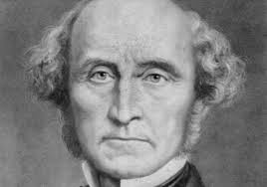
Private Property and Liberty
One can argue that their private property is only one of the sphere of action where individuals can exercise their liberty without the interference of other individuals or the State.
According to J. Stuart Mill, liberty was not a gift of a human nature and even less an attribute of wild animals. It was a late conquest of civilization protecting a sphere of individual sovereignty from authoritarian regimes and democracies.
Mill argued, “The only part of the conduct of anyone, for which he is amenable to society, is that which concerns others. In the part, which merely concerns himself, his independence is, of right, absolute. Over himself, over his body and mind, the individual is sovereign.” That is, in this case his property rights cannot be disputed!
According to Mill , “Liberty as a principle, has no application to any state of things anterior to the time when mankind have become capable of being improved by free and equal discussion. Until then, there is nothing for them but implicit obedience to an Akbar or a Charlemagne, if they are so fortunate to find one”.

Slide 48

Liberty of opinions
L1) Liberty of unexpressed opinions.
B (Beatrix) has full liberty over her own unexpressed opinions and feelings. A’s (Adrian’s) exposure to Beatrix’s unexpressed opinions does not give him the right to force Beatrix to change her opinions for the simple reason that they do not affect him. This can only happen if he investigates what is going on in her mind, thus violating her privacy. A has no right to force B to alter her opinions and feelings.
L2) Liberty of expressed opinions (not instigating harmful action)
Adrian may be affected by the opinions that Beatrix expresses or even publishes. He is exposed to B’s liberty of opinion and may suffer because of her views. As long as B’s opinions do not instigate harmful actions, A has no right to limit B’s liberty.
L3) Liberty of expressed opinions (instigating harmful actions on others)
If Beatrix expresses opinions instigating violent actions against Adrian. The liberty of B should be restricted. It is unfair that A is exposed to B’s behavior. A has a right to restrict her expression of such aggressive opinions. B has a duty to comply with the implications of this right and no liberty to continue to express opinions instigating harmful actions.

Slide 49

Liberty in Hohfeld’s Jural Relations
We can express the problem in terms of the legal relations considered by Hohfeld. With a simple scheme, Hohfeld expressed the idea that the boundary between RA (the rights of A) and EA (the exposures of A) must coincide with the boundary between DB (the duties of B) and LB (the liberties of B).
L1 and L2 pertain to LB, which implies that the corresponding duties D1 and D2 to refrain from these liberties are not part of DB. This also entails that Adrian’s EA set does not include E1 and E2, which are the exposures to Beatrix’s liberties L1 and L2.
Adrian’s RA set includes R3, i.e. the right not be exposed to Beatrix’s liberty to express opinions instigating harmful actions against him. DB comprises the duty D3 not to express those opinions. Beatrix lacks the liberty L3 to do so.
Rights of A (RA): R3 | Duties of B (DB): D3
Exposures of A (EA): E1, E2 | Liberties of B (LB): L1, L2

Slide 50
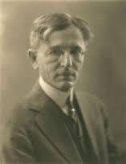
Commons on Morality and Law
If Beatrix and Adrian shared a system of common ethical values, Adrian’s boundary between RA and EA would be perfectly correlated to Beatrix’s boundary between DB and EB.
However, Commons added that "There is, however, a difficulty with these ethical mandates. They are mental processes and therefore as divergent as the wishes and the fears of individuals. Hence, when they emerge into action they are individualistic and anarchistic. They are unrestrained in action by an actual earthly authority to whom each party yields obedience.
For this reason, according to Commons "It seems that the only procedure that will correlate the wishes and fears of each and prevent anarchy is to resort to a third person of an earthly quality whom each consents to obey, or each is compelled to obey."

Slide 51

Powers of Adrian and
Immunities of Beatrix
When enforcement agents – typically State officials – perform their tasks efficiently, Adrian’s rights involve enforcement powers π3 of his rights R3 corresponding to a liability λ3 of Beatrix to perform her duties D3.
Also private citizens have powers. For instance, Adrian may have the power to sell membership of a club to Caesar, and Beatrix, who is also a member of the club, suffers because she does not like Caesar. However, Beatrix may have no immunity against Adrian’s power and she is liable to suffer the consequences of his decision.
Powers of A (πA): π3 | Liabilities of B (λB): λ3
Disabilities of A (δA): δ1, δ2 | Immunities of B (ιB): ι1, ι2

Slide 52

Property as a bundle of rights
The fact that the relations defining private property apply erga omnes (no particular person is a well-identified counterpart of the owners) may give the false impression that private property is a relation between a person and a thing and not among persons. Numerous first-order and second-order legal relations are entailed by the existence of private property.
The private property of a thing involves:
the liberty to decide how to use it,
the right to exclusive access,
the power to sell it to others,
the immunity against others altering the title of ownership.
These relations are general characteristics of legal positions among people and therefore apply as a particular case to private property.
But where does the reciprocal recognition of rights, duties, power and immunities come from?

Slide 53
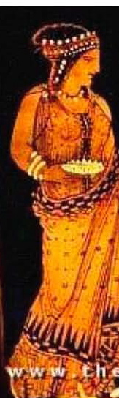
The Classical Hypothesis: Harmony’s Fate.
Harmony was given as bride to Cadmus the founder Thebe who had saved Zeus from the monster Tifeus.
Her own fate and Thebe’s fate show that her mission was a failure and originated the great tradition of Greek tragedy.
She was the daughter of the God of Love and of the God of War and embodies the idea that Harmony required both Love and War.
The solidarity of communities should co-evolved and in some sense it was a product of war and hate.
Harmony was a Goddess of Parrochial Altruism!

Slide 54
The Classical hypothesis:
From War to Love.
Human cultural differentiation allowed an unlimited possibility of waging wars.
Intra-group love was stimulated by intergroup hate.
Wars allowed group selection favouring groups that were characterized by internal harmony.
War generated human harmony, human gender relations and human love together with hate..
Questions: No harmony without wars?
No love without hate?

Slide 55
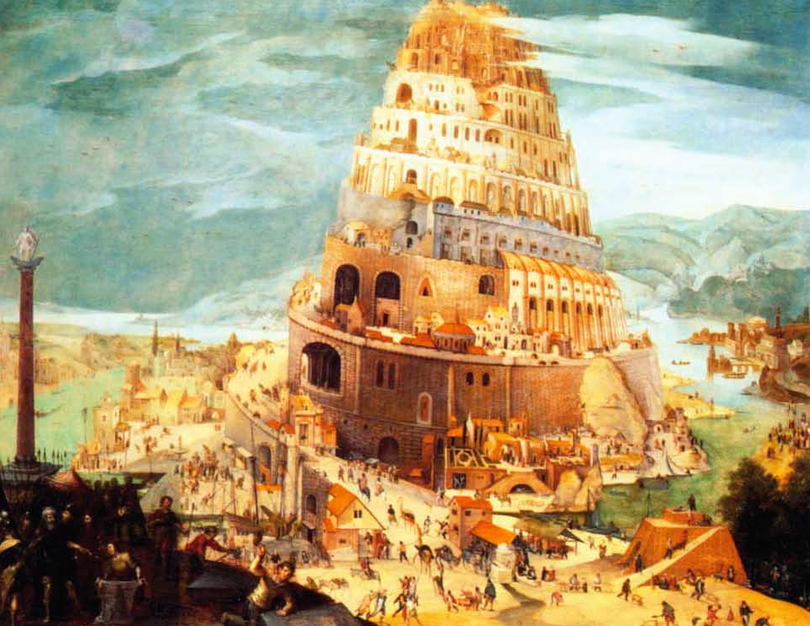
The Biblical hypothesis: Babel Tower.
Now the whole world had one language and a common speech.
They used brick instead of stone, and tar for mortar. Then they said, "Come, let us build ourselves a city, with a tower that reaches to the heavens, so that we may make a name for ourselves and not be scattered over the face of the whole earth."
The LORD said, "If as one people speaking the same language they have begun to do this, then nothing they plan to do will be impossible for them. Come, let us go down and confuse their language so they will not understand each other."

Slide 56
The Biblical Hypothesis:
From Love to War.
In the Babel Tower Story Communication, love and cooperation are given before cultural differentiation and wars. The pre-existence of human culture (and of large human brain) allows later cultural differentiation and wars.
The development of human nature (perhaps linked to the forbidden fruits of knowledge and love) is the prerequisite of a human elementary culture (but far more advanced than the culture of the other species) which in turn can generate cultural differentiation and wars.

Slide 57


The Peacock Tail Tax and the Human Brain Subsidy
Sexual selection has effects on natural selection.
One well-known case is the growth of the peacock tail which imposes a tax for the species in terms of its successful adaptation to the environment.
However, in cases of complementarities, sexual selection can give a subsidy to one particular characteristic and help to unfreeze epistatic interactions.
This last case is relevant for the development of human intelligence.

Slide 58
Sex in the brain.
(Hodgson, Journal of Bioeconomics 2014)
monitoring
cost
Human Gorilla Chimp
intensity
of fertility
signal

Slide 59
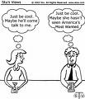
A Sexual Subsidy to Human Reciprocal Intelligence.
Because of concealed ovulation, exclusive access could only be gained by long term relations, which, in hunting and gathering societies, required women’s cooperation. Unlike other female primates, women had some bargaining power, including the possibility of exchanging exclusive access for parental care or other benefits.
Long term deals require articulated languages, emotional and rational understanding, social and political skills and the ability to show some moral virtues such as commitment and loyalty.
The human fertilization system gave a sexual subsidy to the “infant industry of our intelligence”. The positional advantage that intelligence gave in sexual selection allowed us to overcome the public good and complementarities problems that impeded its development.

Slide 60
From property to possession
The simple primary rules from which a sophisticated system of private property evolves should not be confused with those that allow some dovish behavior concerning possession.
The primary rules from which the higher-order rules evolve already contain elements of reciprocity, involving some degree of respect for other individuals.
They may be rules such as (quasi-)monogamy. A society which has evolved relations of this type can respect the property of others in the same way as it considers it to be a (quasi-)duty not to steal other individuals’ sexual partners, or to respect their liberty of opinion.
Empathy and reciprocity
Community enforcement and property rights
Uncontested possession

Slide 61

Advantages of private property
Let us make the heroic assumption that we are in a zero-transaction cost world where we have a market for each level and type of use of each resource. While this world is characterized by Pareto optimality, it looks like a nightmare! We have to make transactions with others for such personal things as rearranging our furniture or changing the color of our bedroom wall!
When we remove the assumption of costless and complete markets, the inefficiency of this solution (and its limitation of individual liberty) is evident. It is obviously better to give each agent the liberty to change the uses of a resource in all circumstances when nobody else is exposed to the consequences of those changes. Private property entails precisely this liberty
Whenever individuals re-arrange the uses that they make of their private property (for instance their furniture), they are increasing their welfare without decreasing the welfare of others.

Slide 62

Private property for rival goods.
In the case of rival goods, the liberty entailed by private property increases the liberty of one individual without the rights of others. This is a case analogous to the L1 case (liberty of unexpressed opinions) considered by Mill.
Like the liberty of expressing opinions, also the liberty of utilizing an object can be allowed even in cases when it gives a limited disutility to other individuals. If this disutility is sufficiently small, the transaction costs to be sustained to take others’ preferences into account are likely to be greater than their benefits.
Within certain limits, the exercise of liberty granted by private property has the same beneficial effects as the liberty to express opinions. Property rights allow uncontested possession for goods having rival uses and gives everybody a liberty to choose among uses that has no or little consequences for others.

Slide 63

Private Property for non-rival goods
The situation is very different for non-rival resources. In this case, the nature and the intensity of each use is not rival to alternative uses. Simultaneous possession by all is possible, and individual exclusive possession is impossible without a sophisticated system of property rights. The fact that Adrian is controlling and using its piece knowledge does not stop Beatrix from controlling and using that same piece of knowledge.
By contrast, exclusive or private property of knowledge is possible. It requires that only one agent has the liberty to use knowledge for certain purposes while all the others have a duty not use knowledge for those purposes without the agreement of the owner and have to buy this liberty from the owner of the knowledge, who has the power to make or not to make this transaction.
Private property rights create an intangible thing, or a fictitious commodity which is the limitation to others to use the knowledge that they posses.

Slide 64
From property to things
Property does not necessarily evolve from the struggle on the possession of things. It can allow the uncontested possession of things but it does not even require their pre-existence.
Since property rights are relations among individuals, property can create intangible things or fictitious commodities that express a re-arrangement of the rights – duty relations.
Property rights define the things to be owned. The things to be owned cannot help the definition of property rights because they do not exist independently of them. Intellectual property rights are fictitious commodities that limit the universal possession that is possible for these goods.
Property rights
Intangible Things
Limited possession

Slide 65
Non rivalry, Possession and Property
 | Rival | Non-Rival
Possession | Low liberty, High Transaction Costs | High liberty, Low Transaction Costs
Private Property | High liberty, Low Transaction Costs | Low liberty, High Transaction Costs
In the case of a non-rival good, the transition from unlimited possession to private property has effects opposite to those that it has for rival goods. For non-rival goods private property decreases the liberty of all the individuals different from the owner and increases transaction costs.

Slide 66
Property rights can create the things to be possessed
Tangible Things
Empathy and reciprocity
Property rights
Struggle for possession
Community enforcement and property rights
Intangible Things
Property rights
Un-contesded possession
Limited possession

Slide 67
Conclusion
The evolution from struggles about possession to property rights without any form of collective enforcement .
Because of specific forms of sexual and group selections humans have evolved forms of empathy and reciprocity that have created a framework of liberties, rights and duties. In this framework private property and, as a consequence, forms of uncontested possession for rival resources can emerge.
Property cannot only determine un-contested possession but also define artificial things that limit universal possession of the assets.
The first quasi-evolutionary story cannot show the emergence of private property from unbounded possession struggles
The second two evolutionary stories involve a substantial inversion of the argument: property rights is at the origin of un-contested possession of rival goods and also at the origin of things limiting possession of non-rival goods.

Slide 68
Marx had a unitary theory of historical development
Productive
Forces
Relations
of Production
Productive
Forces
Relations
of Production

Slide 69
Marx had a unitary project of transforming society
Capitalism
Early Stage Socialism
Full-Blown Communism

Slide 70
Marx divided: the two “Marx Brothers”
This division is only an ex-post artificial construction motivated by 3 points.
1)The two-stage transformation, advocated by Marx, of society has lost its credibility and Marx appears to have two distinct and contrasting projects.
2) The primacy of productive forces can be questioned and the interaction between the two flows of causation should be re-considered.
3) The distinction between the two Marx helps a re-assessment of his theories after NIE.

Slide 71
Marx I: primacy of productive forces and single-firm socialism
Productive
Forces
Relations
of Production
Capitalism
Early Stage Socialism

Slide 72
Marx II: biased productive forces and work as end in itself
Relations
of Production
Productive
Forces
Capitalism
Full-Blown Communism

Slide 73
The Ricardian Marx I
Like Ricardo, Marx believed labour to be objectively measurable under capitalism where workers’ preferences were not taken into account by the employers.
The measurability of labour would also hold in the early stage of capitalism and would be the basis of central planning.

Slide 74
The Smithian Marx II
Like Smith, Marx believed in the relevance of the subjective preferences of the workers for their own work and in the endogenous definition of work.
The fact that these preferences were ignored under capitalism was the basis of his criticism of the capitalist firm and were embodied in his final project of a communist society where these preferences would be fully taken into account.

Slide 75
The (half)subjective foundations of neo-classical theory
Marx has often be criticized for his Ricardian labour theory of value and his ignorance of individual preferences.
However, the neo-classical individual has only preferences for consumption goods and leisure whereas Marx, like Smith, is aware of producers’ preferences.
From this point of view, a striking limitation of neo-classical theory lies in the fact that it considers only a subset of subjective preferences.

Slide 76
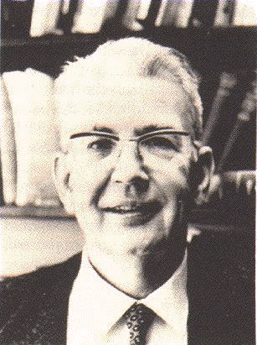
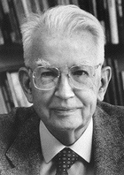
Coase vs. Coase
The Young(er) The Old

Slide 77
The Young English Socialist.
Some fifty-five years ago, in a seminal article called The Nature of the Firm, a young socialist named Ronald Coase sought to explain the existence of firms, of organizations within which markets were replaced by hierarchy and command.
In the words
of Guido Calabresi:

Slide 78
The Old American Libertarian.
Twenty-five years later, in The Problem of Social Cost, Ronald Coase, by then a middle-aged libertarian, indicated how markets could replace hierarchy and command structures to the perceived benefit of those who organized them
In the words
of Guido Calabresi:

Slide 79

Ronald’s Record
Young Ronald (1937) claims:
In a world of zero transaction costs firms would not exist. Firms exist only when market transaction costs are positive.
Old Ronald (1960) claims:
In a world of zero transaction costs (and well defined property rights) all externalities (harmful and beneficial effects) are internalised (taken into account) by market transactions. (Coase theorem)
Old Ronald (1960) also claims:
That the first statement does not contradict the second.
Diagnosis: old age schizophrenia.

Slide 80

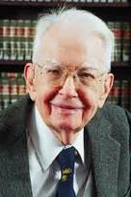
Lissening to Ronald’s reasons........
In his famous 1960 article we must get to Section 6
“The Cost of Market Transaction Taken into Account”
where he points out that:
“The argument has proceeded up to this point on the assumption that there were no cost involved in carrying market transactions.” (1960, p. 114)
"It is clear that an alternative form of economic organization which could achieve the same result at less cost that would be incurred by using the market would enable the value of production to be raised. As I explained many years ago the firm represents such an alternative to organising market transactions" (1960, p. 115).
"But the firm is not the only possible answer to this problem…. "an alternative solution is direct governmental regulation" (Coase 1960 p. 116).

Slide 81
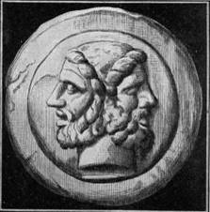
Ronald’s un-divided self.
Coase argues that the “Coase theorem” (but there is no theorem according to Coase!) is perfectly consistent with the 1937 article and they make up one unique theory. He is correct.
According the “Coase theorem”, in a world of zero transaction costs, markets can internalize all externalities. State intervention and Pigouvian taxes (and firms) are all unnecessary in that framework.
Unsurprisingly, if one institution (the market) is assumed to be costless, only two things can happen:
If the other institutions are costly, they disappear.
If the other institutions are also costless, they may co-exist but their mix cannot be a relevant economic issue.

Slide 82
Institutions as costly substitutes
New Institutional Economics has correctly emphasized that institutions are costly substitutes and that growth requires their optimal mix.
Explaining and searching for the efficient institutional mix is one of the main purposes of new-institutional economics.
However, New Institutional Economics suffers from two important limitations:
no institutional complementarities
implicit reliance on meta-institutions.

Slide 83
3
Technology and Institutions

Slide 84

The changing optimal mix of costly institutions: a Coasian example
The optimal mix among institutions is recalculated each time that the technological data change.
Coase provides an example from the ICT technology: the introduction of telephone lines decreased the costs of using both market and firms internal organizations.
However the institutional mix would stay unchanged only if the costs of using markets and firms were decreasing in the same proportion. Otherwise it would be efficiently re-adjusted in all market (?) economies.

Slide 85

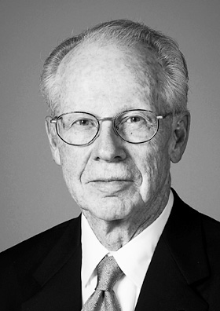
Markets!!!
“I assume, for expositional convenience, that in the beginning there was the market” (Williamson 1975:20)
“Markets and firms are alternative instruments for competing a related set of transactions…where a set of transactions ought to be executed across markets or within a firm depends on the relatively efficiency of each mode” (Williamson 1975:8)

Slide 86

Meta markets
?
NIE has overcome the narrow limits of an Economics built on the premises of costly resources and free institutions.
However its job is unfinished and contradictory:
In the NIE framework the market acts under two contradictory roles
A costly institution to be selected
The costless (meta-)institution by which all the institutions (including markets) are selected.

Slide 87
Costly institutions vs. free meta-institutions
If some meta-institutions were able to calculate the optimal institutional mix for each new technology, all economies would follow the same efficient development path.
But there are no costless meta-institutions!!! In each location, institutional change is constrained by the costly institutions within which the change should take place.
The nature of these constrains becomes clear when we introduce also the concept of institutional complementarity.

Slide 88

Institutional Complementarities
The fact that costly institutions cannot be substituted in a costless meta-institutional environment becomes even more evident when we accept the existence of institutional complementarities ( formalized by Aoki).
If institution are costly one should not only ask whether one institution may be a substitute for another, but also how the existence of one institution may influence the cost of running another institution.
Institutional complementarities limit the possibilities of institutional substitution and may make their substitution particularly costly.

Slide 89
Institutional substitution and institutional frameworks
Free meta-institutions, located in a Nirvana without institutional complementarites, do not exist.
Institutional substitution occurs in a certain moment of history and in specific locations.
The institutional substitution possibilities are limited by various factors, including the pre-existing institutions and their webs of complementarities.
Understanding institutional substitution requires a careful study of each evolving institutional framework.

Slide 90
The Coasian example re-examined
Telephone lines induce an efficient institutional substitution between markets and firms. Coase believes that firms’ size increases.
If meta-markets, internalizing all institutional complementarities, existed, the same new institutional mix would prevail in all economies . By contrast, since substitution is a real situation characterized by numerous institutional complementarities, the results will be different.
If the complementary institutions are not feasible, firms size may not increase or may increase much less.

Slide 91
Marx’ “Dynamic Coasianism”
    “The a priori system on which the division of labour, within the workshop, is regularly carried out, becomes in the division of labour within the society, an a posteriori, nature-imposed necessity, controlling the lawless caprice of the producers, and perceptible in the barometrical fluctuations of the market-prices”.
    “If one took as a model the division of labour in a modern workshop, in order to apply it to a whole society, the society best organized for the production of wealth would undoubtedly be that which had a single chief employer, distributing tasks to different members of the community according to a previously fixed rule”.

Slide 92
The neo-classical double neutrality assumption.
“In a competitive equilibrium it does not matter who hires whom” Samuelson (1957).
First neo-classical neutrality assumption:
Productive forces do not influence the typology of ownership arrangements.
Second neo-classical neutrality assumption:
Ownership arrangements do not influence the nature of the productive forces.
Both neutrality assumptions rely on another assumption:
zero transaction costs.

Slide 93
NIE: Going Beyond the First Neutrality Assumption.
In a world of positive transaction costs, the nature of the assets (i. e. productive forces), which are employed in productions, influences organizational form and ownership arrangements.
Firms’ ownership and control will tend to go to the most specific and difficult to monitor resources.

Slide 94
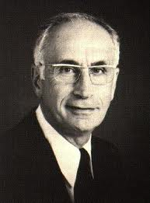
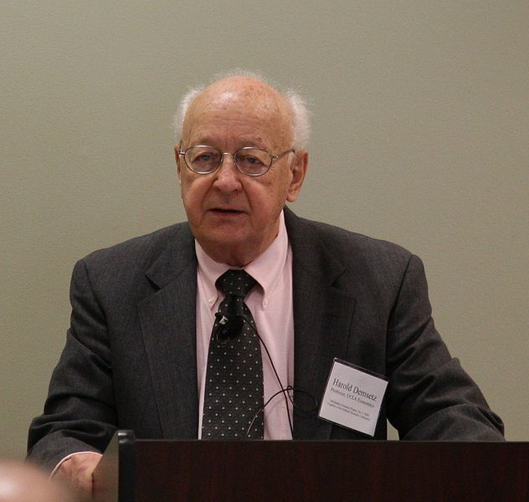
The monitoring problem
(Alchian, Demsetz)
Team work
Employer with hiring
and firing rights
Why capitalist ownership of the means of Production?
Hard to monitor
capital
Capitalist ownership
The same argument can be applied to hard to monitor labour.
Both arguments can be inverted.

Slide 95
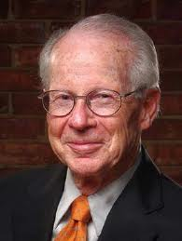
The Specificity Problem (Williamson)
Specificity, Liquidity and Irreversibility
Analogy with monitoring: rights should go to the
most specific factors.
Difference with monitoring: asset specificity cannot be defined by referring to a single relationship
Specificity, Competition and the Fundamental
Transformation.
Ex-ante competition → → → Ex-post monopoly
Two explanations of monopoly
The monopoly branch
The efficiency branch

Slide 96

Oliver Hart Model
Specificity is both absolute and a marginal. There is
more value in specific-type relations than outside it.
b) Contractual incompleteness is justified by the facts that specific investments in human capital are observable but not verifiable.
c) Agents are characterised by unbounded rationality and decide their investments in the 1th period on the basis of the anticipated bargaining of the 2nd period.
d) They exchange machines in the first period to maximise the total surplus
Some important mathematical results which clarify the differences between an economy with incomplete contracts and the standard textbook economy with complete contracts.

Slide 97
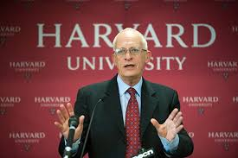
Some Hart’s results
Under incomplete contracts there is always under-investment in human capital
The investment can be reduced by assigning rights on machines to the individuals who have to make the greatest specific investment in human capital.
Independent assets should be owned separately and complementary assets should be owned together.

Slide 98
NIE and Marx I:
A similar efficiency bias?
Like Marx I, NIE comes to the idea that the dynamics of economic systems is efficiently driven by the nature of the productive forces which they employ (i. e. their monitoring and specificity characteristics).
Both theories share a view of the development of economic systems which leads necessarily to a unique set of efficient institutions:
- centralized planning, in the case of Marx I
- the “institutions of capitalism,” in the case of Oliver Williamson.

Slide 99
Marx II and a possible inversion of the NIE argument
According to Marx II, the nature of the assets (productive forces) can be endogenously influenced by property relations and organizational form.
On the basis of this suggestion, the NIE argument can be inverted: property relations and organizational form are not only the outcome of the nature of the assets but they also influence their monitoring and specificity characteristics.

Slide 100
Institutional Complementarities
The fact that costly institutions cannot be substituted in a costless meta-institutional environment becomes even more evident when we accept the existence of institutional complementarities ( formalized by Aoki).
If institution are costly one should not only ask whether one institution may be a substitute for another, but also how the existence of one institution may influence the cost of running another institution.
Institutional complementarities limit the possibilities of institutional substitution and may make their substitution particularly costly.

Slide 101
Two directions of causation
Specificity and Monitoring Characteristics of Assets
Property Rights and
Organizational Form
The most specific and difficult to monitor agents can save the greatest amount of agency costs when they control the organization.
:
:
The agents controlling the organization will tend to become the most specific and difficult to monitor

Slide 102
Under capitalist ownership, the surplus Sc of the firm is equal to:
(1) Sc = Q (k, K, l , L) - [rk + RK +wl + (H+W)L]
Under labor ownership, the surplus SL of the firm is equal to:
(2 ) SL = Q (k, K, l, L) - [rk + (Z+R)K + wl +WL]
Therefore, capitalist property rights can prevail if,
given the factors currently employed, Sc ≥ SL or, alternatively,
ZK - HL ≥ 0 (3)
Workers' property rights can prevail if, SL ≥ Sc, or alternatively,
HL - ZK ≥ 0 (4)

Slide 103
An institution of production is in organizational equilibrium when it is defined by a system of property rights P and technical assets T such that T are the optimal technology under the property rights P, and P is the property rights system that maximizes ownership surplus when the technical assets T are employed in production. Let:
(k_{c},,K_{c}, l_{c}, L_{c}) = argmax S_{c} (k, K, l, L) (5)
(k_{L}, K_{L}, l_{L}, L_{L}) = argmax S_{L} (k, K ,l, L) (6)
Then a firm will be in a capitalist organizational equilibrium (COE) if:
ZK_{c} - HL_{c} ≥ 0 (7)
and in a labor organizational equilibrium (LOE) if:
HL_{L} - ZK_{L} ≥ 0 (8)

Slide 104
If we re-arrange conditions (7) and (4) in the following ways:
K_{c}/L_{c} ≥ H/Z (7')
K_{L}/L_{L} ≤ H/Z (8')
we can see that both conditions are simultaneously satisfied if:
K_{c}/L_{c} ≥ H/Z ≥ K_{L}/L_{L} (9)
Since the relative prices of the high-agency-cost capital and labor are
(H+W)/R under capitalist ownership and W/(Z+R) under workers' ownership,
we have that:
K_{c}/L_{c} ≥ K_{L}/L_{L} (10)
(7’) and (8’) can be simultaneously satisfied,
and we can have multiple organizational equilibria when (9) is satisfied.
When (9) is satisfied, both directions of causation hold

Slide 105
Complementarities between productive forces and relations of production
The relations between productive forces and relations of production should be seen in terms of the complementarities theory advocated with particular efficacy by Mashiko Aoki.
The one way relation of Marx I and NIE
does not allow us to understand the reasons of the diversity of the institutional and technological paths, which characterizes the histories of the different economies.
We need also
the opposite direction of causation.

Slide 106
Technological and institutional paths
Suppose that:
Tx is a technological path using more intensively specific and difficult to monitor productive forces x than Ty using more intesively y.
Ix is an institutional path where control rights are assigned to the owners of assets x and Iy is an institutional path where resources are assigned to the owners of y.
The Marx I and NIE arguments can be then re-stated by saying that the selection of Tx (instead of Ty) in the technological domain favours Ix relatively to Iy in the institutional domain.
The Marx II argument can be re-stated by saying that the selection of Iy (instead Ix) in the institutional domain favours the adoption of Ty instead of Tx in the technological domain.

Slide 107
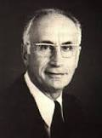

NEW INSTITUIONALISM
ALCHIAN, DEMSETZ, WILLIAMSON
Specificity and Monitoring Characteristics of Assets
Property Rights and
Organizational Form
:
The most specific and difficult to monitor agents can save the greatest amount of agency costs when they control the organization.
(NEW INSTITUTIONAL APPROACH)
:

Slide 108

Synergic complementarities: stakeholders and firms’ technical assets
Specificity and Monitoring Characteristics of Assets
Property Rights and
Organizational Form
:
The most specific and difficult to monitor agents can save the greatest amount of agency costs when they control the organization.
:
The agents controlling the organization will tend to become the most specific and difficult to monitor

Slide 109
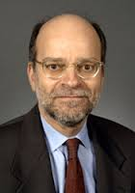

The role of politics:
Roe and Soskice
Politics influences property rights and organizational form
and indirectly technology.
Managers
Dispersed
ownership
<<<<------------------------------------
Disorganized
workers’ interests
Concentrated ownership
Organized
workers’ interests
<<<<------------------------------------
M

Slide 110

Conflictual Complementarities: different stake-hoders interactions
Managers
Dispersed
ownership
Disorganized
workers’ interests
Concentrated ownership
M
Organized
workers’ interests

Slide 111

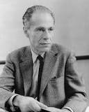
Micro-Marxism?
Stake-Holders Struggles
Conflictual Complementarities
Varieties of Capitalism
Synergic complementarities
Development of Corporate Technical Assets

Slide 112
4
Institutional Complementarities and Varieties of Capitalism

Slide 113
Institutional Complementarities and Varieties of Capitalism
Institutional scarcity involves that there are both institution substitution and complementarities within economic systems.
Because of institutional complementarities, the efficient substitution of different pieces of an economic system may be impossible and there is no necessary convergence to a single system.
Institutional change is always constrained by past history and there are no costless meta-institutions where institutional change can take place.
Different forms of social organizations and different types of divisions of labor are well-likely to persist over time.

Slide 114
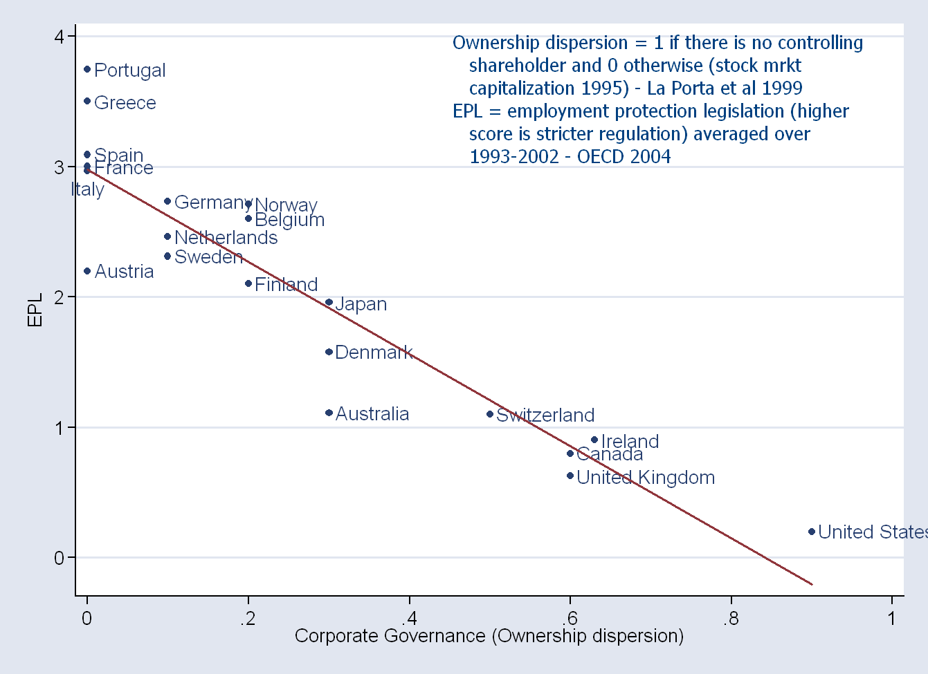

Slide 115
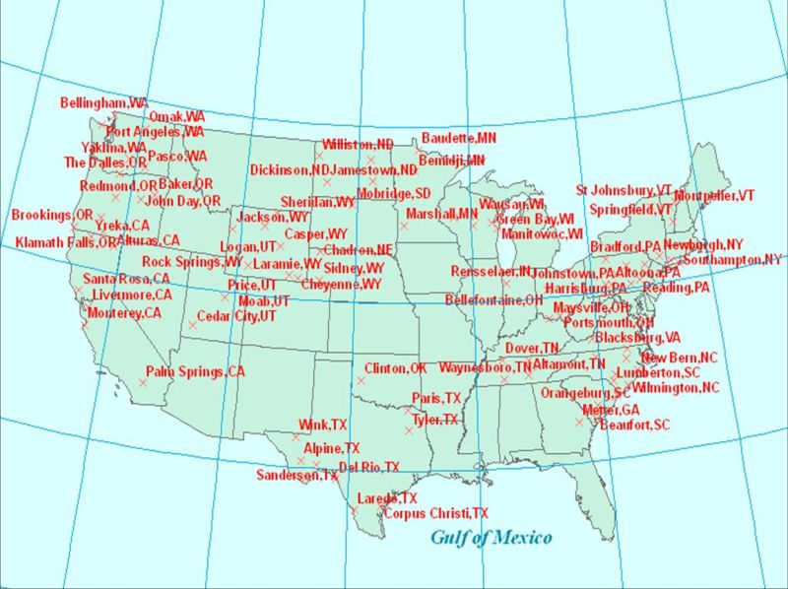
The American case
In the U. S large firms were made possible by numerous institutional complementaries including:
Because of the myth of the self-made man, American industrial dynasties were unstable. Landed aristocracy had lost its privileges at the time of the second industrial revolution.
Democratic politicians opposed concentrated economic power. They enacted anti-trust and taxation laws, making it impossible to control big firms with a little share of capital. Dispersed share-holding was favored.
It was also favored by complementary institutions such as a good judicial system, stock exchange supervision, press relatively independent from other business and an efficient federal-managed bankruptcy law (chapter 11).
These, and other institutional complementarities, allowed the emergence of big managerial public companies that substituted smaller family-controlled firms.

Slide 116

Diverging institutional paths: the U. S.
- The greater permeability of the top jobs of the American corporation contributed to make class divides acceptable and made the American Unions weaker than those existing in Europe.
Because of the weakness of the Unions, the administration of the corporation could be delegated to managers without fearing that they would be “captured” by the workers.
Big firms with dispersed share holding and weak workers organizations became the typical U. S. organizational equilibrium.
A new institutional complementarity between dispersed share holding and weak unions had emerged and involved new synergic complementarities.
Managerial hierarchies and firms’ size were not limited by the owners’ interests to control the firm.
Managerial skills became important difficult to monitor and specific corporate assets. In many cases they replaced the corresponding skills of owners and workers.

Slide 117
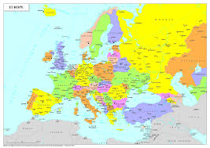
The European cases
In Europe the complementary institutions for very large firms did not exist:
Since parvenus were despised, industrial dynasties were stable. Landed aristocracy was still powerful at the time of the second industrial revolution.
Democratic politicians were weak and most monarchies still powerful. Institutions favored the control of large firms by minority block-holders that concentrated their assets in few firms.
Most other complementary institutions (judicial system and stock exchange supervision, independency of the press and efficient bankruptcy ) were missing or underdeveloped.
The size of private firms was limited by dynastic control. When these size limits were a serious problem for economic development, Europe had often to rely on state-controlled enterprises.

Slide 118

Diverging institutional paths: Europe
The impermeability of the top jobs of European firms reinforced class divides and made the Unions stronger.
Because of the strength of the Unions, the administration of the corporation could not be delegated to managers because the owners were fearing that they would be “captured” by workers.
Firms, smaller than their U. S. counterparts, with concentrated share holding and strong workers organizations became the typical European organizational equilibrium.
A new institutional complementarity between concentrated share holding and strong unions had emerged and involved new synergic complementarities.
Managerial hierarchies and firms’ size were limited by the owners’ behavior willing to control the firm.
Managerial skills could not become important difficult to monitor and specific assets. In most cases this role was taken by concentrated owners and organized workers.

Slide 119


The British Metamorphosis
(I): from concentrated equilibrium to disequilibrium.
At the time of the second industrial revolution, aristocratic influence, early unionization and a deep sense of class division made Britain a typical case of concentrated equilibrium.
However, transmission and division of inheritance, coupled with the international role of the city produced a dispersion of property.
In seventies the UK was characterized by a situation of "institutional disequilibrium" where the traditionally well-organized British unions were not matched by a countervailing centralization of firms' ownership.

Slide 120


The British Metamorphosis
(II): from disequilibrium to dispersed equilibrium.
This institutional disequilibrium coincided with a crisis of the British economy . For some time, "continental solutions" (such as pyramids and cross-share holding on one side and some "responsible" centralization of union's activity on the other) seemed to have a chance to prevail (Franks, Mayer, Rossi 2005).
These "continental solutions" were, however, opposed by the city. Eventually the Thatcher government made a sharp move towards a dispersed type of institutional equilibrium, characterised by strong limitations of unions' activities and by a (much advertised) shareholder popular capitalism.
These arrangements have not been substantially reversed by the subsequent Labour Party governments.

Slide 121

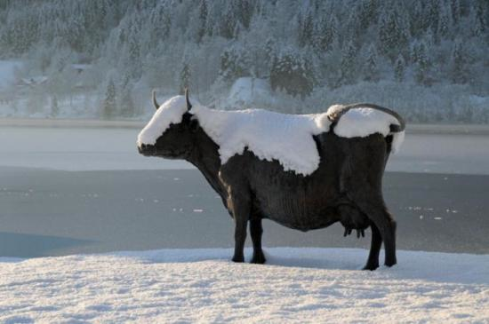
Switzerland: an Alpine America?
There are remarkable similarities between U. S. and Switzerland. Both countries came to an early tolerance of religious and ethnic diversity. The "cement of society" relied more on shared values and ways of life than on ethnic or religious homogeneity.
Also Switzerland achieved an early definitive exit from aristocratic privileges (in 1847). Swiss feudal ties were traditionally weak. The peasants were difficult to dominate because they were often far away on the Alpine pastures and because they were well trained in military activities (serving, often, as the most valuable mercenaries all around Europe).
Like the U. S., at the time of the second industrial revolution, Switzerland had a robust democracy and satisfied the conditions to realize a “dispersed equilibrium”.

Slide 122

The sad fate of the “Italian Recipe”
In the 80ties the Italian Model seemed to be the best recipe to overcome the crisis of Fordism and to move to the “new knowledge economy.
Italian districts were glorified as the institutions where common knowledge could be shared, improved and used productively by small and flexible firms.
After two decades almost everyone in Italy is complaining about the fact that the “nanismo” of the Italian firms is a serious handicap for the development of the country.
Good institutions have become bad institutions!
Why? In the meantime the knowledge economy had undergone through an impressive metamorphosis and become a very unfavorable environment for the small family-owned Italian firms. But this is a problem that we will consider later in our course…......

Slide 123
5
Divisions of Labor

Slide 124
The division of labor
1) How do markets and non-market organizations
influence the division of labor?
2) What are the advantages of the division of labor?
3) What is different between in the division of labor
between capitalism and other economic arrangements?
4) Which are the differences among different
models of capitalism in organizing the division of labor
5) What are the consequences of reinforcement
of Intellectual Property on the international division
of labor

Slide 125
The market and the division of labour.
According to Smith the market is the ultimate cause of the division of labour and its size limits the extension of the division of labour.
However, as Marx and Coase pointed out some years later, firms have a division of labour without exchanges. Moreover in primitive and agrarian societies there is a sophisticated division of labour but there are very underdeveloped markets.
So, what is the link between specialization and market economies?

Slide 126
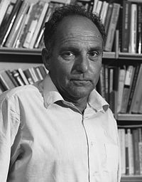
According to Gellner,
Markets may inhibit the extent of the division of labour.
High job mobility, that is typical of markets, implies that acquiring job specific skills may be more dangerous under capitalism than in agrarian societies. How is this problem overcome?
Here the role of cultural standardisation and of nationalism becomes very important.

Slide 127


Agrarian vs. Industrial Societies.
Agrarian societies:
Horizontal and vertical cultural and linguistic diversity are a product and a cause of social and economic immobility.
Linguistic/cultural diversity and socio/geographical immobility are complementary elements of a very stable institutional equilibrium.
Industrial societies:
Horizontal and vertical cultural and linguistic standardisation are a product and a cause of social and economic mobility.
Linguistic/cultural homogenization and socio/geographical mobility are complementary elements of a very stable institutional equilibrium.

Slide 128
Institutional Equilibrium of the Agrarian Society
----> Economic stagnation ---->
No structural changes ---->
Immobile division of labour ---->
Vertical and horizontal cultural differentiation
(no nationalism) ---->
No reward for productive effort and innovation ---->
Economic stagnation ---->

Slide 129
Institutional Equilibrium of the Industrial Society.
----> Economic development ---->
Frequent structural changes ---->
Mobile division of labour ---->
Social mobility and cultural
homogenisation (nationalism) ---->
Rewards for productive effort and innovation ---->
Economic development ---->

Slide 130
Stable Institutional Equilibria:
Agrarian Society
Social and Economic Immobility
Horizontal and Vertical Cultural Diversity

Slide 131
Stable Institutional Equilibria:
Industrial Society
Social and Economic Mobility
Horizontal and Vertical Cultural Standardisation

Slide 132
Transition from agrarian to industrial societies
It requires a marriage between a State (a potential
National State) and a High Culture to be spread on the
majority of the population.
Ideal initial conditions (France and England):
a single State ruling on a territory with a shared view of the dominant high culture.
Italy and Germany: a groom (National State) for a bride (a high culture).
Belgium and Switzerland: symmetric cases?
The difficult Balkans: no groom and no bride?

Slide 133
Political conditions and cultural- linguistic differentiation
 | Loyalty to a political unity | No Loyalty to a Political unity
Homogeneous language and culture | A Early National States (France, Engl) | B Struggle for National Unity (Italy, Germany)
Non-homogeneous language and culture | C Multilingual multicultural National States. (Switz., Belgium) | D Ethnic conflict, ethnic cleansing (Jug., India-Pak, Turkey-Greece)

Slide 134
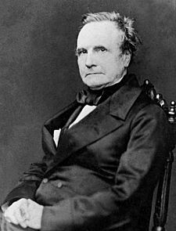
Babbage: a Principle of the division of labour.
"That the master manufacturer, by dividing the work to be executed into different processes, each requiring different degrees of skills or force, can purchase exactly that precise quantity of both which is necessary for each process; whereas, if the whole work were executed by one workman, that person must possess sufficient skill to perform the most difficult, and sufficient strength to execute the most laborious, of the operations in which that art is divided."(Babbage, 1832 pp.137-8).

Slide 135
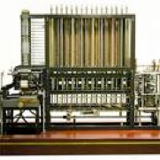
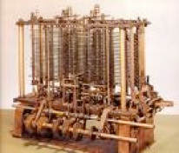
According to Babbage
The division of labor entails:
- the exploitation of the principle of comparative advantage (because it allows each individual to perform only that activity in which she is comparatively more gifted).
- a dramatic saving of training time.
If each worker is performing all the tasks necessary for a certain productive process , then all workers must learn all these tasks.
By contrast if a very detailed division of labour happens to be introduced, and each worker is assigned only one task, then she obviously has to learn only that task.
The principle can also be applied to intellectual work
and even after the introduction
of Babbage’s calculating engine.

Slide 136
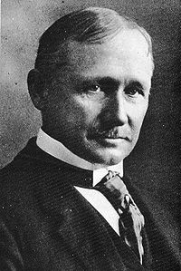
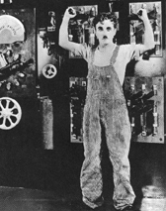
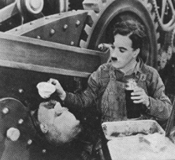
F. Taylor’s Scientific Management
Braverman (1974) pointed out how the three main principles of Taylor's "scientific management" implied respectively:
a) the dissociation of the labour process from the skills of the workers
b) the separation of conception from execution
c) the use of management's knowledge of the productive process to plan and control each step of the productive process.
In this respect "Taylorism" can be considered as a detailed set of corollaries of the Babbage principle.

Slide 137
Hierarchy and the firm
The Gioia-Babbage principle gives powerful reasons for the relative efficiency of an authoritarian and detailed division of labour. It offers a normative justification for the hierarchical structure of the firm: hierarchies increase productivity, and therefore human welfare, because they save on the learning necessary to acquire new skills and use more efficiently given skills because of the principle of comparative advantage.
Command giving and taking save on training costs.
Firms exists because the evaluation of command is costly?
(Indeed, the great informational advantage of command is that you do not have to evaluate it)

Slide 138
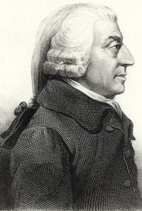
Adam Smith’s principles of the division of labour.
The difference in skills more a consequence than a cause of the division of labour. There is little comparative advantage to be exploited before the introduction of the division of labour. The differences in skills arise as a consequence of the introduction of the division of labour.
Smithian principles of the division of labour: improved dexterity, saving of time otherwise spent on changing occupation, and invention of machines by workmen. Specialization favours the acquisition of job-specific skills.

Slide 139
Smith vs. Babbage.
Babbage concentrates on the advantages due to an optimal utilization of given skills
Smith: the advantages of the division of labour due to a better acquisition of new skills,
Babbage: the division of labour increases productivity because it minimises the amount of learning which is required for doing.
Smith: the division of labour increases productivity because it maximizes the amount of learning acquired by doing.
For Babbage: the learning necessary for the doing should be minimized
For Smith: the learning due to the doing should be maximized.

Slide 140
Time profile of Smith and Babbage principles.
The benefits of the Babbage principles is different occur immediately by reducing the training time
The Smithian principles take more time. They occur after that the workers have acquired additional skills because of the learning by doing process.
Overall optimization problem of productivity over time often involves some compromise between the degrees of specialization suggested by the Babbage and the Smithian principles.

Slide 141
Degrees of specialization.
The Smithian principles involve a less detailed division of labour than that which the Babbage principle does.
Increases in specialization decrease the learning required for doing certain activities, but, after a certain point, they may also inhibit the future advantages to be gained from the learning by doing process. In this case enlarging the job may be a way of exploiting the Smithian advantages.
Work satisfaction (also enphasized by Smith) points in the same direction.

Slide 142
Babbage-type and
Smith-type workers
Up to now we have spoken in terms of an “optimal” degree of specialization involved by the two principles.
In actual market economies some workers enjoy the Smithian advantages of learning by doing and others are employed in such a way to minimize training time.
In the global economy this has also become often a distinction between workers of core industrialized countries and of third world countries.

Slide 143
Knowledge and specificity
The relation between knowledge and specificity is particularly complex. Here we focus on only two features:
(1) Each piece of knowledge is unique and increases its value when used together with other pieces of knowledge.
(2) Each piece of knowledge is a non-rival good and can be used simultaneosly by many people for an infinite number of times.
Because of (1), when knowledge is privatized, it becomes a great source of specificity.
Because of (2), when knowledge is used intensively and used as a public good, the overall intensity of specific assets is likely to decrease.

Slide 144
The knowlege struggle
1) 1800-1860 Skilled workers had no fiduciary responsibility.
2) 1860- 1890 Development of Trade Secrets as a Obligation of Employment and the Use of Contracts to control knowledge.
3) 1890 -1920 Breach of Trade Secret as a misappropriation of property automatically forbidden by the employment contract.
“In enforcing contracts first, only if they were express, and later by recognizing such contracts as implied-to maintain secrecy of the employer's methods, courts created a new species of "intellectual" property at the expense of older notions of artisanal independence. This was undoubtedly a case of "creative destruction" of one form of economic privilege to create another-the corporate intellectual property.” (Fisk, 445).

Slide 145
The code of Capital
Three attributes transform ordinary assets into capital assets: priority, universality, and durability.
Priority gives the holder of capital a superior right over others. It operates like an ace in a game of cards.
Universality ensures that the priority right will be upheld against anybody; it extends priority in space.
Durability insulates capital from a range of creditor claims; it extends priority in time.
Each of these attributes strengthens capital relative to other assets, but the key attribute for amassing wealth over time is durability.
(Katharina Pistor, forthcoming book)

Slide 146
Trade secrets vs. IPR
Even if trade secrets can be seen as a primitive form intellectual property they cannot be included among capital assets because they lack the attributes of priority, durability and universality which characterizes IPR.
1) The holder of a trade secret has no priority towards other holders of trade secrets. Unlike the case of IPR his right is not like an ace in a house of cards.
2 )The right to enforce trade secrets is not universal. It holds only against individuals who got the knowledge from the person who developed the technology. By contrast the universality of intellectual property rights ensures that priority can be upheld against anybody.
3) Trade secrets are not durable. They can expire at any moment in time when the technology is available in the public space. By contrast, IPR have a durability of 20 years (usually for patents) which is longer than most other tools used in production.

Slide 147
The US Tayloristic model
(P_{A}): A distribution of rights that gives shareholders and management strong liberties including the liberty to fire easily the workers.
The workers are exposed to this liberty and have no right to a well-defined occupation or to some generic job within a certain firm.
The firm can be traded as a commodity and takeovers often imply that the implicit contracts of the workers can be easily broken by new management.
(T_{A}): The centralization of knowledge in the hands of management and top-down co-ordination and innovations; workers at the bottom of the hierarchy perform very detailed jobs and have to execute very narrow and rigid instructions.

Slide 148
The Tayloristic model as an organizational equilibrium
P_{A ----->} T_{A}
Weak rights decrease the intensity of Labour as a high-agency cost factor.
T_{A} _{----->} P_{A}
Because workers tend to be low-agency-cost factors they rarely have organizational or occupational rights.
Self-reinforcing organizational equilibrium:
_{----->} P_{A ----->} T_{A ----->} P_{A ----->}
The U. S: a. Market-led economy?
(i) market for low-skilled jobs
_{(ii) market for companies.}

Slide 149
The Japanese Model.
(P_{J}): A distribution of rights limiting some shareholders and management liberties including the liberty to fire the workers who hold the right to a job of unspecified nature in the organization. Main banking and cross-shareholding isolate the firm from the stock exchange and protect the workers implicit contracts from the risk of take-takeovers.
(T_{J}): The decentralisation of a great deal of knowledge and some bottom-up co-ordination and innovations; workers have to rotate among different jobs and acquire remarkable firm-specific jobs as well as an overall vision of the way in which production could be improved.

Slide 150
The Japanese Model as an Organizational Equilibrium.
Also here:
_{----->} P_{J ----->} T_{J ----->} P_{J ----->}
P_{J ----->} T_{J}
Because workers have rights in the organization some agency cost (monitoring and specificity risk) are "cancelled". This biases the technology towards a high intensity of high-agency-cost labour.
T_{J ----->} P_{J}
Because the technology is intensive in high-agency-cost workers (very specific and difficult-to -monitor), more agency costs can be "cancelled" by giving them rights in the organization.

Slide 151
The German Model: property rights
(P_{G}): A distribution of rights limiting some shareholder and management liberties including the liberty to organise some aspect of the division of labour and of job specification.
Unions and employers' associations acquire the right to interfere with the organization of production of each single firm.
Co-determination with union representatives hold for the firms with more than 200 employees. Banks have an important in corporate governance through credit, direct acquisition of shares and proxy voting, they make it very difficult hostile take-takeovers and their presence in many board of directors favours the co-ordination among firms.

Slide 152
The German Model: Technology.
(T_{G}): The decentralisation of a great deal of knowledge and some bottom-up co-ordination are also a characteristic of the German system; jobs are standardised across firms and workers can change organization finding equivalent occupational slots in the different firms that share a similar division of labour.

Slide 153
The German Model as an Organizational Equilibrium
P_{G}----> T_{G}
Occupational Rights bias technology toward firm-general-purpose but occupational specific rights.
T_{G} ----> P_{G}
A technology intensive of occupational specific rights makes it convenient to decrease the agency costs of occupational skills through the attribution of occupational rights

Slide 154
Rigidity and Flexibility
_{American Capitalism:}
organizational and occupational flexibility.
_{Japanese Capitalism:}
organizational flexibility and occupational rigidity
_{German Capitalism:}
organizational rigidity and occupational flexibility
Occupational rigidity
Organizational flexibility
Organizational rigidity
Occupational flexibility

Slide 155
6
Power and Wealth

Slide 156
Introducing Positional Goods.
Hirsh (1976) argued that positional goods pose social limits to growth. While some goods could be produced in unlimited quantities, other goods were only available in limited supply and related to the relative positions of the individuals.
Under the umbrella of positional goods Hirsh included two types of goods:
1) goods limited by natural scarcity
2) goods limited by social scarcity like power an status (Veblenian goods).
We will concentrate on this second “Veblenian” category of goods. Unlike the first, it requires an extension of the standard space of economic goods .

Slide 157
Public and Positional Goods
Pure private goods: other individuals consume a zero amount of what each individual chooses to consume.
Pure public good: each agent consumes the same positive amount consumed by other agents.
Pure positional good: given the consumption choice of an agent, other agents must consume a corresponding negative amount.
Sociological goods Traditional economic goods
-1 ---------------------------------------- 0 --------------------------------------------- 1
Pure positional Pure private Pure public

Slide 158
Two goods:
y "a-priori" private
x with many "a-posteriori" definitions given by fraction t_{ih}.
t_{ih} is the fraction of x that individuals i consumes when individual h consumes a quantity x_{h}
t_{ih} is:
equal to O in the case of private goods
positive in the case of (semi)public goods and equal to 1 in the case of pure public goods
negative in the case of (semi) positional goods and is equal to -1 in the case of pure positional goods.

Slide 159
An individual i will consume a quantity y_{i} of the private good and quantities t_{ih} x_{h} of good x.
Denote:
by µ_{i} the weight given to the utility function of individual i in the social welfare function.
by T(y,x) the social transformation function between the two goods.
The maximization problem for society taken as a whole is:
Max: W = µ_{i} U_{i} (y_{i}, t_{i1} x₁ + t_{i2} x₂ +.......... t_{ii}x_{i} +...t_{ih}x_{h} +... t_{in}x_{n}) + ∑_{h} µ_{h} U_{h} (y_{h}, t_{hi} x_{i} + t_{h2} x₂ +...t_{hh} x_{h} +.....t_{hi}x_{i} +......t_{in} x_{n})
(h = 1.......n and h ≠ i)
subject to a: T (x,y) = 0

Slide 160
The maximization problem:
Max: W = µ_{i} U_{i} (y_{i}, t_{i1} x₁ + ti₂ x₂ +.......... t_{ii}xi +...t_{ih}x_{h} +... t_{in}x_{n} +
+ ∑_{h} µ_{h} U_{h} (y_{h}, t_{hi} x_{i} + t_{h2} x₂ +...t_{hh} x_{h} +.....t_{hi}xi +......t_{in} x_{n})
(h = 1.......n and different from i)
subject to: T (x,y) = 0
µ_{i} ∂U_{i}/∂y_{i} = λ∂T/∂y (1)
µ_{h} ∂U_{h}/∂y_{h} = λ∂T/∂y (2)
µ_{i} t_{ii}∂U_{i}/∂x_{i} + ∑_{h} µ_{h}t_{hi} (∂U_{h}/∂t_{hi}x_{i}) = λ ∂T/∂x (3)
Replacing in (3) the values of µ_{i} e µ_{h} obtained from (1) and (2):
∂T ∂U_{i}/∂x_{i} ∂T t_{hi} ∂U_{h}/∂t_{hi}x_{i}
λt_{ii} ---- --------- +∑_{h} λ ---- ----------------- = λ ∂T/∂x (4)
∂y ∂U_{i}/∂y_{i} ∂y ∂U_{h}/∂y_{h}
From (4) dividing by λ and by ∂T/∂y we obtain:

Slide 161
We obtain:
t_{ii}MRS^{i}(x_{i},y_{i}) +∑_{h} t_{hi} MRS^{h}(t_{hi} x_{i},y_{h}) = MRT(x,y)
Public good( t_{ih} and t_{ii} are both equal to 1)
MRS^{i}(x_{i},y_{i}) + ∑_{h} MRS^{h}(x_{i},y_{h}) = MRT(x,y)
Private good (t_{ih} is equal to 0 and t_{ii} is equal to 1)
MRS^{i}(x_{i},y_{i})= MRT(x,y)
Bi-positional good (t_{ih} is equal to -1 for h=j and otherwise equal to 0;
t_{ii} is equal to 1).
MRS^{i}(x_{i},y_{i}) - MRS^{j}(-x_{i},y_{i}) = MRT(x,y)
Pan-positional good (t_{ih} is equal to -1 for all individuals h;
t_{ii} is equal to 1).
MRS^{i}(x_{i},y_{i}) - ∑_{h} MRS^{h}(-x_{i},y_{h}) = MRT(x,y)
The ambiguity of national defence and education.

Slide 162
In an agrarian society
social scarcity constrains development. The fixed allocation of power and status positions destroys the incentives to engage in productive activities.
The accumulation of human and physical capital is constrained by the fact that it cannot be allowed to upset the fixed distribution of power and status.
We are well likely to have an "under-accumulation" of wealth.

Slide 163
Power and Wealth in industrial societies
In an "industrial society" causation flows often in the opposite direction.
The positions of the individuals are not given in terms of power and status. Access to education, occupations and wealth accumulation are formally open to all individuals.
Status and power can sometimes favour the access to some occupations and to the accumulation of wealth. However, this relation is rather weaker.
In industrial societies, the opposite is true.
The accumulation of wealth and of human capital is the most important way by which individuals can acquire power and status.

Slide 164
In an industrial society
access to wealth via productive and innovative activities gives access to temporary positions of power and status.
However, unlike wealth, power and status are zero-sum goods. The increase in the positive consumption of positional goods by some individuals brings about an increase of negative consumption by some other individuals.
Here, social scarcity, far from limiting the incentive to produce and innovate, brings about an drive to accumulate physical and human capital, which is often unrelated to the aim of increasing present or future consumption of material wealth.

Slide 165
Gellner’s Problem.
Adam Smith: a market economy entails the learning by doing
advantages associated to the division of labour
Marx underlined how a complex division of labour pre-dates
market economies and Coase (and Marx) how the division of
labour is organised also by other institutions such as firms.
Gellner’s problem: contrary to Smith’s intuition the highly
mobile market economy would be the most unfriendly environment for promoting the acquisition of job-specific skills.
Gellner’s Solution: complementary institutions (mainly nationalism), promoting cultural standardisation and social protection, make market mobility compatible with a complex division of labour.

Slide 166
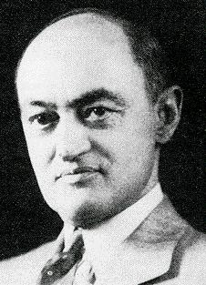
According to Schumpeter
“Industrial mutation ..... incessantly revolutionises the economic structure from within, incessantly destroying the old one, incessantly creating a new one. This process of Creative Destruction is the essential fact about capitalism. It is what capitalism consists of and what every capitalist concern has got to live in”
The problem may be reformulated by saying that the fear of future "Destruction" may seriously inhibit the "Creative" element of Capitalism. Specialising in new skills and equipment may be inhibited by the fear that they will soon become old and redundant.

Slide 167
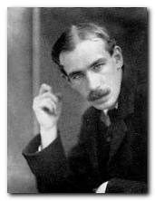
Keynes and illiquidity.
From the General Theory:
“capital equipment will differ from another "(a) in the variety of the consumable in the production of which they are capable of assisting, ......(c) in the rapidity with which the wealth embodied in them can become "liquid", in the sense of producing output, the proceeds of which can be re-embodied if desired in quite a different form"
Extending the Keynesian concept: the lack of liquidity of specialised (human and non-human) capital may inhibit specialised investments (in both human and non-human investments). It may favour Babbage over Smith.

Slide 168
Keynes on Effective Demand (G. T. 210-2)
“The absurd, though almost universal, idea that an act of individual saving is just as good for effective demand as an act of individual consumption, has been fostered by the fallacy, much more specious than the conclusion derived from it, that an increased desire to hold wealth, being much the same thing as an increased desire to hold investments, must, by increasing the demand for investments, provide a stimulus to their production; so that current investment is promoted by individual saving to the same extent as present consumption is diminished.
It is of this fallacy that it is most difficult to disabuse men’s mind. It comes from believing the owner of wealth desires a capital-asset as such, whereas what he desires is its prospective yield. Now prospective yield wholly depends on the expectation of future effective demand in relation to conditions of supply.”

Slide 169

Williamson and the safeguards for specific investments
The degree of specificity of investments is measured by the percentage of these investments and it is not substantially different from the concept of (lack of) liquidity considered above. When complete contracts are not possible, agents who make specific investments cannot defend themselves against opportunistic behaviour by moving their investment to alternative relations with new partners. They need safeguards for these investments.
Job rights and safeguards are not necessarily inefficient limitations to market mobility but they can rather be efficient ways of encouraging human capital investments

Slide 170
Williamson and the market economy dilemma.
The mobility of market economy could inhibit the "specific" investment in human capital that are typically associated to the Smithian advantages of the division of labour.
A market economy would find itself in this dilemma:
either to give up the productivity improvements that come with the learning by doing Smithian advantages,
or to give up that mobility among occupations that is the most typical characteristics of markets.

Slide 171
Gellner and New Institutional Economics.
A) Cultural standardisation can eliminate a lot of specificity. Liquid markets emerge with cultural nationalism. The large majority of assets are specific in agrarian societies. Specificity or liquidity are not technologically given but they can be altered by national policies.
B) National solidarity can reduce the risks of specificity. Unemployment benefits and subsidised retraining imply that one has more time to find the right employer and to retrain if he is not available.
C) The “specificity risk” re-appears in the form of specificity to a certain culture. Investments in this culture require appropriate poltical safeguards.
D) Only, when all this fails, we are in Williamson’s world of private governance.
E) Institutional complexity related more to liquidity than to specificity.

Slide 172
Cultural standardisation and social protection.
Mutually reinforcing institutional complements:
the solidarity stemming from a common scheme of social protection may reinforce common cultural-linguistic investment
cultural and linguistic standardisation may reinforce social solidarity.
Institutional Substitutes:
there is an inverse relation between the optimal level of standardisation and the optimal level of redistributive taxation
the optimal policy mix is characterised by a higher level of redistribution and a lower level of standardisation as its cost increases

Slide 173
Cultural standardisation and redistribution as substitutes.
We can insure ourselves against a job loss:
- by the “liquidity”of the skills that we learn by doing our jobs
(that is the easiness by which we can employ the acquired skills in other employments). One important way is to achieve this result is cultural and linguistic standardisation.
by some form of social protection that entails some redistribution in favour of the individuals who loose their jobs.
Both insurance devices are (increasingly) costly.
Hence, cultural standardisation and redistribution are also institutional substitutes.
Their optimal combination involves that by using more intensively one instrument it is possible to save on the use of the other.
.

Slide 174
States on the Market:
the Neo-Classical View of Federalism.
The Eterogeneity of individuals is given. It is not influenced by solidarity and the complementarity-substitution problems do not arise.
Individuals are mobile and States compete for individuals.
A market mechanism for the demand and supply of jurisdictions exists. Individuals with similar tastes cluster together in the jurisdictions closer to their preferences.
Extreme conclusion: different States should show little respect for their own minorities.
Both the majority and the minority gain if each one of them is
organized in different jurisdictions according to its own
community values.
Notes:
Limits to am. View of fed

Slide 175
The optimal number of Nations.
Eterogeneity implies a reduction of the benefits deriving from a public good.
It implies a greater variance of the preferences concerning its quantity and quality.
The optimal dimension and, therefore, the number of nations must be such to balance the cost of eterogeneity with the benefits of size. (Alesina e Spolaore)

Slide 176
Contradictions of the “neo-classical” view of federalism
Federalism is considered to be a way to enhance diversity in the population by clustering people according to their characteristics
But this view of federalism relies on low mobility costs that can only hold if the individual are homogeneous in other relevant respects.
Example: if individuals are homogeneous in their linguistic characteristics, their mobility is enhanced and they could easily cluster according to the welfare provisions offered by the different States.

Slide 177
Complementarities between homogeneity and heterogeneity
In general, the homogeneity in one dimension (often the cultural-linguistic dimensions) can favour a competitive heterogeneous clustering in other dimensions.
In the neo-classical model a fair degree of cultural-linguistic standardisation is wrongly taken for granted while it is a crucial institutional precondition for the working of both “political” and economic markets
The traditional view fails to see the market as an institution that has required a long process of linguistic, legal and customary standardisation and has, in turn, induced a further enhancement of this process.

Slide 178
Rent seeking explanations of Nationalism.
In Gellner analysis the main incentive to develop a national state is
wealth creation. The related creation of markets implies that
total wealth is increased. Some groups may benefit and other groups
may loose or benefit less but there is an increase in the total pie.
Rent-seeking explanations: nationalism decreases the total pie
but changes the distribution of the benefits in such a way that
for some groups it is convenient to invest in nationalism.

Slide 179
Breton’s theory.
Breton shows how nationalistic investments can be a rational choice for a group seeking particular privileges at the expense of other social groups of the same nation. In particular, the middle class can gain from investments in nationality. Its members can get better jobs when other ethnic groups cannot compete for them. In this way, investments yielding a higher social rate of return are sacrificed for projects that maximize the privileges of the middle class.
Nationalistic investments may have also the result of manipulating the preferences of the working class so that it may even gain some psychological benefits from the nationalistic policies. However, these psychological benefits are only obtained at the cost of losing the fruits of unbiased investment projects yielding a higher rate of return.

Slide 180
Nationalists breaking markets.
Instead of creating cultural homogeneity, solidarity and market mobility, nationalists invent "old" traditions that bring about intolerance and discord.
In this way they can break a nation into smaller nation where they can hold the best jobs. They tend to limit, instead of enhance, market mobility and the positive effects of the division of labour.
They do not create or enlarge markets but break them. In this way they can gain some rents that would be wiped out by competition in larger national markets.

Slide 181
The Logic of collective action
Consider again expression:
t_{ii}MRS^{i}(x_{i},y_{i}) +∑_{h} t_{hi} MRS^{h}(t_{hi} x_{i},y_{h}) = MRT(x,y)
Suppose that the good has a public good nature for a rent-seeking
group and each individual of the group has to forgive some units
of the private good y to exercise the rent-seeking pressure.
Rent-seeking pressure will be exercised only by the individuals
for whom:
t_{ii}MRS^{i}(x_{i},y_{i}) > MRT(x,y)

Slide 182
Size, inequality and collective action.
If ∑_{h} t_{hi} is unequally distributed,
then collective action will be more likely and
it is most likely when:
∑_{h} t_{hi} = t_{ii}
Collective action is more likely to be exercized by groups:
That are small
Where the distribution of the benefit is unequal.
Inefficiency of collective action and possible inefficiency
of nationalist policies.

Slide 183
The complementarity-substitution problem.
The relations of complementarity and substitution between social solidarity and cultural-linguistic standardisation create a difficult puzzle in situations where both factors are lacking.
- a low level of cultural-linguistic standardisation make redistributive policies more important because the liquidity of the skills of the losers is low
- the same low level cultural-linguistic homogeneity may inhibit social solidarity and make it difficult to implement redistributive policies
Is Europe caught in the complementarity-substitution problem?

Slide 184
The Nature of European Federalism
The theories of federalism based on the “American experience-
Neo-classical theory mix” provide a poor guide for the understanding of the European mild federalist project.
The European project is not so much about the optimal clustering that could be obtained by the free mobility of the individuals.
It is about decreasing the costs of mobility and, at the same time, about protecting individuals against excessive and/or undesired mobility.
For instance, to decrease mobility costs individuals:
- are encouraged to become bilingual or trilingual and understand
each other Culture (Erasmus project)
- are protected against undesired mobility (Structural Funds).

Slide 185
The European puzzle.
European Federalism tries to struck a compromise between cultural standardisation and undesired
costly mobility in a linguistically differentiated Europe.
In creating a single market Europe faces the complementarity-substitution puzzle:
Social protection is particularly important in a linguistically divided Europe where mobility and the related economic and political markets are a very poor substitute for it.
But the same linguistic and cultural divisions make it
very difficult to have social protection at European level.

Slide 186
The role of the National Welfare State in the process of European integration.
A possible solution to the complementarity-substitution puzzle relies on National States continuing to supply much
social protection with the blessing of the European Union.
The National Welfare State cannot be easily substituted:
an European Welfare State is limited by the absence of a
complementary cultural homogeneity that makes it acceptable
substantial redistribution at European level
European cultural standardisation is a very costly substitute
insurance device in a linguistically divided Europe.

Slide 187
A difficult future for Europe?
Europe runs the risk of becoming an aggregation of countries lacking both:
1) the U. S. horizontal solidarity
2) the vertical solidarity existing in the typical European National States.
A mild integration is required to overcome these difficulties.

Slide 188
 | Vertical cultural Homogenization | Vertical cultural Differentiation
Horizontal Cultural Homogenization | Social and Regional Solidarity (Classic National states) | (2) Regional Solidarity without Social Solidarity (United States)
Horizontal Cultural Differentiation | (3)Social Solidarity without Regional Solidarity (Europe) | (4) No Social and No Regional Solidarity? (The future of a “globalized” Europe?)

Slide 189
7
Intellectual Monopoly Capitalism

Slide 190
Globalism: the highest stage of nationalism?
Like nationalism, globalism favours a self-reinforcing interaction between cultural standardisation and various forms of market mobility.
Unlike nationalism, globalism does not stress the complementarity aspects between social protection and cultural standardisation.
Economic integration is not associated to redistribution and risk-sharing among the individuals sharing the same culture.
Social policy becomes a divisive issue.
Some individuals (the cosmopolitans and/or the rich)
can more easily replace
social protection with cultural standardisation
than other individuals (the provincial and/or the poor).

Slide 191
Globalism involves unrestricted cultural and economic integration
without social protection (offered at international level).
But can nations still offer social insurance at national level
in a global economy?
Can the gains due to international trade fund the insurance expenses
due to the risks of increased specialization?
Social insurance can be provided if there is a sufficient number of sectors in the economy.
Specialization and economic integration increase collective risk and imply that countries find it more difficult to offer
social insurance.
The optimal degree of specialization should involve that the
marginal gains from specialization should offset the increase in risk due to specialization.
However, the number of sectors is a public good and private agents will tend to overspecialize the national economy.

Slide 192
If globalism is economic and cultural integration without
social protection, it implies:
a) Increased international cultural standardisation among nations
but increased vertical cultural diversity within nations (cosmopolitans and provincials).
Neo-agrarian characteristics of the modern globalised world?
b) Decreased social protection due to the absence or the weakening of international and national social protection. The argument can be also based on the tendency to overspecialise according to the standard theory of comparative advantage.
However, this uniform picture of increasing inequality, associated to economic integration, may be challenged by the fact that, in an increasingly globalised economy, nations tend also to specialise according to their institutional comparative advantage.

Slide 193
Countries with different system of rights could specialise
in some sectors and countries with different systems of rights
could specialize in other sectors.
The exploitation of the principle of comparative institutional advantage might imply that some countries provide more social protection and other countries provide less social protection.
Each country specialises in those sectors where, because of its national system of rights, it enjoys a comparative institutional advantage.
However, this mechanism assumes that globalisation is simply a form of cultural and economic integration and not also a system of global rights and, in particular, of intellectual property rights.
Consider two countries:

Slide 194
Country a). (“Babbage-type country”) Its rights and institutions entail a comparative advantage in the production of codifiable knowledge that it is also applied in a top down manner to the production process.
Most skills are general purpose. (The only form of specificity is related the human capital dedicated to the improvement of given piecesof codifiable knowledge).
Country b). (Smith-type country). Its rights and institutions entail a comparative advantage in the production of tacit knowledge that is directly applied in bottom up manner to improve physical products.
Most skills (including those of the workers
who are directly employed in production) are specific.
Economic integration will imply that each country will specialize in those production processes where it enjoys a Comparative Institutional Advantage. Country a may become less egalitarian and Country b more egalitarian.

Slide 195
In country a the production processes, where strong hiring and firing
rights and/or weak social insurance are advantageous, will spread in
all the national economy.
Top down applications of codified knowledge will pervade the entire
economy.
In country b the production processes, where job security and/or
generous social insurance are advantageous, will spread
in all the national economy.
Bottom up applications of tacit knowledge will pervade the entire
economy.
Because of economic integration, inequality may increase in country a
and decrease in country b.
But specialization according
to comparative institutional advantage
requires delicate assumptions on international
IPR (Intellectual Property Rights)………….

Slide 196
Suppose that (at least part of) the codifiable knowledge of country a
is an input in the production of the tacit knowledge of country b.
Regime I. The rights on intellectual property are weakly defined.
Countries b (based on the production and application of bottom up
tacit knowledge) can exploit and free ride on countries a (based on the production and application of top down codifiable knowledge).
Regime II. The rights on intellectual property are strongly defined
and “upstreamed”.
Countries a (based on the production and the application of codifiable top down knowledge) can exploit and impose high monopoly prices on countries b (based on the production and the application of bottom-up tacit knowledge).
Globalization is not only global cultural standardisation
and global economic integration but also an introduction of global rights that marks a move from Regime I to Regime II.

Slide 197
Suppose that globalization is intended
as the introduction of a
global systems of rights
favouring very much country a types.
Then specialization according to the principle of Comparative Institutional Advantage
(which requires that each nation is able
to choose its own system of rights)
becomes impossible.
The more egalitarian distribution,
which may characterise countries b,
may become incompatible with
the present regime of
Global Intellectual Property Rights.

Slide 198
A new model of accumulation?
When contracts are incomplete, rights and safeguards give incentives to agents to develop specific skills (Williamson).
However, these incentive effects are much stronger for intellectual property rights where individuals cannot find similar assets available in the economy.
The complementarity between the accumulation of skills and
intellectual capital may generate increasing inequality:
-----> Ownership of Intellectual Capital ----->
Incentive to acquire new IPR-specific skills --
-----> Ownership of more Intellectual Capital -
-------->

Slide 199
Economic integration and inequality: summing up.
1) Globalism is (like nationalism) characterised
by cultural standardisation and economic integration.
Unlike nationalism, the process occurs in an international environment without forms of social protection.
Moreover specialization, which is carried out according to the
standard principle of comparative advantage may imply that each country “overspecialises” and it is unable to offer social insurance for the losers.
2) Specialization according to the principle of comparative institutional advantage may imply that for some countries there is counter-tendency (as long as social protection and job rights allow some form of Comparative institutional advantage).
3) However, this countertendency may be rather weakened by the fact that globalization is also associated to stronger and upstreamed IPRs.

Slide 200

Intellectual Monopoly
Intellectual property is a temporary intellectual monopoly, restricting temporarily the liberty of others to use the good .
This restriction involves always some inefficiency but it may be compensated by the incentives that the acquisition of a monopoly gives to the producers of new knowledge (incentive effect).
However, against this positive incentive effect, one should consider the negative effect that intellectual monopoly has on the intellectual investments of other firms (blocking effect).
Observe that when “intellectual property” is enforced with greater vigor, the incentive effect is immediate whereas the blocking effect comes later.

Slide 201

Knowledge and
Land Enclosures.
While industrial capitalism was preceded by the enclosure of lands, intellectual monopoly capitalism has been made possible by the enclosure of ideas in privately owned fields
Land enclosures may have even prevented the over-exploitation of a resource being depleted by overcrowding (but there is some evidence against this thesis) .
No similar claim can be made for the case of intellectual enclosures. The fields of knowledge are not subject to overcrowding. By contrast, the access to knowledge is seriously limited by the fields privatized by others. The agents are forced to specialize in narrow fields and suffer a dramatic squeeze of investment opportunities.

Slide 202
Globalization:
are we moving towards a neo-agrarian society?
There are some paradoxical similarities between the inequalities of the modern world and those of agrarian societies:
a) Vertical and horizontal cultural diversity due to differential
access to the global culture.
b) Lack of social security and solidarity.
c) A new cosmopolitan aristocracy based on monopolies
on Intellectual Property (replacing that on Land).

Slide 203
Global Patents and Investments.

Slide 204
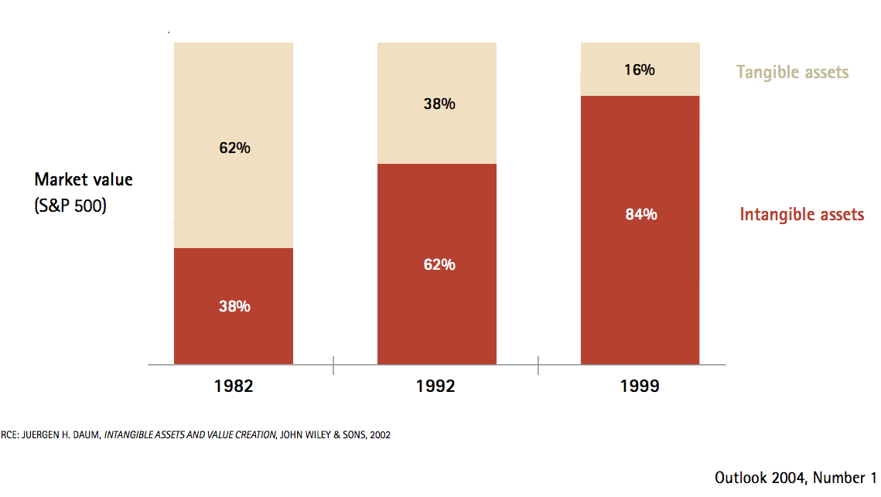
1982-1999:
The great capitalist metamorphosis

Slide 205


Financial Times of March 6 2009
“Our impression is that Opel has not freed itself from GM’s influence and that it is not being serious about becoming more autonomous as a business,” the insider said, confirming that both Mr. Guttenberg and Ms Merkel were losing patience with the companies.
Berlin has refused to assist Opel without cast-iron guarantees that the money will not flow to GM or be lost in the wake of a GM insolvency. Officials say Opel’s restructuring suggestions so far have failed to provide this guarantee.
The government suspects GM has provided some of Opel’s patents as collateral to the US Treasury in exchange for financial assistance. Berlin therefore doubts Opel would be shielded against an GM insolvency.”

Slide 206

The ownership of round corners
According to Samsung:
“Apple could not claim the rights for all rectangles with rounded corners or other basic design used for phones or tablets”.

Slide 207
Global vs. local legal positions.
Property rights on well-defined material objects involve only local duties restricted to the location in space that is occupied by those objects. Rivalry in consumption is associated to the fact that the limited space of the object can easily involve overcrowding.
Property rights on immaterial objects like knowledge may involve global restrictions that potentially involve all the individuals in the world.
The global application of IPR has created “pan-positional goods”. The exclusive rights of an individual or a firm involves duties that hold for all the individuals of the World - whatever is their physical location.

Slide 208
Pan-positional property rights.
The private appropriation of knowledge does not imply that the liberty of non-owners should be only limited when it interferes with the (spatially limited)consumption rights of the owners: because of the non-rival nature of knowledge this never happens.
The nature of ownership involves a pan-positional right, limiting the liberty of all non-owners to use all the other non-rival pieces of the same knowledge in all the possible locations.

Slide 209
IPRs as Global Tariffs.
Because of its non-rival nature knowledge can be used by many individuals without decreasing its value. However, paradoxically, the public-good nature of knowledge makes its privatization much more limiting for the liberty of non-owners. It transforms a public good into a pan-positional right that involves a global monopoly on knowledge.
The countries at the frontier of knowledge do not give a public benefit to developing countries but limit their liberty and their incentives to produce autonomous forms of knowledge.
Whereas developing countries, specializing in standard commodities, are forced to open their markets, IPRs act as a very high global tariffs, which can be enforced well beyond the boundaries of the country producing the knowledge-good.

Slide 210
The (over) privatization of knowledge
A a second-best solution may involve that part of knowledge should be private. However, even relatively to this second-best solution, in the global economy there is over-privatization of knowledge.
Private IPR are defined and enforced at international level. By contrast, there is no public global institution, which is funding basic research. Countries tend to free-ride on public research. The fund to public institutions are cut and these institutions are induced to increase privately appropriable research.
The standard catch-up argument is also challenged by the dramatic decrease of investment in public research that can be freely appropriated by developing countries.

Slide 211
The Knowledge-Economy Paradox.
The non-rival nature of knowledge, which could in principle favor small, and even self-managed, firms, is used to create artificial economies of size which make a cheap acquisition and the defense of property rights possible only for big business.
Absent knowledge privatization, the need to provide incentives to invest in human capital would be an argument favoring the labor-hiring-capital solution.
Because of the monopolization of intellectual capital the knowledge economy can become the most unfriendly environment for small labor-managed firms.

Slide 212
Knowledge-Markets institutional complementarities
Increases the relative adavantage of
Open
Science
Open
Markets
Increases the relative adavantage of
Closed
Science
Closed
Markets
We have two possible
institutional complements
O-S ,
O-M
C-S ,
C-M

Slide 213


Commodification of knowledge
Financialization of the economy
Commodification
of knowledge
Financialization
of the economy
The commodification of kwowledge allows the firm to be traded as a thing of financial markets (not equally possible for knowledge embodied in human beings).
In turn, the financialization of the economy induces companies to commodify their intellectual capital because they need to attract cheap finance.

Slide 214
IPR and Asymmetric Development of Human Capital
In the traditional New Property Right approach:
Human Capital
IPR
But an IPR involves a global legal position, preventing others from utilizing a given piece of knowledge. So the relation can be easily inverted:
IPR
Human Capital
We are likely to have vicious and virtuous circles of cumulative causation, leading to asymmetric and increasingly divergent developments.

Slide 215
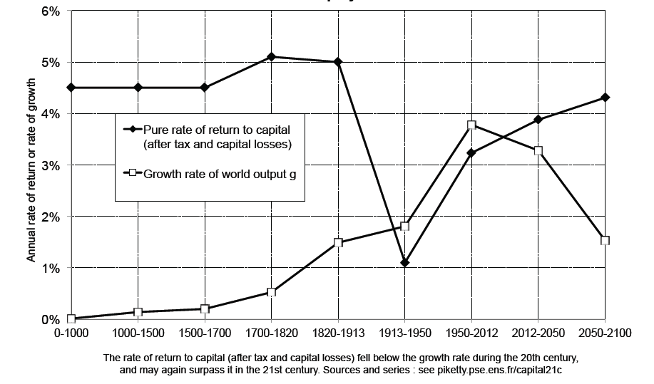
Piketty’s r>g

Slide 216
Capital-Destructive Wealth
Piketty’s increasing inequality involves the puzzle that vigorous capital accumulation continues in spite of a very high return on capital.
Stiglitz has introduced a useful distinction between capital and wealth. In Piketty r is the return to Wealth. It may have little to do with the r of standard growth theory, which measures the (marginal) productivity of capital. It includes all sorts of “exploitation rents” including those related to monopoly power. When these rents increase, wealth does also increases (even if capital is unchanged):
If monopoly power of firms increases, it will show up as an increase in the income of capital, and the present discounted value of that will show up as an increase in wealth (since claims on the rents associated with that market power can be bought and sold.) Stiglitz (2015 p. 24)

Slide 217
The Political Trilemma of the World Economy (Rodrik p. 200)
Golden Strait jacket
Hyperglobalization
Global Governance
Nation State
Democratic Politics
Bretton Woods Compromise

