Slide 1
Economic Organization and Theory of the Firm
Ugo Pagano
2022-23

Slide 2
Outline of the course
1) Analysis of economic transactions,
2) Property rights in a framework of incomplete contracts,
3) Technology and property rights
4) The complex governance of the firm
5) The hybrid thing-person nature of the corporation
6) Financialization, intangibles and the privatization of knowledge
7) The evolution of human nature and the principles of economic organization.

Slide 3
1
Analysis of economic transactions

Slide 4
Two architectures of economic theory
Consumers Firms
Markets
Individuals
Markets Firms

Slide 5
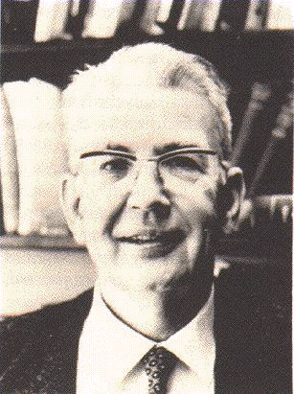
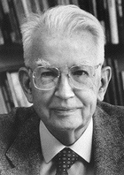
Ronald vs. Ronald
The Young(er) The Old

Slide 6
The Young English Socialist.
Some fifty-five years ago, in a seminal article called The Nature of the Firm, a young socialist named Ronald Coase sought to explain the existence of firms, of organizations within which markets were replaced by hierarchy and command.
In the words
of Guido Calabresi:

Slide 7
The Old American Libertarian.
Twenty-five years later, in The Problem of Social Cost, Ronald Coase, by then a middle-aged libertarian, indicated how markets could replace hierarchy and command structures to the perceived benefit of those who organized them
In the words
of Guido Calabresi:

Slide 8



Mixing ages: a Schizophrenic
Ronald?

Slide 9

Ronald’s Record
Young Ronald (1937) claims: In a world of zero transaction costs firms would not exist. Firms exist only when market transaction costs are positive.
Old Ronald (1960) claims: In a world of zero transaction costs (and well defined property rights) all externalities (harmful and beneficial effects) are internalised (taken into account) by market transactions. (Coase theorem)
Old Ronald (1960) also claims:
That the first statement does not contradict the second.
Diagnosis: old age schizophrenia.

Slide 10

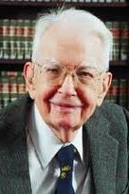
Lissening to Ronald’s reasons........
In his famous 1960 article we must get to Section 6
“The Cost of Market Transaction Taken into Account”
where he points out that: “The argument has proceeded up to this point on the assumption that there were no cost involved in carrying market transactions.” (1960, p. 114)
"It is clear that an alternative form of economic organization which could achieve the same result at less cost that would be incurred by using the market would enable the value of production to be raised. As I explained many years ago the firm represents such an alternative to organising market transactions" (1960, p. 115).
"But the firm is not the only possible answer to this problem…. "an alternative solution is direct governmental regulation" (Coase 1960 p. 116).

Slide 11
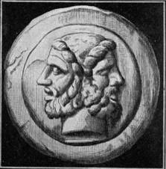
Ronald’s un-divided self.
Coase argues that the “Coase theorem” (but there is no theorem according to Coase!) is perfectly consistent with the 1937 article and they make up one unique theory. He is correct.
According the “Coase theorem”, in a world of zero transaction costs, markets can internalize all externalities. State intervention and Pigouvian taxes (and firms) are all unnecessary in that framework.
Unsurprisingly, if one institution (the market) is assumed to be costless, only two things can happen:
If the other institutions are costly, they disappear.
If the other institutions are also costless, they may co-exist but their mix cannot be a relevant economic issue.

Slide 12

The challenge to microeconomics of the Re-constructed Ronald.
In this way, Coase challenges the standard building of microeconomics
where the existence and the size of the firms are explained
by U-shaped cost curves (with an initial phase of increasing returns).
The positive and negative effects (increasing and decreasing returns)
which the production of some units has on other homogeneous units,
are only a particular type of externality
which would be internalized by markets in a word of zero transaction costs.
Once this compensation is made, in order to break even, it is not necessary
to produce a certain number of units within a firm.
Again in a world of zero transaction costs,
whatever the technology, firms do not exist................

Slide 13
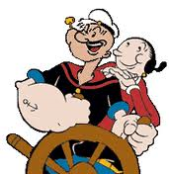
Sailing with Ronald………
……….far away from the neoclassical island of Crusoe
If all institutions are costly, institutional mixes will prevail in the economy.
Even the least costly mix will be incomplete.
There will be a tendency to choose mixes with lover costs.
Changing mix is itself costly and path dependency will characterize the development of the institutions.
Costly institutions involve institutional substitution and complementarity.

Slide 14
Limitations of the Coasian approach
1)Efficiency bias: firms exist because markets are imperfect
but the firms-markets mixture is supposed to be efficient
in a market economy.
2) Transaction costs without transition costs
3) No disequilibrium transaction costs.
(Relative advantages of Marx and Hayek)

Slide 15
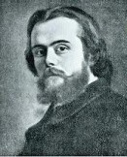

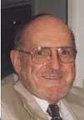
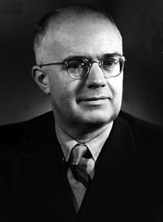
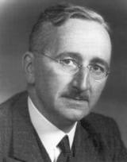
Disequilibriun
Transaction Costs
?
Forms of
Co-ordination
Forms of authority
 | Command | Competition
Ex-ante | (A) Marx | (B) Rational expectations
Ex-post | (C) Lange | (D) Hayek

Slide 16
Within a firm, its members:
(a) can act under the authority of a single plan derived
from a single model,
(b) can learn how to formulate the plan according to consistent
learning rules the authority of which is accepted
by the members of the firm,
(c) can save the costs which they would incur if each member
of the firm had to formulate her own complete plan
on the basis of her own model,
(d) can avoid costly inconsistencies by co-ordinating ex-ante
the actions before they are implemented
(e) can eliminate unforeseen ex-post inconsistencies in the plan by constantly monitoring the emergence of ex-post imbalances.

Slide 17

Coase: the fall from the Economic Nirvana.
Coase observed that in the world of pure economics all decisions were coordinated by prices at zero costs.
In this world firms would not exist. We would live in what became later the world of the “Coase theorem”.
In the world of the Coase theorem all possible externalities, including those related to economies and diseconomies to scale would have been internalized by market transactions.
Firms, state regulation and other arrangements can only appear in a word where no alternative institution is available at zero costs.
There is no Economic Nirvana: all institutions are costly.

Slide 18
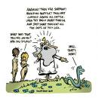
Fuller: the fall from the Legal Nirvana.
Fuller defined law as the enterprise to subject to rules human behaviour.
This enterprise is too costly to be carried out by a centralized ordering.
The costs of Law can and are in fact decreased by decentralizing its enterprise to a plurality of orderings.
Unions, Churches and Universities have their internal orderings. Firms themselves can also be seen as private orderings.
There is no Legal Nirvana: completeness, unity and consistency can possibly be the aim of a legal ordering but they cannot be taken for granted.

Slide 19
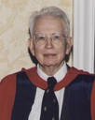
Coase’s
Journey
Costly decentralized market transactions.
The firm as centralization of market transaction

Slide 20
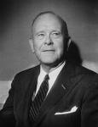
Fuller’s
Journey
Costly centralized public orderings.
The firm as decentralization of public orderings

Slide 21
A joint Coase-Fuller
Journey?
Costly decentralized market transactions.
Costly centralized public orderings.
The firm
as as centralization of market transaction
and
as decentralization of public orderings

Slide 22
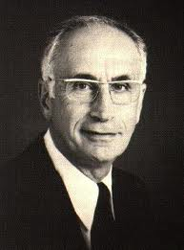
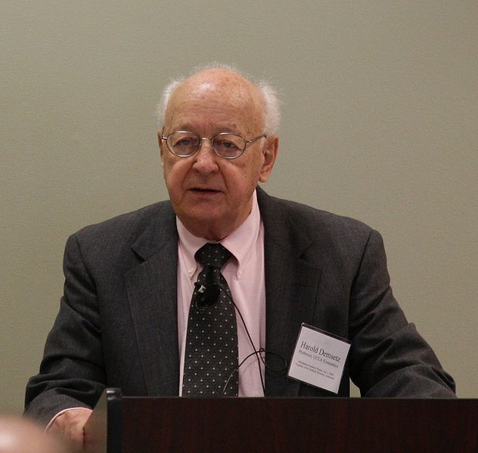
The monitoring problem
(Alchian, Demsetz)
Team work
Employer with hiring
and firing rights
Why capitalist ownership of the means of Production?
Hard to monitor
capital
Capitalist ownership
The same argument can be applied to hard to monitor labour.
Both arguments can be inverted.

Slide 23
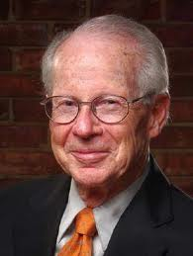
The Specificity Problem (Williamson)
Specificity, Liquidity and Irreversibility
Analogy with monitoring: rights should go to the
most specific factors.
Difference with monitoring: asset specificity cannot be defined by referring to a single relationship
Specificity, Competition and the Fundamental
Transformation.
Ex-ante competition → → → Ex-post monopoly
Two explanations of monopoly
The monopoly branch
The efficiency branch

Slide 24
Transaction cost efficiency under alternative behavioural assumptions
Bounded Rationality | Opportunism | Asset Specificity | Contracting Process:
0 | + | + | Planning
+ | 0 | + | Promise
+ | + | 0 | Ex-post competition
+ | + | + | Governance

Slide 25
2
Property rights in a framework of incomplete contracts

Slide 26


From butter milk to Swiss cheese
In a famous passage, quoted by Coase in his 1937 article on Nature of the Firm (p. 35), Denis Robertson (1928) observed how in the market economy firms can be seen as
"islands of conscious power in this ocean of unconscious cooperation like lumps of butter coagulating in a pail of buttermilk".
In the New Property Rights approach the memory of the butter and the buttermilk has faded away . Its place has been taken by some sort of Swiss cheese where holes of incomplete contracts are open in a desert of perfectly working and costless markets.

Slide 27
Grossman, Hart and Moore Model
a) Specificity is both absolute and a marginal.
b) Contractual incompleteness is justified by the facts
that specific investments in human capital are
observable but not verifiable.
c) Agents are characterised by unbounded rationality
and decide their investments in the 1th period on the
basis of the anticipated bargaining of the 2nd period.
d) They exchange machines in the first period to
maximise the total surplus (Swiss Cheese Assumption)

Slide 28
M1 (Input) M2
_______ <------ _______
a1 a2
Ex-ante relationship-specific investments are made at date 0 and the widget is supplied at date 1.
There is only uncertainty about the type of widget M1 requires and this uncertainty is resolved at date 1.
Assume that:
-the parties are risk-neutral and have large (unlimited) amounts of initial wealth and the interest rate to be zero;
it is too costly for the parties to specify particular uses of assets a1 and a2 in a date 0 contract.
Non-integration: M1 owns a1 and M2 owns a2.
Type 1 integration: M1 owns a1 and a2
Type 2 integration: M2 owns a1 and a2
i non-negative number expressing level and cost of M1's relationship-specific investment.

Slide 29
If trade occurs:
M1's revenue is denoted by R(i);
his ex post payoff is R(i) - p where p is the agreed widget price
his ex-ante payoff is R(i) - p - i
If trade does not occur:
M1 buys a "non-specific" widget from an outside supplier at price p that may lead to lower-quality output
M1's revenue is indicated by r(i;A)
his ex-post payoff by r(i;A) - p
Remark: lower-case r indicates the absence of M2's human capital and the argument A refers to the set of assets M1has access to in the event that trade does not occur.
Under non-integration A = {a1}
under type 1 integration A = {a1, a2}.
under type 2 integration A ={Φ}

Slide 30
e denotes M2's relationship-specific investment at date O
If trade occurs
M2's production costs are denoted by C(e)
her ex-post payoff is p-C(e)
her ex-ante payoff is p - C(e) -e
If trade does not occur
M2 will sell her widget on the competitive spot market for p
but will have to make some adjustments to turn it into a general-purpose widget. In this case
M2's production costs are denoted by c(e; B)
her ex-post payoff is p-c(e;B)
Remark: lower-case c indicates the absence of M1's human capital and the argument B refers to the set of assets M2 has access to in the event that trade does not occur.
Under non-integration B = {a2}
under type 1 integration B ={Φ}
under type 2 integration B = {a1, a2}.

Slide 31
If trade occurs
the total ex-post surplus is:
R(i)-p+p-C(e) = R(i) - C(e)
If trade does not occur:
the total ex-post surplus is:
r(i;A) - p + p - c(e;B) = r(i;A) - c(e;B)

Slide 32
Assumption 1: because of the specific investments there are always ex-post gains from trade:
(2.1) R(i) - C(e) > r(i;A) - c(e;B) ≥ O
for all i and e and for all A,B
where A ∩ B = Φ
and A U B= {a1, a2}
Remark : (2.1) captures the idea that the investments i and e are relationship-specific: they pay off more if trade occurs than if it does not.

Slide 33
Assumption 2: relationship-specificity also applies in a marginal sense:
the marginal return from each investment is greater the more assets in the relationship, human and otherwise, to which the person making the investment has access.
(2.2) R' (i) > r' (i; a1, a2) ≥ r' (i; a1) ≥ r'(i; Φ)
for all 0 < i < ∞
(2.3) |C'(e)| > |c'(e; a1, a2)| ≥ |c' (e; a2)| ≥ c' (e; Φ)
for all 0 < e < ∞.
where: r'(i;A) = ∂r(i;A)/∂(i) and c'(e) = ∂c(e;B)/∂e
R' > 0, R" < 0 r' ≥ 0 r" ≤ 0
C' < 0 C" > O c' ≤ 0 c" ≥ 0

Slide 34
Assumption 3:
(Swiss Cheese)
R,r,C,c (the results) and i, e (the investments) are observable to both parties, but are not verifiable to outsiders. Thus, neither the results of the investments in human capital nor the levels investments themselves can be part of an enforceable contract.
The Physical Assets a1, a2 can be exchanged at zero transaction costs.

Slide 35
Ex-post division of surplus.
Consider what happens at date 1 given particular investment decisions i and e.
Take also the asset ownership structure as fixed for the moment.
We can suppress i, e and the set of assets A and B that M1 and M2 control.
Denote M1's revenue and M2 costs by:
R and C if trade occurs
r and c if trade does not occur.
Assumption 1---> there are ex post gains from trade given by:
[(R-C) - (r-c)].
Assumption 3 ---> they cannot be achieved under the initial contract.
Since the parties have symmetric information, it is reasonable to expect them to realise the gains through negotiation.

Slide 36
Assumption 4 Bargaining is such that the ex-post gains from trade [(R-C) - (r-c)] are divided 50/50 as in the Nash bargaining solution. Then M1 and M2 ex-post payoffs equal:
(2.4) Π1 = R-p = r - p + 1/2 [(R-C) - (r-c)] =
= - p + 1/2R + 1/2r - 1/2C + 1/2 c
(2.5) Π2 = p - C = p - c + 1/2[(R-C) - (r-c)] =
p - 1/2C - 1/2 c + 1/2R + 1/2r
and the widget price is given by:
(2.6) p = p + 1/2 (R-r) - 1/2 (c - C)

Slide 37
The first-best choice of investments
(We assume no wealth effects)
In a first-best world the parties would maximise the date 0 (net) present value of their trading relationship.
(2.7) R(i) - i - C(e) - e
Denote the unique solution to the first-best problem by (i*, e*)
The first-order conditions for maximising 2.7 are:
(2.8) R' (i*) = 1
(2.9) | C' (e*) | =1

Slide 38
The second-best choice of investments.
Now consider the second best incomplete contracting world, where the parties choose their investments non-cooperatively at date O.
Suppose that the ownership structure is such that:
M1 owns the set of assets A
M2 owns the set of assets B
(2.10) Π1 - i = - p + 1/2R(i) + 1/2r(i;A) - 1/2C(e) + 1/2 c(e;B) - i
(2.11) Π2 - e = p - 1/2C(e) - 1/2 c(e;B) + 1/2R + 1/2r(i;A) - e
Differentiating (2.10) with respect to i and (2.11) with respect to e yields the following necessary and sufficient conditions for a Nash equilibrium:
(2.12) 1/2 R'(i) + 1/2 r'(i; A) = 1
(2.13) 1/2 |C'(e)| + 1/2 |c'(e;B) | = 1

Slide 39
(2.12) and (2.13) can be written as follows for the three leading ownership structures:
Non-integration.
(2.14) 1/2R'(io) + 1/2 r'(io, a1) = 1
(2.15) 1/2 |C'(eo)| + 1/2 |c'(eo; a2)| = 1
Type 1-integration.
(2.16) 1/2R'(i1) + 1/2 r'(i1; a1,a2) = 1
(2.17) 1/2 |C'(e1)| + 1/2 |c'(e1; Φ )| = 1
Type 2-integration.
(2.18) 1/2R'(i2) + 1/2 r'(i2; Φ ) = 1
(2.19) 1/2 |C'(e2)| + 1/2 |c'(e2;a1,a2)| = 1

Slide 40
Proposition 1. Under any ownership structure there is underinvestment in relationship-specific investments. That is, the investment choices in (2.12) and (2.13) satisfy i < i*, e < e*.
Proof. Suppose i,e satisfy (2.12) and (2.13). Then, by (2.2) and (2.3)
R'(i) > 1/2 R'(i) + 1/2 r'(i;A) = 1
| C'(e)| > 1/2 |C' (e)| + 1/2 | c'(e;B)| = 1
The result follows since R" < 0, C" > 0.
Intuition: M1's payoff increases by less than R'(i); the remaining gains go to M2. M1 does not take M2 payoffs into account and hence invests too little.

Slide 41
1) All ownership structures imply under-investment.
2) Relative to non-integration, type 1 integration raises M1's investment, but lowers M2's.
3) Relative to non-integration, type 2 integration raises M2's investment but lowers M1's.
(2.20) i* > i1 ≥ io ≥ i2
(2.21) e* > e2 ≥ eo ≥ e1
Efficient ex-post bargaining implies that the total surplus from the relationship is given by:
S = R(i) - i - C(e) - e
where i and e satisfy the necessary and sufficient Nash bargaining conditions (2.12) and (2.13).

Slide 42
The ex-ante choice of the ownership structure.
Simply compare the total surplus from the various arrangements:
So = R(io) - io - C(eo) - eo
S1 = R(i1) - i1 - C(e1) - e1 (2.23)
S2 = R(i2) - i2 - C(e2) - e2
The theory predicts that the ownership structure that yields the highest value of S will be chosen in equilibrium.
Example: If at the starting point of their relationship M1 owns a1 and M2 owns a2, and S1 > Max(So S2),
then M1 will buy a2 from M2 at some price that will make both better off.
Remark: Any change in ownership structure that increases r'(i.)) (resp. increases |c'(e; .)|) without decreasing |c'(e; .)| (resp. decreasing r'(i; )) or, more generally that increases i or e without decreasing the other moves the parties closer to the first best.

Slide 43
Definition 3. Assets a1 and a2 are independent if
r'(i; a1,a2) = r'(i; a1) and c'(e;a1,a2) = c'(e;a1).
Intuition: Independent assets should be owned separately because with respect to no-integration concentrating ownership of independent assets does not increase the investment of the owner while it reduces the incentive to invest of the non-owner.
Definition 4. Assets a1 and a2 are strictly complementary if either r'(i;a1) = r'(i; Φ ) or c'(i;a2) = c'(e; Φ ).
Intuition: Complementary assets should be owned together because with respect to non-integration concentrating the ownership of complementary assets increases marginal return from investment of the owner without decreasing the incentive to invest of the non-owner.

Slide 44
Proposition 2(C) If assets a1 and a2 are independent, then non integration is optimal.
Proof. Because of the definition of independence the solution to:
(2.14) 1/2R'(io) + 1/2 r'(io, a1) = 1
(2.16) 1/2R'(i1) + 1/2 r'(i1; a1,a2) = 1
is the same; that is i1 = io. Since e1 ≤ eo non-integration dominates type 1 integration. Also, the solutions to:
(2.15) 1/2 |C'(eo)| + 1/2 |c'(eo; a2)| = 1
(2.19) 1/2 |C'(e2)| + 1/2 |c'(e2;a1,a2)| = 1
are the same; that is eo = e2. Since i2 ≤ io non-integration dominates also type 2 integration.

Slide 45
Proposition 2 (D) If assets a1 and a2 are strictly complementary, then some form of integration is optimal.
Proof: Suppose first that:
r'(i;a1) = r'(i; Φ)
Then the solutions to
(2.14) 1/2R'(io) + 1/2 r'(io, a1) = 1
and
(2.18) 1/2R'(i2) + 1/2 r'(i2; Φ) = 1
are the same; that is io = i2. Since eo ≤ e2 type 2 integration dominates non-integration. The same argument shows that, if c'(e;a2) = c'(e, Φ) type 1 integration dominates non-integration.

Slide 46
Williamsons’s Fundamental Transformation:
Because of bounded rationality, negotiations occur after individuals have invested in specific assets.
Ex-Ante Competition
Ex-Post Bilateral Monopoly
Ex-Post Transactions under Firms’ Governance.

Slide 47
Williamsons’s Fundamental Transformation:
Because of bounded rationality, negotiations occur after individuals have invested in specific assets.
Ex-Ante Competition
Ex-Post Bilateral Monopoly
Ex-Post Transactions under Firms’ Governance.

Slide 48
Hart’s non-fundamental transformation:
Lacking courts’ verification, ex-post bargaining is not constrained by competitive markets.
Ex-Ante Competition
Ex-Post Bilateral Monopoly
Ex-ante competitive exchanges of property rights .

Slide 49
Limitations of the GHM model.
One way relation between technology and property rights.
Identification between ownership and control.
No genuine theory of the firm as private governance.
Swiss Cheese Assumption.

Slide 50
3
Technology and property rights

Slide 51
Institutional Substitution and Institutional Complementarity
Scarcity does not only involve substitution but also complementarity
problems.
This is true for both standard economic resources and for institutions.
Two different questions arise:
a) Which institutions can replace other institutions?
b) Which institutions can favour some institutions instead
of other institutions?
The questions a) and b) are related:
When following Coase we say that, under some circumstances,
there is tendency to replace markets with firms we should not forget
that this tendency may be favoured by the fact that
the public ordering has very incomplete rules and poor enforcement.
Markets and the public ordering are complementary institutions.
(Fuller L. L. 1969, Pagano IRLE 2000)

Slide 52
The Notion of Institutional Complementarity (Aoki, 2001)
Economic agents face different domains of games in selecting their choice in a given institutional framework; choices in one domain act as exogenous parameters in other domains and vice-versa
EXAMPLE:
two domains of choices X and Y; {X1, X2} and {Y1, Y2}, with agents i choosing in X and agents j choosing in Y, according to their utilities (respectively, u for i and v for j).
a) for agent i
b) for agent j
There can be one Nash equilibrium, but also two pure Nash equilibria (institutional arrangements) for the system as (X1,Y1) and (X2,Y2).
When such multiple equilibria exist, we say that
(i) X1 and Y1 are institutional complements;
(ii) X2 and Y2 are institutional complements.

Slide 53
Complementarities and Evolution.
Complex organisms and survival of the fittest.
Epistatic Relations, Stasis and Punctuated Equilibria.
Allopatric Speciation and the Continuity of Evolution.

Slide 54


Division of labor in distant species
O. E. Wilson has pointed out in his book “The Social Conquest of the Earth” (Norton 2012, New York), social species include around two thirds of the earth’s biomass.
These social species – humans and social insects – are located at extreme forms of life. The queens of small social insects produce thousand of larvae, whereas the much larger human females invest heavily in their children who are directly born with an even relatively larger brain.
In spite of these and many other obvious differences, social insects and humans have conquered the earth because of common characteristics: a very developed system of social cooperation and an articulated division of labor

Slide 55

The puzzle
If there are evident evolutionary advantages of cooperation and specialization why did only few species were able to increase their fitness in this way?
Why did these characteristics emerge in such extremely different forms of life?
Or, in other words, why thinkers such as Mandeville had to find it convenient to tell stories of human virtues and vices as a Fable of the Bees rather than in terms of a Fable of the Chimps with whom we share so many more genes?

Slide 56
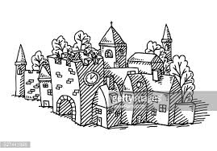
Structure of the paper
Principles of the division of labor.
The evolution of a cooperative division of labor in insect societies.
The organization of primate societies.
The possible emergence of a complex primate society.
Only two extreme paths towards the division of labor?

Slide 57
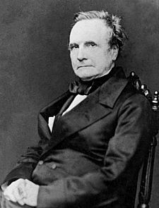
Babbage Principle of the division of labour
"That the master manufacturer, by dividing the work to be executed into different processes, each requiring different degrees of skills or force, can purchase exactly that precise quantity of both which is necessary for each process; whereas, if the whole work were executed by one workman, that person must possess sufficient skill to perform the most difficult, and sufficient strength to execute the most laborious, of the operations in which that art is divided."(Babbage, 1832 pp.137-8).

Slide 58
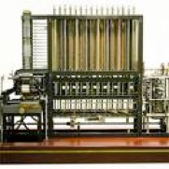
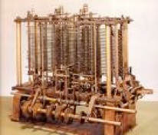
According to Babbage
The division of labour entails:
- the exploitation of the principle of comparative advantage (because it allows each individual to perform only that activity in which she is comparatively more gifted).
- a dramatic saving of training time.
If each worker is performing all the tasks necessary for a certain productive process , it also becomes necessary that each worker learn all these tasks.
By contrast if a very detailed division of labour happens to be introduced, and each worker is assigned only one task, then she obviously has to learn only that task.
The principle can also be applied to intellectual work
and even after the introduction
of Babbage’s calculating engine.

Slide 59
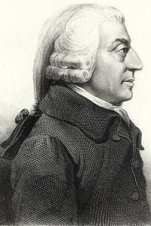
Adam Smith’s principles of the division of labour.
The difference in skills more a consequence than a cause of the division of labour. There is little comparative advantage to be exploited before the introduction of the division of labour. The differences in skills arise as a consequence of the introduction of the division of labour.
Smithian principles of the division of labour: improved dexterity, saving of time otherwise spent on changing occupation, and invention of machines by workmen. Specialization favours the acquisition of job-specific skills.

Slide 60
Smith vs. Babbage
Babbage concentrates on the advantages due to an optimal utilization of given skills
Smith: the advantages of the division of labour due to a better acquisition of new skills,
Babbage: the division of labour increases productivity because it minimises the amount of learning which is required for doing.
Smith: the division of labour increases productivity because it maximizes the amount of learning acquired by doing.
For Babbage: the learning necessary for the doing should be minimized
For Smith: the learning due to the doing should be maximized.

Slide 61
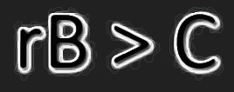
Social insects: the traditional explanation
The traditional explanation of the cooperative division of labor, existing in some insect societies, has been based on the Hamilton (1964) rule.
The Hamilton rule relates the degree of altruism of individual towards other individuals to the degree to which they share the same genes. If each selfish gene maximizes its fitness, some degree of altruism can only be shown towards closed relatives.
Social insects share the same queen mother and have a degree of relatedness greater than that existing in the other species. This would explain their altruism and their consequent cooperative behavior, leading to a sophisticated division of labor.

Slide 62
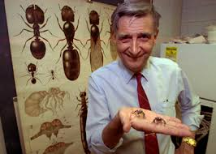
O. E. Wilson’s Criticism
In the bees’ or ants’ societies only Queens transmit their genes. The altruism or the selfishness of the other social insects is therefore irrelevant to explain their behavior.
We can also add that altruism cannot by itself explain why cooperation takes the sophisticated mode of the division labor, in which different individuals of the population specialize in different and interdependent tasks.
O. E. Wilson (2012) challenge has given raise to a fierce dispute within the field of evolutionary biology and in particular a harsh reaction Dawkins (2012) .
For equilibrated accounts of the debate are given by Gadagkar (2010) and Gintis (2012).

Slide 63
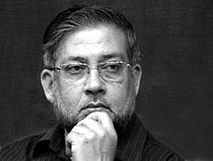
Gadagkar’s Transition Societies
In wasps' societies the fertilization system has mixed characteristics.
Whilst some wasps have an individual reproduction system similar to that of non-social insects, some others join as workers a common nest ruled by a Queen specialized in the production of larvae.
In the Queen's nest workers are still potentially fertile. They can do better than isolated wasps, which do not share the common facilities (for instance, defence) existing in the nest. The workers can hide their own offspring in the Queen's nest. Sometimes, they have also the chance of organizing a coup d'état and, if successful, can become Queens.

Slide 64


From Wasps to Bees
The survival and reproduction strategies, carried out in the Queen's nest, involve both cooperation and conflict.
For instance, while everyone cooperates in raising the larvae, the workers try to smuggle their eggs in the nest, going against the fitness of the Queen.
A possible strategy of the Queen is to produce unfertile offspring that specialize in different functions. This mutation, genetically transmitted and reinforced from Queen to Queen, can easily spread to the entire population.
The nests, where the Queen's strategy is adopted, can outcompete the other nests by decreasing the cost of conflicts and by capturing the gains of specialization.

Slide 65

Smith and Babbage in the world of insects.
The Smithian advantages of the division of labor do not have an important role. No learning by doing process characterizes the working life of each insect.
Moreover no exchange among insects takes place in their society.
By contrast some principles analogous to the ones indicated by Babbage seem to be working in insect societies.

Slide 66

The Insects’ Queen as a Master Manufacturer
Like Babbage’s Master Manufacurer the Queen minimizes her costs. Her total reproductive effort (instead of training time) is minimized by investing in the ant workers only the capability to carry small amounts of food and making the fighting ants are much bigger.
Moreover, the division of labor is organized by the Queen on the basis of comparative advantage:
- the big ants have an absolute advantage in both fighting and carrying staff but they have not a comparative advantage in carrying staff. Hence they specialize in fighting.
- the small ants, having a comparative advantage in carrying food, specialize in that activity.

Slide 67


Primates vs. Insects
1) In primate societies sex consumes much energy and involves many fights (among males). By contrast social insects are characterized by little energy dedicated to sex. Males are in subordinate positions. Most fights are among females.
2) Female insects can produce a large number of offspring. Primates (including humans) can produce only few.
3) In the case of mammals great individual care is required for each offspring. Insects can rely on large numbers of larvae requiring comparatively little individual initial investment and care.
The pre-condition of the insects' division of labor is that one female (the Queen) can specialize in the reproductive function outsourcing to others the remaining tasks. This route towards a complex division of labor is not available to mammals.

Slide 68

Chimps and over-investment in fertility signals
Like many other species, female chimps advertise very much their fertility periods.
What matters is not simply to advertise but also to signal with greater efficacy than other females. Female receptivity, other fertility signals (smell, visual signals etc.) and length of the receptivity period undergo a process of positional competition.
The reinforcement of fertility signals is likely to come to a rest at the point where the energy invested in the positional advantage equals the fitness sacrifice due to forgone alternative investments.
Males react by making huge positional investments in insemination capacities. By contrast they invest little in exclusive access as their size similar to that of female shows. They do not invest in the protection of their offspring (that they cannot identify!).

Slide 69

Under-investing in fertility signals: gorillas
However if the female fertility signal is fairly low and short, it may be convenient to make it even lower and shorter. Males, facing a lower cost of monitoring the entire fertility period, can invest in the exclusive access of females and in the protection of their offspring.
Gorillas belong to this minority category. Males make huge positional investment in body size to fight other males and get exclusive access to females. The strongest males are able to control a good and large territory where some females may choose to live and reproduce. The short and weak fertility female signal can be well perceived only within the territory controlled by the dominant male. If a male gorilla is strong enough, the harem can be easily controlled.
Male gorilla's sexual attributes are very small. They have evolved as an efficient adaptation to sexual monopoly.

Slide 70


The gorilla’s territory as a wasps’ nest
Similarly to the wasps' nest the territory controlled
by the male gorilla is a locus of conflict and cooperation.
Female gorillas can increase their fitness by joining the harem of a silverback. Similary to a wasp, a female gorilla could reproduce outside the territory of a dominant male. She could easily be inseminated by the numerous gorilla males who have failed to monopolize a valuable area of the territory.
However, the eventual benefit of multiple inseminations would be negligible in comparison to the fitness loss related to the forgone advantages of the silverback cooperation and in particular of his protection against predators.
The female gorilla finds it convenient to cooperate in the harem. However she finds also convenient to device conflictual strategies to attract more attention than the other females.

Slide 71

A transition primate society?
Also the gorilla territory is not only a place of cooperation but also a locus of conflict. Each female belonging to the harem may gain in fitness by receiving more attention by the silverback. The two signals of fertility (female receptivity and "mechanical" signals in the form of color and smell) may be manipulated and disentangled.
A female, who can extend her behavioral receptivity signals and hide her mechanical signals, may attract more attention than the other females. A dynamics of extended receptivity signals and of decreased mechanical signals is well possible.
With a zero or very low mechanical signals, the silverback loses the criterion to monitor a particular female. Sexual conflict may involve a disintegration of the harem system. Similarly to wasps, the gorilla arrangements can be seen as those of a transition society.

Slide 72

The consequences of a negligible mechanical fertility signal
A negligible mechanical fertility signal opens the way to smaller harems and eventually to widespread monogamy. More important, the techniques of control have to change.
The absence of short and weak fertility signal makes male physical strength a much weaker tool to secure exclusive access. Female self-monitoring and her assessment become very important. Communicating trust and reciprocity attitudes stimulate paternal investment. More sophisticated language capabilities than the birds' melodies or the gibbons' love singing (indicated by Darwin as precursor of the human language) are required for this purpose.
A brain-intensive understanding of potential partners and rivals become necessary to make convenient deals. Communication capabilities, the Smithian requisites for the division of labor, are favored by this new type positional competition.

Slide 73


In medio stat virtus?
A complex division of labor could be reached in two opposite ways: with minimum and maximum initial parental investment.
The social insect road was a là Babbage. It evolved by outsourcing functions to unfertile offspring requiring minimum reproductive effort and exploiting the principle of comparative advantage.
The human road was a là Smith. It evolved by maximizing the learning capabilities of a large brain requiring maximum reproductive effort.
In between these two extreme cases, both evolutionary roads towards a complex division of labor were closed and only the species existing at the extreme of lifes could realize what O. E. Wilson calls the social conquest of the world.
(Non) est modus in rebus!

Slide 74
A final remark
The social movements revolting against the factory system based on the Babbage principle have often claimed that Capitalism was doing violence to human nature.
In Marx’ words “the better formed his product, the more deformed becomes the worker ”.
The claim may seem moralistic. However there is some evolutionary evidence supporting it.
Humans evolved their division of labor by developing their learning capabilities. However, some of them were later forced to organize according to principles of the division of labor characterizing the other extreme of life.

Slide 75
Two directions of causation.
Specificity and Monitoring Characteristics of Assets
Property Rights and
Organizational Form
The most specific and difficult to monitor agents can save the greatest amount of agency costs when they control the organization.
:
:
The agents controlling the organization will tend to become the most specific and difficult to monitor

Slide 76
New Institutional theory has emphasized that owners of specific and
hard-to-monitor resources tend to acquire rights and safeguards more than the owners of general purpose and easy-to monitor resource. This claim can be stated as:
(1) In the property right domain, a property right system P^{C} is marginally better than another property right system P^{L} if the corresponding technology T^{c} instead of the technology T^{L} prevails in the technology domain.
Where
T^{c} : a technology where capital is intensively used as a specific and hard to monitor resource
T^{L} : technology where labour is intensively used as a specific and hard to monitor resource
P^{C} : a governance system where the owners of capital have strong rights and safeguards
P^{L} : a governance system where workers have strong rights and
Safeguards.

Slide 77
Inverting the Argument.
In a word of positive transaction costs the owners of resources enjoying rights and safeguards tend to become more specific and hard to monitor than those without rights and safeguards. This claim can be stated as:
(2) In the technology domain a technology T^{L} is marginally better than a technology T^{c} if a property right system P^{L} instead of property right system P^{C} prevails in the property right domain.
This is an argument that has been typical emphasized by radical economists against the efficiency predictions of NIE. However, it is consistent when NIE when one assumes positive transaction costs.

Slide 78
(1) In the property right domain a property right system P^{C} is marginally better than another property right system P^{L} if the corresponding technology T^{c} instead of the technology T^{L} prevails in the technology domain.
(2) In the technology domain a technology T^{L} is marginally better than a technology T^{c} if a property right system P^{L} instead of property right system P^{C} prevails in the property right domain.
Where
T^{c} : a technology where capital is intensively used as a specific and hard to monitor resource
T^{L} : technology where labour is intensively used as a specific and hard to monitor resource
P^{C} : a governance system where the owners of capital have strong rights and safeguards
P^{L} : a governance system where workers have strong rights and
safeguards.
We can have multiple equilibria (P^{C}, T^{c}) and (P^{L}, T^{L} )
P^{C} and T^{c} and P^{L} and T^{L} are, in this case, institutional complements.

Slide 79
IPR as Global Rights
With the institutions of WTO and Trips, the possibility of choosing the rights of a particular model of capitalism has become limited.
Intellectual Rights are global rights and limit the available choices.
This raises the following questions:
What are the effects of intellectual property rights on human capital investments?
Is there a “second best” allocation of intellectual property rights?
What is the dominant force? The efficient drive to second best or path dependency.
Could we do better with a reward system operating in the public sphere of the economy?
What are the effects of Trips on the open vs. closed science boundaries?

Slide 80
Why is the NPR approach better interpreted as a theory of intellectual ownership?
When technological knowledge is involved to a significant extent the degree of contractual incompleteness is likely to be high.
The notion of asset specificity has a clear-cut content when the specific investments at stake concern assets that, because of IP protection, cannot be legally replicated without the owner’s consent. They become unique resources.
  (By contrast, even when the physical asset is presently unique, the specificity of human capital may only last a relatively short time if the asset can be reproduced).
The incentive effect of private property are likely to be greater for IPRs
Notes:
As I recalled a couple of slides ago, the New Property Rights theory provides an analytical framework relevant in circumstances characterized by contractual incompleteness.
The easier it is to specify in a contract the details of the relationship, the lower the importance of the allocation of residual rights of control.
Now, in the NPR approach the source of contractual incompleteness resides in the impossibility of third-party verification of the contractual provisions. This is a circumstance particularly likely to occur when contracts involve investments specific to intellectual assets.

Slide 81
Tension
  The NPR theory is better interpreted as a theory of the allocation of intellectual ownership
  but........
  ......the “inverted” NPR logic is also more stringent when IP assets are involved
Thus, the self-reinforcing interaction between property rights and technology may have particularly perverse consequences that hinge upon the direction of technological development and contribute to the perpetuation of inequalities.
Both redistributive interventions and the adoption of incentive mechanisms based on disclosure may be justified by the need to avoid excessive monopolization of knowledge and to ensure greater equality as well as greater overall efficiency.

Slide 82
Characteristics of the optimal ownership allocation
Property of intellectual assets should be given to the agents that are going to make the most relevant investment in human capital specific to these assets.
Complementary intellectual assets should be under common ownership.
Independent intellectual assets should be owned separately.

Slide 83
Implications of the characteristics of non-rivalness and non-excludability for the theory
Non-rivalness
  Efficient ex-post use of intellectual assets involves simultaneous access by many agents
  Absent IP protection, many agents could have simultaneously invested in human capital specific to the assets.
Non-excludability
  The incentives, provided by an efficient allocation of ownership, may not display the full effects that the theory predicts

Slide 84
Transaction costs and inversion the Skills-IPR direction of causation.
If transaction costs prevent property rights from being attributed to the “efficient owner”, whoever is the current owner will invest in human capital specific to the assets
The logic of the NPR approach can therefore be inverted
A double relation of causation should be considered. If property rights are chosen on the basis of given technologies and abilities, also the opposite is true: abilities and technologies are chosen on the basis of existing property rights. (Concept of Organizational Equilibrium and of Institutional Complementarities).
Firms Capabilities
Intellectual Property

Slide 85
A simple model on the institutional complementarity between IPRs and technology
Consider two different (sets of) agents G and B and consider two different domains of choice:
  the property rights domain (P)
  the technology domain (T)
P^{G} and P^{B} denote, respectively, the cases in which the assets A are attributed to the individuals G and the case in which they are given to the individuals B at the beginning of the period
T^{G} and T^{B} denote two different technologies characterized by the fact that the intensity of the specific investment of agents G with respect to agents B is relatively higher in T^{G} than in T^{B}
Denote by x the extra-agency cost that G must pay to induce B to invest in capabilities when G owns A
Denote by y the extra-agency cost that B must pay to induce G to invest in capabilities when B owns A

Slide 86
Given the property rights system P^{G}, the firm will maximise::
(1) R_{G} = Q(I_{G}, I_{B}) – [I_{G}c_{G}+ (x + c_{B}) I_{B}] ----->T^{G}
Given the property rights system P^{B} , the firm will maximise::
(2) R_{B} = Q(I_{G}, I_{B}) – [(y +c_{G}) I_{G}+ c_{B} I_{B}] -----> T^{B}
Given an (optimal) technology T, defined by (I_{G}, I_{B}) , property rights over assets A will be attributed:
to agents G when the benefit U(P^{G}) of the property rights structure P^{G} exceeds the benefit U(P^{B}) of the property rights structure P^{B}, that is when R_{G} ≥ R_{B}, or:
(3) yI_{G} ≥ x I_{B} -----> P^{G}
to agents B if the benefit U(P^{B}) of the property rights structure P^{B} is greater that the benefit deriving of the property rights structure P^{G} , i.e. when R_{B} ≥ RG, or:
(4) x I_{B} ≥ y I_{G} -----> P^{B}

Slide 87
(3) yI_{G} ≥ x I_{B}
(4) x I_{B} ≥ y I_{G}
can be rewritten as:
(3’) T^{G} =I_{G} /I_{B} ≥ x / y
(4’) T^{B} =I_{G} /I_{B} ≤ x / y
P^{G}
P^{B}
P^{G}
P^{B}
In the domain of property rights P the benefit from choosing the
property rights structure P^{G} (instead of choosing P^{B}) increases when a
technology characterized by a relatively higher intensity of investment by
agents G is selected in domain T, that is when T^{G} is selected instead of T^{B}.
U(P^{G}, T^{G} ) - U(P^{B} , T^{G} ) ≥ U(P^{G}, T^{B}) - U(P^{B}, T^{B})

Slide 88
(1) R_{G} = Q(I_{G}, I_{B}) – [I_{G}c_{G}+ (x + c_{B}) I_{B}]
(2) R_{B} = Q(I_{G}, I_{B}) – [(y +c_{G}) I_{G}+ c_{B} I_{B}]
Maximizing (1) and (2) imply that:
T^{G} =I_{G} /I_{B} ≥ T^{B} =I_{G} /I_{B}
In the domain of technology T the benefit from choosing technology T^{B}, characterized by a relatively higher intensity of investment by agents B, increases when the property rights structure selected in domain P is P^{B} instead of P^{G}.
U(T^{B}, P^{B}) - U(T^{G} , P^{B} ) ≥ U(T^{B}, P^{G} ) - U(T^{G} , P^{G} )

Slide 89
(P^{G}, T^{G}) is a green (organizational) equilibrium
for the set of values for which the property rights structure P^{G} maximizes profits under the prevailing technology T^{G} and, in turn, the choice of technology T^{G} maximizes profits given the property rights structure P^{G} . This occurs when the values of the arguments (I_{G}^{G}, I_{B}^{G}) that maximize (1) satisfy also (3’), i.e. when:
(5) I_{G}^{G} / I_{B}^{G} ≥ x / y
(P^{B}, T^{B}) is a brown (organizational) equilibrium for the set of values for which the property rights structure P^{B} maximizes profits under the prevailing technology T^{B} and, in turn, the choice of technology T^{B} maximizes profits given the property rights structure P^{B}. This occurs when the values of the arguments (I_{G}^{B}, I_{B}^{B}) that maximize (2) satisfy also (4’), i.e. when:
(6) I_{G}^{B} / I_{B}^{B} ≤ x / y

Slide 90
Since:
the ratio x / y is positive and I_{G}^{G} / I_{B}^{G} ≥ I_{G}^{B} / I_{B}^{B}
x / y can either fall in the interval defined by I_{G}^{G} / I_{B}^{G} and I_{G}^{B} / I_{B}^{B}
0r outside it.
We have therefore that:
a) Multiple property rights-technology equilibria (P^{G}, T^{G}) and (P^{B}, T^{B}) exist when the following condition is satisfied:
I_{G}^{G} / I_{B}^{G} ≥ x / y ≥ I_{G}^{B} / I_{B}^{B}
i.e. when both condition (5) and (6) are satisfied.
b) A unique equilibrium (P^{G}, T^{G}) exists when: I_{G}^{G} / I_{B}^{G} ≥ x / y
i.e. when condition (5) is satisfied but condition (6) is not satisfied.
c) A unique equilibrium (P^{B}, T^{B}) exists when: I_{G}^{B} / I_{B}^{B} ≤ x / y
i.e. when condition (6) is satisfied but condition (5) is not satisfied.

Slide 91
The tragedy of the anti-commons.
Increased role of closed science:
“Upstream” patenting may exacerbate the problems posed by the dispersion of complementary assets – the so-called “Tragedy of the anticommons”.
  some inventions may never be realized
  the prospect of incurring high transaction costs may bias the choice of technology towards research paths deliberately and excessively independent one from the other.
Merits of open science:
Because of the associated rule of disclosure reward systems,, may facilitate the aggregation of complementary assets to the extent that efficient mechanisms for the diffusion of innovations are put in place and avoid the anti-commons tragedy.

Slide 92
The New Property Right Approach has stressed the incentive effect of ownership of specific assets in a world of incomplete contracts. However, these incentive effects are much stronger for “intellectual capitalism”.
The complementarity between the accumulation of skills and
intellectual capital may generate increasing inequality:
-----> Ownership of Intellectual Capital ----->
Incentive to acquire new IPR-specific skills --
-----> Ownership of more Intellectual Capital -
-------->
A new model of accumulation?

Slide 93
4
The complex governance of the firm.

Slide 94
The Law-Economics Marriage
Remember that in Calabresi’s Cathedral a Fuller-Coase marriage can be easily celebrated.
The firm can be seen as a child of the marriage embodying the genes of both parents:
a centralization of market transactions
a decentralization of the public ordering
The main feature of the firm is not a common property of non-human assets but a system of common liabilities and of centralized power which, inter alia, allows an internalization of a Calabresi-type judicial function.

Slide 95
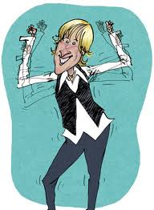
The usual view of the degenerate child
Many economists (such as Demsetz) have seen the corporation as generated by high transaction costs: they make it convenient to centralize contracts in the corporations.
However, the corporation is seen as degenerate child of the market: its powerful incentives are lost and manager’s incentives are not aligned with the goals of shareholders.
Remedies: incentives, such as stock-options, could re-align managers’ incentives with the interest of the corporation.

Slide 96
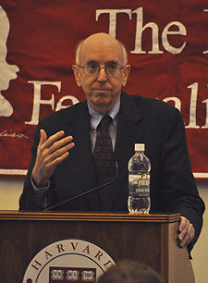
Posner: advantages of the degenerate child
The business corporation ended up by having a legal personhood similar to that of other public organizations.
It had an inner dynamism superior to other organizations whose personalities were restricted to a territory (national states and their bodies) or to a specific mission (universities), or which required faith in particular beliefs (churches).
The business corporation has no territorial limitation, no specific mission, and no faith constraining its opportunities.

Slide 97
Posner: disadvantages of the degenerate child
However, territory, mission and faith do not simply constrain personalities; they also define their identities.
This may be particularly important in the case of non-mortal legal persons. In spite of their non-mortality, these can only live if some mortal individuals identify with them.
This identification is much easier if the non-mortal person has a well-defined identity.
In the case of Posner the corporation stems from a decentralization of legal personality to a half-person that can be sold and bought on the market. The bench marks for degenerate child are the public bodies that generated it.

Slide 98
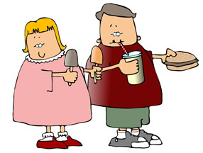
Degenerate parents!
If the corporation was generated by costly markets and/or by costly centralized orderings, there are no perfect parents.
Degenerate parents generated degenerate children.
There is no perfect bench-mark to which the corporation should be compared.
We are always comparing imperfect solutions..........

Slide 99
History Matters!
The Evolution of the Coorporation has gone along different paths in Europe and the U. S.
In Europe strong block holders and families dynasties have prevailed.
In the U. S. dispersed ownership and managerial power have been much more frequent.
In different historical circumstances, degenerate parents can generate all sorts of degenerate children!

Slide 100
The economic consequences of Justice
In a Coase-theorem world with zero transaction costs attributing the rights to a particular individual has no “economic” consequences. In any case rights will flow to the individual who values them the most. We are in a Legal and Economic Nirvana where judges can ignore the economic consequences of their decisions.
In a world with positive transactions the decisions of the judges have economic consequences because rights will not necessarily flow efficiently to the individuals who value them the most. According to Posner (and to much classical Chicago, law and economics) in this case judges should allocate rights, according to criteria of economic efficiency to the individuals who value them the most.

Slide 101
Judges as wealth maximizers?
According to Posner, Judges, aware of the economic consequences of their actions should behave like quasi-markets attributing the rights to the individuals who in a world of zero transaction costs would have acquired them.
They apply the Kaldor criterion according to an allocation is efficient if the gainers could have compensated the losers.
Relation between Kaldor criterion and Pareto principle.
He claims that this is consistent with an intuitive view of justice. If avoiding some damages is very costly for some agents and not costly for the others, the latter are guilty for the damages.

Slide 102
Fading boundaries?
Posner view is extreme. Clearly, in most cases, economic efficiency cannot be only criterion for the administration of justice. But it shows how difficult is to separate efficiency and justice considerations in a world of positive transaction costs.
The impossibility of defining sharp boundaries becomes even more clear when we accept Fuller’s view (and also Hayek’s and Bruno Leoni’s views!): all sorts of public and private orderings co-exist in the economy and they all face the problem of compromising efficiency and (other types) of justice considerations.
In the law and economics approach some boundaries between the two disciplines disappear and also a clear-cut delimitation with ethical considerations fades away.

Slide 103
Posner’s public ordering Nirvana.
In spite of these interesting implications for the activity of the judiciary, Posner pushes to extreme consequences the economists’ implicit assumption of a legal Nirvana where judges can efficiently fix the problems of the market economy.
This assumption implies that the judiciary is not limited by any form of “economic” scarcity (both in terms of cognitive and physical resources).
Moreover Posner does not consider the possibility that lobbies may influence the activity of legislation (Olson’s rent-seeking or influence costs).

Slide 104
Williamson: a symmetric private ordering Nirvana?
While Williamson rejects the idea of an efficient public ordering, he assumes that private orderings can efficiently fill the gaps that are left open by the incompleteness and the efficiency of the public ordering.
Firms and the organizations of private governance are explained by their efficiency attributes. They fix the problems due to the incompleteness of “public domain” contracts.

Slide 105
Posner vs. Williamson.
There is an evident (and explicit!) contradiction between Williamson NIE and Posner’s law and economics: each one is making a Nirvana assumptions about one different domain.
The Nirvana domain is fixing the inefficiencies of the other domain and, therefore, there is no feed-back of its inefficiency on the other domain.
In both cases there is no mutual interaction between the possible inefficiencies of the two domains. The Nirvana domain does best whatever the other domain does.

Slide 106


The Cathedral framework.
Contractual incompleteness does not imply that everything should be decided at the outset on the basis of future negotiations, unfettered by some form of third party judiciary.
In the Cathedral, when ex-ante exchanges have been impossible, ex-post negotiations can still be supervised by courts.
In Calabresi’s framework, when high transactions make it impossible to have ex-ante property exchanges, it is still possible to apply liability rules and courts’ supervision of ex-post transactions.

Slide 107
3 (+1) Columns for the Cathedral.
Property rules (low transaction costs).
Liability rules (intermediate transaction costs)
Negligence rules and criminal law (high transaction costs or inalienable assets).
Another Column:
Private orderings and corporate governance.
Both Calabresi and Williamson involve a fundamental transformation that makes monopoly and competition two different stages of the same relations.

Slide 108
Calabresi’s Fundamental Transformation:
Because of the high number of possible accidents, negotiations occur after individuals have “disinvested” in specific accidents.
Ex-Ante Competition
Ex-Post Bilateral Monopoly
Ex-Post Transactions under Courts Supervision.

Slide 109
Williamsons’s Fundamental Transformation:
Because of the high number of possible events, negotiations occur after individuals have invested in specific assets.
Ex-Ante Competition
Ex-Post Bilateral Monopoly
Ex-Post Transactions under Firms’ Governance.

Slide 110
The Fundamental Differences.
Unlike accidental disinvestments, specific investments are more likely to involve a voluntary choice of the counterpart and of the third party endowed with judicial power.
In cases like car accidents, the ex-post relation lasts only for the time of readdressing the specific damage. There are no gains from continued cooperation and no incentive of private third parties to make second-order specific investments in the verification of the specific (dis)investments.
The private agents making verification investments can set up governance structures and become residual claimants for the extra-return on (first order) specific investments which are due to they “second-order investments” in the building of appropriate private orderings.

Slide 111
Ex-ante contractual Incompleteness
Calabresi and Williamson
Ex-post Verification Capabilities.
Calabresi
Williamson
Public orderings.
Independent
Agents.
Fuller-Coase
Emergence
of
the Firm.
Private Orderings.
Employed
Agents

Slide 112
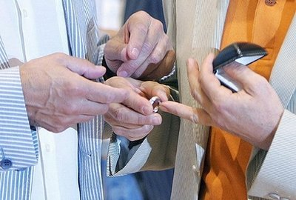
Same-Sex Marriage in the Cathedral
In Calabresi’s Cathedral a Fuller-Coase marriage can be easily celebrated.
The firm appears as a centralization of market transactions and a decentralization of the public ordering which arises when co-specific investments make it desirable a system of joint liabilities.
The main feature of the firm is not a common property of non-human assets.
Its main characteristic is a system of common liabilities and of centralized power which, inter alia, allows an internalization of a Calabresi-type judicial function.

Slide 113

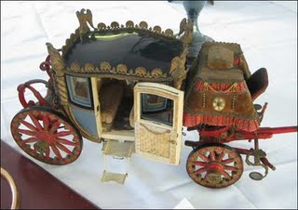
GM-Fisher Body: an hold-up story?
Much literature sees the reason for the existence and growth of firms in common ownership of machines and plants which avoids hold-up problems.
A typical example, given in this literature, is the GM-Fisher Body vertical integration when Fisher-Body was holding-up GM which wanted to expand production facilities
Fisher increased its short-term proﬁt by failing to make the investments required by GM in a plant located near GM production facilities in Flint, Michigan.

Slide 114
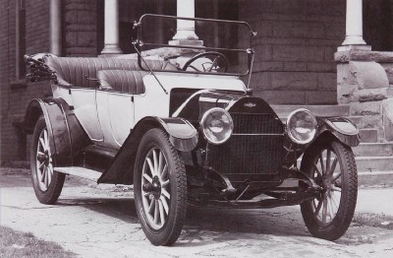



Top management with a judicial function.
GM growth required the adjudication of the responsibilities among individuals cooperating in production.
Example: Kettering vs. the production production and the failure of the copper-cooled (air-cooled) engine.
The role of Alfred Sloan:
- Separation between top management and management of division
- No horse trading in the central offices.
- Top management with a “judicial function” adjudicating rewards and liabilities.

Slide 115


A different interpretation.
The transition from open body to closed body.
Road-holding: fit between car body and engine.
Unlike airplanes and boats, the body and engine of the car became co-specific.
Unified liability towards customers and internal adjudications of liabilities.
Sloan’s “internalization” of the judicial function.

Slide 116
5
The hybrid thing-person nature of the corporation

Slide 117
The evolution of the corporation
The corporation evolved from a process of concentration of ownership along Coasian lines which involved an huge centralization of market transactions.
The centralization could not have been by mortal legal person but involved the creation of immortal legal fictions.
This last process evolved along Fullerian lines and implied an evident decentralization of the public ordering.

Slide 118
Commitment and Esteem
Commitment (Colin Mayer) and Esteem (Petit) are two aspects of human nature that are relevant to understand all sorts of human institutions and organizations.
Human evolution involves that commitment and esteem play a central role in human affairs. Moreover, the esteem derived from the commitment to non-human persons is likely to be a universal outcome of the evolution of our species.
A naive view of evolution, paralleling the utility maximizing individual of neoclassical theory, would only emphasize the role of the selfish gene and would be unable to explain the evolutionary emergence of commitment and esteem.
The esteem for individuals showing commitment to non-( and often super-) human entities has marked the most important achievements and the most tragic failures of our species.

Slide 119
Selection taxes and subsidies.
The natural world is often seen as some sort of competitive market exclusively driven by the adaptations to the environment.
However, in nature, tax and subsidies are produced by the interactions of different selection mechanisms.
While what matters is overall fitness, the different forms of selection can still be distinguished in terms of the different selective agents:
forces active in the environment (natural selection),
- a mate or a rival (sexual selection),
humans (artificial selection).
One selective agent may impose a tax or a subsidy on other selective agents.
Humans (artificial selection) impose these taxes and subsidies on natural selection.
However, also sexual selection can play a similar role.

Slide 120


The Peacock Tail Tax and the Human Brain Subsidy
Sexual selection has effects on natural selection.
One well-known case is the growth of the peacock tail which imposes a tax for the species in terms of its successful adaptation to the environment.
However, in cases of complementarities, sexual selection can give a subsidy to one particular characteristic and help to unfreeze epistatic interactions.
This last case is relevant for the development of human intelligence.

Slide 121
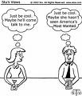
A Sexual Subsidy to Human Intelligence.
Because of concealed ovulation, exclusive access could only be gained by long term relations, which, in hunting and gathering societies, required women’s cooperation. Unlike other female primates, women had some bargaining power, including the possibility of exchanging exclusive access for parental care or other benefits.
Long term deals require articulated languages, emotional and rational understanding, social and political skills and the ability to show some moral virtues such as commitment and loyalty.
The human fertilization system gave a sexual subsidy to the “infant industry of our intelligence”. The positional advantage that intelligence gave in sexual selection allowed us to overcome the public good and complementarities problems that impeded its development.

Slide 122


Human intelligence and sexual selection
For women, concealed ovulation implied that brain-power was a decisive element in sexual selection. With concealed ovulation receptivity signals could be sent only to the particular males best fitting their tastes and their interests (including the parental investments that one could have expected from particular partners). While, for most species, signalling receptivity was a mechanical action, in the case of humans it became one of the many brain-intensive activities that women had to learn to perform.
In order to gain exclusive access to fertility also men had also to acquire brain-intensive social skills. In order to find reliable partners they had to learn to play all sorts of complicated social games (and also, sometimes, the ability to break the rules).

Slide 123
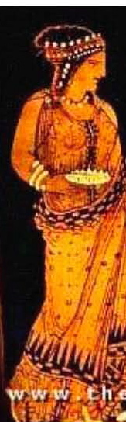
The Classical Hypothesis: Harmony’s Fate.
Harmony was given as bride to Cadmus the founder Thebe who had saved Zeus from the monster Tifeus.
Her own fate and Thebe’s fate show that her mission was a failure and originated the great tradition of Greek tragedy.
She was the daughter of the God of Love and of the God of War and embodies the idea that Harmony required both Love and War.
The solidarity of communities should co-evolved and in some sense it was a product of war and hate.
Harmony was a Goddess of Parrochial Altruism!

Slide 124
The Classical hypothesis:
From War to Love.
Human cultural differentiation allowed an unlimited possibility of waging wars.
Intragroup love was stimulated by intergroup hate.
Wars allowed group selection favouring groups that were characterized by internal harmony.
Human gender relations were shaped by the need to reduce internal conflict. Concealed ovulation, hiding sexual attributes and monogamic relations may have been the product of wars and of group selection.
War generated human harmony, human gender relations and human love together with hate..
Questions: No harmony without wars?
No love without hate?

Slide 125
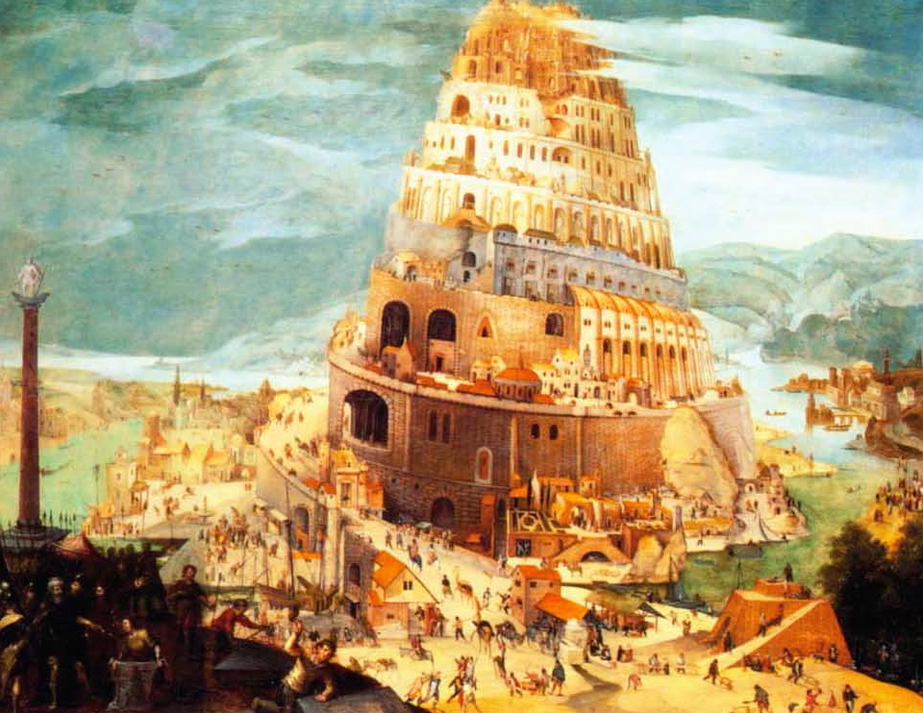
The Biblical hypothesis: Babel Tower.
Now the whole world had one language and a common speech.
They used brick instead of stone, and tar for mortar. Then they said, "Come, let us build ourselves a city, with a tower that reaches to the heavens, so that we may make a name for ourselves and not be scattered over the face of the whole earth."
The LORD said, "If as one people speaking the same language they have begun to do this, then nothing they plan to do will be impossible for them. Come, let us go down and confuse their language so they will not understand each other."

Slide 126
The Biblical Hypothesis:
From Love to War.
In the classical hypothesis, cultural differenziation and wars are exogenous and the human fertilization system may endogenously arise.
In the Babel Tower Story Communication, love and cooperation are given before cultural differentiation and wars. The pre-existence of human culture (and of large human brain) allows later cultural differentiation and wars.
The development of human nature (perhaps linked to the forbidden fruits of knowledge and love) is the prerequisite of a human elementary culture (but far more advanced than the culture of the other species) which in turn can generate cultural differentiation and wars.

Slide 127
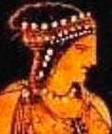
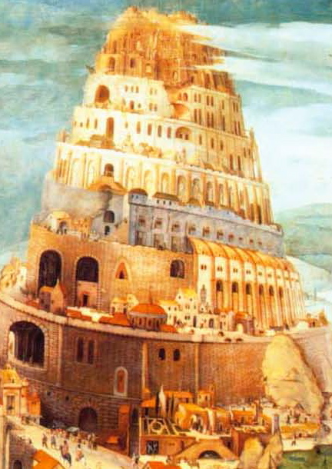
A CLASSICAL-BIBLICAL INTEGRATION?
Human Love
Large Brain & Culture
Cultural differentiation
Wars
Group Selection

Slide 128
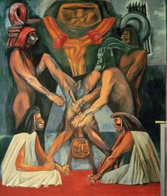
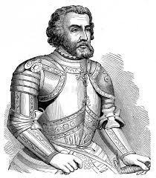
Sacrifices and group personalities
Individuals that see each other that are ready to die (and kill) for a group. They feel like being part of a single organism because:
1) divides, created by cultural diversity, make groups real selection units.
2) selection favors groups with ideologies esteeming individuals according to their commitment to the group.
The group is treated an independent entity characterized by a super-human personality, pre-existing and going beyond individual lives. The personality of the group and the nature of its “fiduciaries” change from group to group but it does usually involves rules consistent with the superior community interests.
When Cortes went to Mexico, different ethnic groups where ready to sacrifice themselves in war to capture people to sacrifice to their super-human entities dictating their cruel laws.

Slide 129
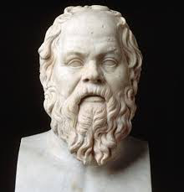

Laws as Persons
In (Plato Crito) Laws are Persons asking Socrates:
“……since you were born, nurtured, and educated through our means, can you say, first of all, that you are not both our offspring and our slave, as well you as your ancestors?”
The rule of law requires Socrates to accept the death sentence and not to escape from jail. The laws of the community are seen as an independent corpus whose will must be respected for the welfare of the community. Even if Athens was a model for democracy its rules share Aztec Gods superiority to individual fates.
Humans regard the commitment to a superior person expressing the rules of the community as the basis their self-esteem. Only on this evolutionary basis, sophisticated legal systems could be built.

Slide 130


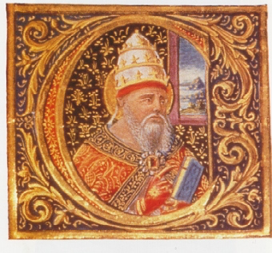
Legal Personality and the Rule of Law
If the power of all the individuals, including that of the present ruler, is constrained by the rule of law, the State must be an independent person. It must be able to have powers and liabilities and rights and duties transcending the particular person acting on its behalf.
The State must be a corporation (an independent corpus) whose potential immortality guarantees the continuity of the laws, allowing the individuals to interact with each other under certain rules.
A similar mechanism characterizes other institutions such as Churches Monasteries, Universities etc. . They are all independent legal persons. As the Aztec priests, their temporary rulers are supposed to identify with community missions, defining their (legal) personality and shaping the nature of rules that they produce.

Slide 131

Chartered Corporations
Chartered corporations, such as the East Indian or the Hudson Bay companies emerged from the need to decentralize the orderings of the National States. For distant missions abroad, rules could not be efficiently set and enforced by the central state.
The corporations became independent legal persons able to own goods and stipulate contracts. Their assets were separated from the assets of shareholders which were liable for the debts of the corporation only for the amounts that they had invested.
More important, since a (legal) person cannot contract with itself (or sue itself in court) chartered corporations where responsible for for settling disputes internal to the corporation and could build a system of rules tailored for their organizational needs.

Slide 132

Monopoly and institutional infrastructure
The first chartered companies had commercial monopolies on enormous territories. Such regulations were later seen as an obstacle to free markets.
However the Sovereign and the Company struck a deal such that the company was paying for the institutional infrastructure necessary to have markets and, in exchange, it could get some monopoly profits. And they shared with the Nation the commitment to the expansion of some political power.
All the institutions that we have considered had an independent personality justified (directly or indirectly via a charter) by a well defined mission (defense or conquest of a territory, diffusion of the faith, education).

Slide 133
The Business Corporation
The chartered corporations made it clear the advantages that firms could derive from having an independent legal personality. They paved the way to free incorporation.
The limited liability of the shareholders allowed unprecedented funding possibilities. The corporation, endowed with its own assets and its potential immortality, could make lasting contracts with the other persons. Many contracts and litigations were replaced by the acts of the corporation internal private ordering.
By decentralizing legal personality the State also decentralized the public ordering.
According to L. Fuller, also the employer may find it convenient to have a "legal system in miniature” and an internal rule of law.
“ If the employer disregards his own rule, he may find his system of law disintegrating and without any open revolt, it may cease to produce for him what he thought to obtain from it."

Slide 134


Business Corporations as half-persons
Iwai says that the business corporation is a half-person.
Like a person it can commit itself to rules and internal orderings, make contracts and enhance its reputation. And indeed its potential unlimited life should mark its superiority with respect to physical persons.
However, unlike a physical persons and unlike other legal persons such as Nation-States, Monasteries, Universities etc it can be treated as a thing to make money and can be bought and sold in the market as a thing.
But things are hardly compatible with persons. They cannot command much esteem for people committed to them and they cannot make commitments that real people are going to trust.
If the thingness of the corporation invades all its personality, then even its economic advantages fade away.

Slide 135
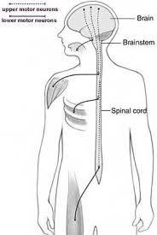
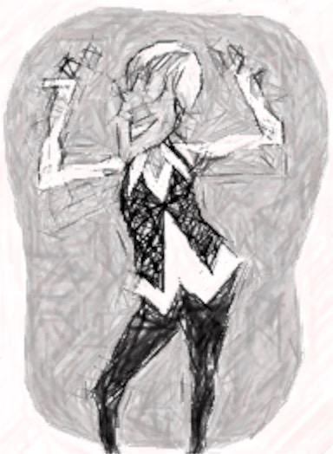
Two ways of keeping degeneration under control
Shareholders have long term advantages from the fact that as a person the corporation can take commitments with other parties. However, they can also gain from selling the corporation as a thing to new owners who do not honor these commitments.
For some time two different paths have been followed to keep the degeneration of the corporate personality under control.

Slide 136

The origins of the American
Corporate Model
At the time of the second industrial revolution, thanks to two major revolutionary conflicts (independence war and secession war), the US had already fought successfully against the old European aristocracy and the slave-owning American farmers of the South.
The development of large firms happened in the framework of a strong democracy. Large block holdings, present in more than one firm, were seen with suspicion by early antitrust authorities, (Sherman and Clayton acts). Pyramids were dismantled by F.D. Roosevelt by the means of appropriate fiscal policies.
This “exceptional” early dispersion of capitalist interests made it less important to concentrate workers’ interests in strong unions and in social democratic parties.
A dispersed equilibrium emerged.

Slide 137
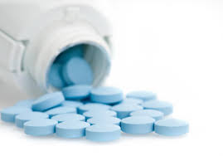
The American anti-degenerative medicine
The American dispersed equilibrium has encouraged investment in human skills of professional managers, the diversification of ownership, and the concentration of large amounts of capital in corporations.
By contrast, it has provided only very mild incentives for the human capital of owners and workers. The absence of family control (Berle and Means) and the extension of managerial hierarchies have allowed the growth of large firms.
In the American case ownership dispersion (and weak unions) and the independence of management have allowed managers to make commitments on behalf of the corporation. In this way the corporation could not be easily treated as thing and could often act as a reliable person.

Slide 138
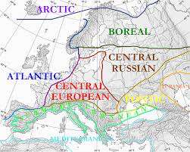
Evolutionary roots of the European Corporations
The European countries (with possible exception of Switzerland) followed a different path: at the time of the second industrial revolution, their societies were hierarchical and still permeated by aristocratic privileges.
No democratic authority could limit the concentration of the power of the capitalist dynasties occurring with the second industrial revolution.
A social-democratic reaction concentrated also workers’ interest.
A concentrated equilibrium emerged in all these countries.

Slide 139
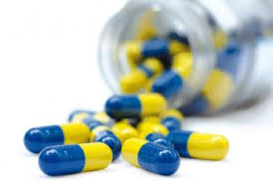
European anti-degenerative medicines
This distribution of rights entailed a stronger incentive for owners (and their heirs) to invest in the human capital necessary to run firms while, at the same time, employment protection creates conditions favourable to firm-specific investments also for some workers.
By contrast, investments in the human capital of professional managers is discouraged. Family control and limited managerial hierarchies have also limited the size of the firms.
In this case, the personality of the business corporation is saved from its “thingness” by identification of the corporation with the fate of the family’s dynasty and by the countervailing powers of the unions. German codetermination system has been a typical example of this type of anti-degenerative medicine.

Slide 140

The failure of anti-degenerative medicines
The financialization of the economy is leading to a failure of the anti-degenerative strategies of corporate personality.
Financial pressure makes managers of Anglo-American corporations treating the corporation as a thing from which they have to extract the maximum value for their shareholders, even when they have taken as persons commitments with other stakeholders.
Financial pressure has the same effect on European family dynasties that can sell their assets to raiders that break the commitment that they have taken with other stake holders. The weakening of Unions makes these moves much easier…..
However, the change that is taking place cannot be understood without referring to another correlated change of modern capitalism……..

Slide 141
6
Financialization, intangibles and the privatization of knowledge

Slide 142
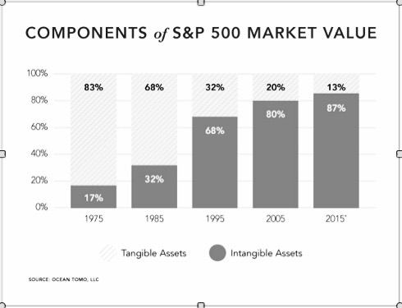
The great asset transformation

Slide 143

Intellectual monopoly capitalism
Big corporations have moved from being rich in machines (and numerous skilled workers) to being rich in intellectual monopoly. Patent, copyrights and trade marks have now become the lion’s share of big corporations assets and they are a distinctive characteristic of a new form of intellectual monopoly capitalism.
The 1980 Bayth Doyle Act and the 1994 TRIPs agreement (an annex to the institution of the WTO) have allowed a massive privatization of knowledge.
Corporations have exploited the huge economies of scale and of scope that arise when knowledge becomes a private input. They have also been able to decentralize production to firms in low labor cost countries without the fear that knowledge could be used by their competitors.

Slide 144

The Knowledge-Economy
Paradox.
The non-rival nature of knowledge, which could in principle favor small, and even self-managed, firms, is used to create artificial economies of size which make a cheap acquisition and the defense of property rights possible only for big business.
Absent knowledge privatization, the need to provide incentives to invest in human capital would be an argument favoring the labor-hiring-capital solution.
Because of the monopolization of intellectual capital the knowledge economy can become the most unfriendly environment for small labor-managed firms and ideal setting for big corporations

Slide 145
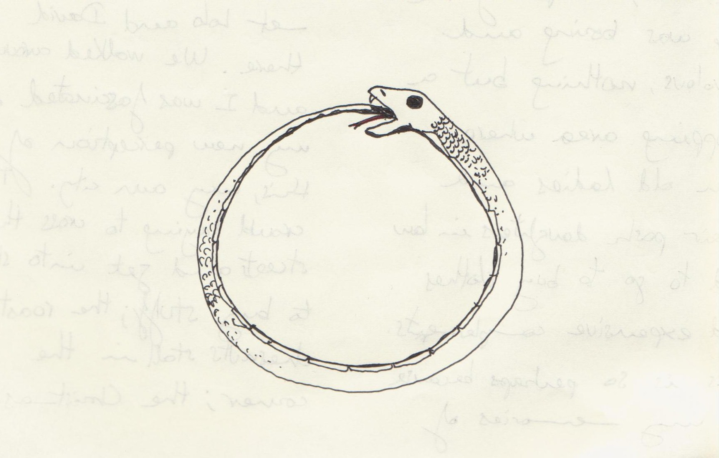

Vicious and virtuos circles
The monopolistic ownership of intellectual property encourages investment in the skills necessary to improve the knowledge that one owns. The skills that are developed make it even more convenient to acquire and produce more private knowledge.
Other individuals may be trapped in vicious circles of under-investment in human capital where the lack of intellectual property discourages the acquisition of skills and the lack of skills discourages the acquisition of intellectual property.

Slide 146


Commodification of knowledge
Financialization of the economy
Commodification
of knowledge
Financialization
of the economy
The commodification of kwowledge allows the firm to be traded as a thing of financial markets (not equally possible for knowledge embodied in human beings).
In turn, the financialization of the economy induces companies to commodify their intellectual capital because they need to attract cheap finance.

Slide 147
Incomplete Law
According to Fuller, Law is the activity to subject to rules human behavior. Since humans are also engaged in other activities (such as producing food) there are trade-off between Law and other activities.
These trade-off would be enough to make law incomplete. However, some other trade-offs are internal to law itself.
For instance, if rules have to guide human behavior, they cannot change too often. At the same time they have to adapt to a changing reality. There is a trade-off between flexibility and rigidity of rules.
Another important trade-off considered by Fuller is that between the comprehensibility and the technical precision of a rule.
Even more important: the trade-off between the specificity (deepness) and generality (wideness) of rules considered by Katharina Pistor….....

Slide 148
Forms of Incompleteness
 | Detailed ex-post enforcement | Wide ex-post enforcement | Forms of Incompleteness
Ex-ante specific rules | + | 0 | Wideness Incompleteness
Ex-ante general rules | 0 | + | Deepness Incompleteness

Slide 149
Jural positions
Right of i | Duty of j
Exposure of i | Liberty of j
In the framework of complete law rules would specify both the extension of the rights of i (i. e. their boundary with the exposures) and the extension of duties of j (i. e. their boundary with the liberties).
In a situation of incomplete law only the rights or only the duties (or no one of them) would be completely defined ex-ante. Some ex-post adjustment is necessary.

Slide 150
Incompleteness and legal uncertainty
 | Certain Duties | Uncertain Duties
Certain rights | 1) Ex-ante defined rights Ex-ante defined duties | 2) Ex-ante defined rights Ex-post defined duties
Uncertain rights | 3) Ex-ante defined duties Ex-post defined rights | 4) Ex-post defined Rights Ex-post defined duties

Slide 151
Incomplete Legal Orderings
 | Ex-ante defined duties (liberties) | Ex-post Defined duties (liberties)
Ex-ante defined rights | (1) Complete Legislation Complete Contracts | (2) Liability Law and judicial arbitration Social and Welfare policy Bankruptcy law
Ex-post defined rights | (3) Regulation, Rules of Negligence Rules of duty and care | (4) New Law Making Power Corporate and public executive powers
Traditional banking falls mainly under (2). Creditors have well defined ex-ante rights to which the ex-post duties of the borrowers are adjusted.
Shareholding finance falls mainly under (3). Corporate managers have well defined ex-ante duties which involve ex-post rights (dividends etc) of shareholders

Slide 152
The role of asset-specificity
Under traditional banking (2) creditors have well defined ex-ante rights to which the ex-post duties of the borrowers are adjusted. Their rights have priority in case of bankruptcy. Their interests are protected by projects that involve the development of low specificity assets that can be easily redeployed in case of bankruptcy. By contrast they are not interested in high returns of risky projects involving high asset specificity.
Under shareholding financing (3) share-holders have ex-post rights (dividends etc) corresponding to managers’ ex-ante duties. Shareholders are the last ones to be compensated in case of bankruptcy and gain little from low specific assets in case of liquidation. By contrast they share the gains of risky projects characterized by high asset specificity.
Higher degrees of asset specificity increase the value of the company for shareholders and decrease its value for creditors.

Slide 153
From specificity to finance
Low Asset Specificity
Low Equity-Debt ratio
High Asset Specificity
High Equity-Debt ratio

Slide 154
Endogenous specificity
Specificity characteristics cannot be assumed to be independent of the existing governance mechanism.
If creditors have control on the governance of the firm they will favor low specificity investment projects. Their ex-ante rights of recovering their capital will be translated in (over-)strong duties of low specificity projects.
If shareholders have control on the governance of the firm they will favor high specificity investments. Their ex-post rights to earn profits will be translated in (over-)strong duties of high specificity projects that increase the value of the shares.

Slide 155
From finance to specificity
Low Asset Specificity
Low Equity-Debt ratio
High Asset Specificity
High Equity-Debt ratio

Slide 156
Finance-Technology Complementarities and Multiple Financial Equilibria
Low Equity-Debt ratio
Low Asset Specificity
High Equity-Debt ratio
High Asset Specificity
Nicita A., Pagano U. (2016) Finance-Technology Complementarities: an Organizational Equilibria Approach.
Structural Change and Economic Dynamics. V. 37 pp. 43-51.

Slide 157
Technological and Institutional Shocks
Because of the self-reinforcing nature of each equilibrium high path-dependency may characterize different countries – an observation consistent with the literature on the varieties of capitalism.
Moreover some general institutional or technological shocks may also influence the performance of a particular type of arrangement.
A growth of specific assets may be due to technological or institutional change. In both cases cases it may move the economy towards a financial equilibrium.
We are going to argue that the great asset transformation which has characterized the last decades has had this effect and it is mainly due to institutional shocks.

Slide 158
Knowledge and specificity
The relation between knowledge and specificity is particularly complex. Here we focus on only two features:
(1) Each piece of knowledge is unique and increases its value when used together with other pieces of knowledge.
(2) Each piece of knowledge is a non-rival good and can be used simultaneosly by many people for an infinite number of times.
Because of (1), when knowledge is privatized, it becomes a great source of specificity.
Because of (2), when knowledge is used intensively and used as a public good, the overall intensity of specific assets is likely to decrease.

Slide 159
The knowlege struggle
1) 1800-1860 Skilled workers had no fiduciary responsibility.
2) 1860- 1890 Development of Trade Secrets as a Obligation of Employment and the Use of Contracts to control knowledge.
3) 1890 -1920 Breach of Trade Secret as a misappropriation of property automatically forbidden by the employment contract.
“In enforcing contracts first, only if they were express, and later by recognizing such contracts as implied-to maintain secrecy of the employer's methods, courts created a new species of "intellectual" property at the expense of older notions of artisanal independence. This was undoubtedly a case of "creative destruction" of one form of economic privilege to create another-the corporate intellectual property.” (Fisk, 445).

Slide 160
The code of Capital
Three attributes transform ordinary assets into capital assets: priority, universality, and durability.
Priority gives the holder of capital a superior right over others. It operates like an ace in a game of cards.
Universality ensures that the priority right will be upheld against anybody; it extends priority in space.
Durability insulates capital from a range of creditor claims; it extends priority in time.
Each of these attributes strengthens capital relative to other assets, but the key attribute for amassing wealth over time is durability.
(Katharina Pistor, forthcoming book)

Slide 161
Trade secrets vs. IPR
Even if trade secrets can be seen as a primitive form intellectual property they cannot be included among capital assets because they lack the attributes of priority, durability and universality which characterizes IPR.
1) The holder of a trade secret has no priority towards other holders of trade secrets. Unlike the case of IPR his right is not like an ace in a house of cards.
2 )The right to enforce trade secrets is not universal. It holds only against individuals who got the knowledge from the person who developed the technology. By contrast the universality of intellectual property rights ensures that priority can be upheld against anybody.
3) Trade secrets are not durable. They can expire at any moment in time when the technology is available in the public space. By contrast, IPR have a durability of 20 years (usually for patents) which is longer than most other tools used in production.

Slide 162
Intangibles and Specificity
The increased intensity of intangible assets has increased the degree of specificity of the assets of the firms.
Trade-marks, patents, reputation, copyrights, design and projects ownership and industrial secrets are often unique assets that can be hardly redeployed in other firms. Unlike, buildings, land, plants, industrial machines, trucks or airplanes, they do not have thick markets and offer a very poor collateral.
The weightless economy makes traditional banking increasingly difficult. The equity-debt ratio has increased and this has in turn increased the specificity of assets.
Since intangibles have no thick markets the values of the companies have become more volatile.
Because of intangibles, financial wealth has greatly increased.
Unfortunately greater financial wealth has not gone together with an increase of productive capital…....

Slide 163
Post-crises Financial Regulations
Tougher financial regulations have been seen as the main remedy to the financial crisis. With the Dodd-Frank act, the U. S. have seen a return to a diluted version of of the 1933 Glass-Steagall act. With some exceptions, commercial banks should not engage in proprietary trading. Basel II and Basel III have increased the capital and liquidity requirement of the banks.
These regulations are useful to restore some space for some finance in a “banking equilibrium, overtaken by the speculative mood of the pre-crisis economy.
However in an investment crisis these regulations cannot help too much. In some cases they may make banks too cautious in a period in which quantitative easing, even in the form of helicopter money, is advocated to re-launch the economy.
Its is now becoming clear that the problem is low effective demand!

Slide 164
Asset regulations vs. financial regulations
Finance is about IOU claims on certain assets. Standard financial regulations are about the nature of claims. Regulations need to change also the nature of the underlying assets.
Many underlying assets have become discounted rents of intellectual monopoly. They generate huge incomes for a monopolist but they depress the average returns of the economy.
They squeeze future effective demand by:
Making the monopolist a lazy investor.
Depriving competitors of valuable investment opportunities.
Creating huge inequalities depressing the average propensity to consume.
We need regulations that change the nature of the assets.
Again, we should think about them in a framework of Incomplete Law!

Slide 165
Incomplete Legal Orderings (again!)
 | Ex-ante defined liberties | Ex-post Defined liberties
Ex-ante defined rights | (1) Complete Contracts on very well-defined research projects. | (2 ) Intellectual property. (Closed Science) Trade Secret Restrictions
Ex-post defined rights | Academic Research Rewards (Open Science) Artisanal independence | (4 ) Fruits of free and creative intellectual exchanges. Forms of collective learning.

Slide 166

Knowledge-intensive things
The “intangible” corporation has become an irresponsible thing. Thanks to strong IPRs, production can be outsourced and many stakeholders have lost rights in the corporation.
Since its profits derive mainly from intellectual monopoly , the knowledge intensive corporation is also a litigation-intensive one. As a shareholders’ thing the corporation is ready to find all the possible ways to defend and expand the knowledge, disembodied from the workers, that it also owns as a thing.
The main advantage of legal personality lies now on the possibility of assembling large packages of complementary knowledge and partially overcoming the anti-commons tragedies arising from knowledge privatization. This partial solution of the anti-commons problem comes together with an even greater monopoly power of the modern corporation.

Slide 167
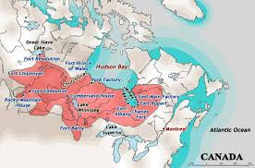

New Charters for
New Monopolies?
Old corporations had a monopoly on a limited (but fairly vast) territory. New corporations have a monopoly on a limited (but increasingly large) field of knowledge.
In the case of old corporations a charter guaranteed the consistency of corporation’s monopoly power with national interest that was the colonization of new lands.
Should we have a charter that makes the monopoly power of corporations consistent with the aim of advancing the frontiers of knowledge?
Or should we refer to a later stage of the history of the chartered corporation when their monopoly power was limited and state undertook the task of managing the institutional infrastructure of the colonies?

Slide 168

Intellectual Monopoly
Intellectual property is a temporary intellectual monopoly, restricting temporarily the liberty of others to use the good .
This restriction involves always some inefficiency but it may be compensated by the incentives that the acquisition of a monopoly gives to the producers of new knowledge (incentive effect).
However, against this positive incentive effect, one should consider the negative effect that intellectual monopoly has on the intellectual investments of other firms (blocking effect).
Observe that when “intellectual property” is enforced with greater vigor, the incentive effect is immediate whereas the blocking effect comes later.
One can still argue that corporations give a partial solution to the anti-commons problem that would arise if their rights on intellectual property were dispersed among different owners. However, the investment blockage arising from their concentrated monopolistic power may still be sufficient to provoke a stagnation of the global economy.

Slide 169

IPRs as global tariffs
IPRs can be seen as global tariffs.
While a tariff limits the imports of the good in a single country, an IPR involves that the good cannot be produced by other firms and in other countries.
IPRs involve a new type of specialization and international division of labor in which countries may be forced not to specialize in the areas where they do not own IPR.
Countries and firms with substantial packages of IPR do relatively better than those deprived of technology ownership. However, the overall effect is an increasing global famine of innovative investment opportunities.

Slide 170
Global Patents and Investments.

Slide 171

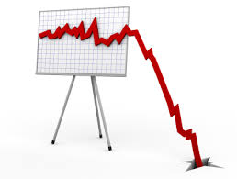
Dynamics of Intellectual
Monopoly Capitalism
The overall restriction of investment opportunities generates a dynamic process shown in the preceding figure.
In the figure of the preceding slide, we can observe a total world increase of investments for about five years after the TRIPs but, after this initial phase, a continuous decline starting in 1999 and culminating with the recent global financial crisis.
The interactions between productive forces and production relations is likely to have produced two different dynamics of Intellectual Monopoly Capitalism, the first characterizing the roaring nineties and the second the much less glamorous first decade of the new millennium. And the 2008 financial crisis was more due to a famine of good investment opportunities than to an excess of savings……

Slide 172

Improving corporate personality
New charters are not likely to be a powerful for the thingness of the corporation and its dependence from financial markets.
A more promising route seems to me to weaken corporate intellectual monopoly and its link with the financialization of the economy. More knowledge in the public space and more knowledge embodied in workers are likely to make corporations more committed to people and less responsive to financial markets.
Weakening intellectual monopoly may improve corporate personality and the esteem for the people committed to them. It may also improve the global economy by opening innovative new investments opportunities and by eliminating some the divides between the few owning technological trajectories and the many who are trapped in vicious circles between the deprivation of intellectual property and of the

Slide 173
7
The evolution of human nature and the principles of economic organization

